Slide 1
Global Interconnectivity Report
Patrick Christian
GPF Denver
April, 2025

Slide 2
What we’ll cover
Global network trends
How fast is int’l IP bandwidth growing globally? Where are sub cables landing?
Where are content DCs being built? How fast are global prices falling
Regional network trends
Inter-regional int’l capacity growth
Capacity and pricing changes
Intra-regional trends
Interconnection hub trends
New Metro Connectivity tool
Data center and IXP Trends

Slide 3
Global Network Trends

Slide 4
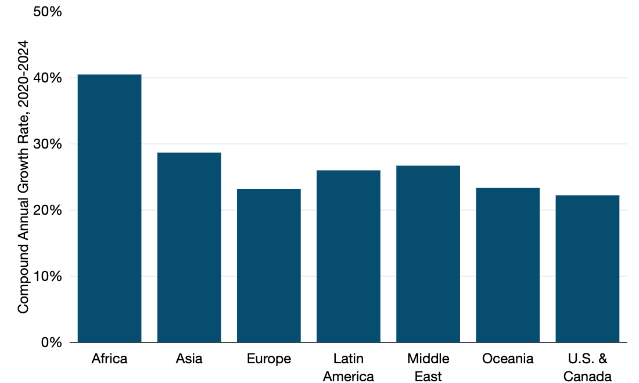
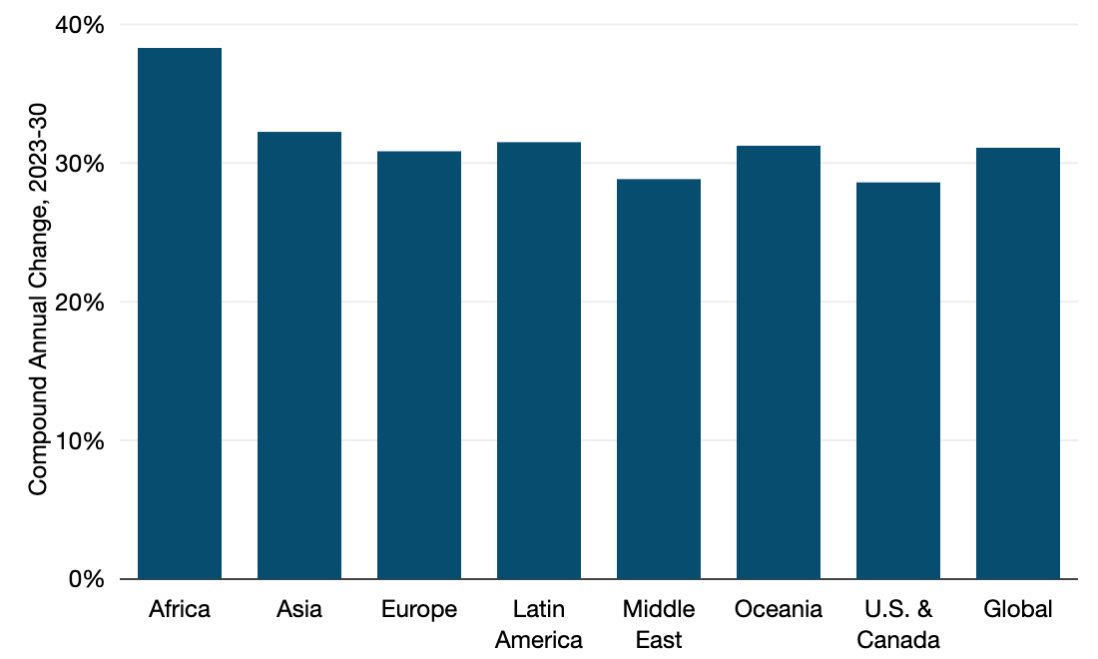
Int’l used bandwidth growth by region
Past
Forecasted
Global 31%
Source: TeleGeography, Transport Networks

Slide 5
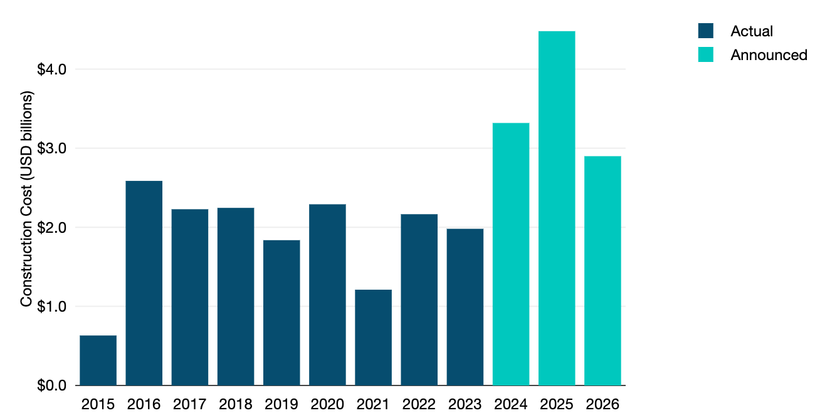
Submarine cable investment
Source: TeleGeography, Transport Networks

Slide 6
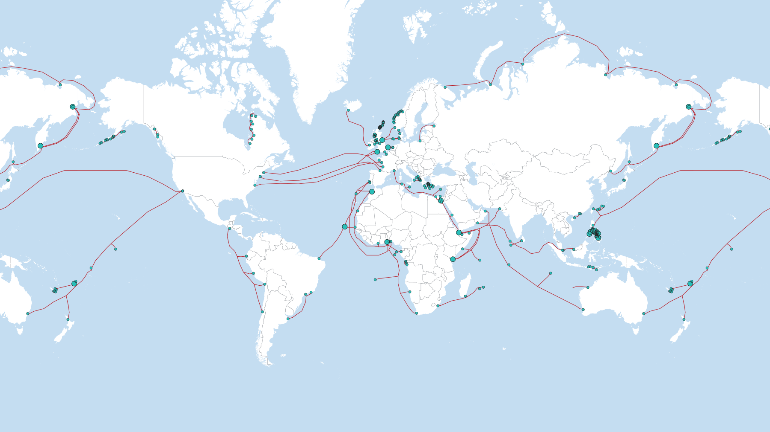
Recently activated cable systems (2021-2023)
Source: TeleGeography, Transport Networks
www.telegeography.com

Slide 7
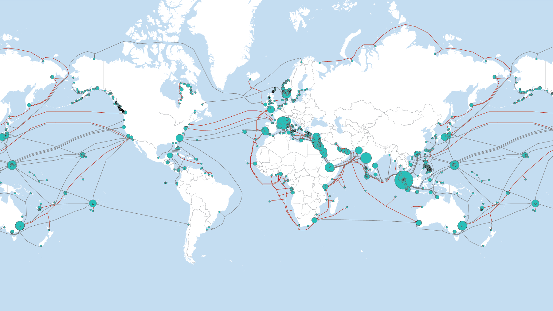
Planned + recent cable systems
Source: TeleGeography, Transport Networks
www.telegeography.com

Slide 8
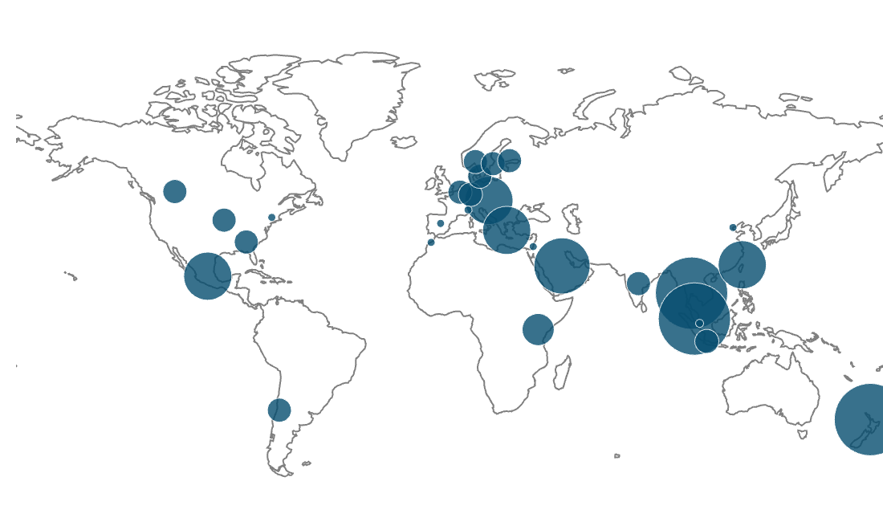
Planned cloud data centers
Source: TeleGeography, Cloud and WAN
www.telegeography.com

Slide 9
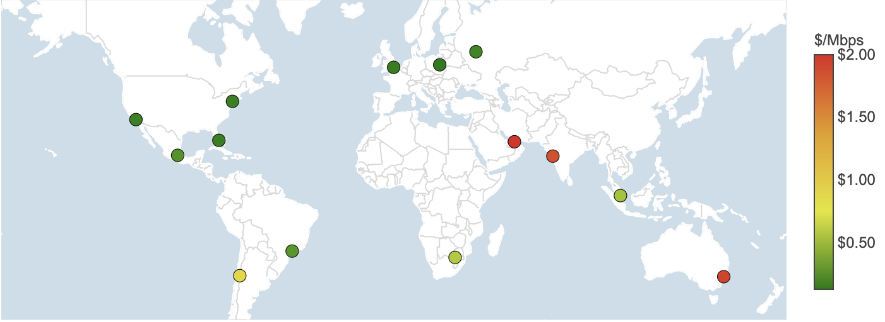
IP Transit Prices in Major Global Cities
Weighted Median 100 GigE IPT
Source: TeleGeography, IP Networks

Slide 10
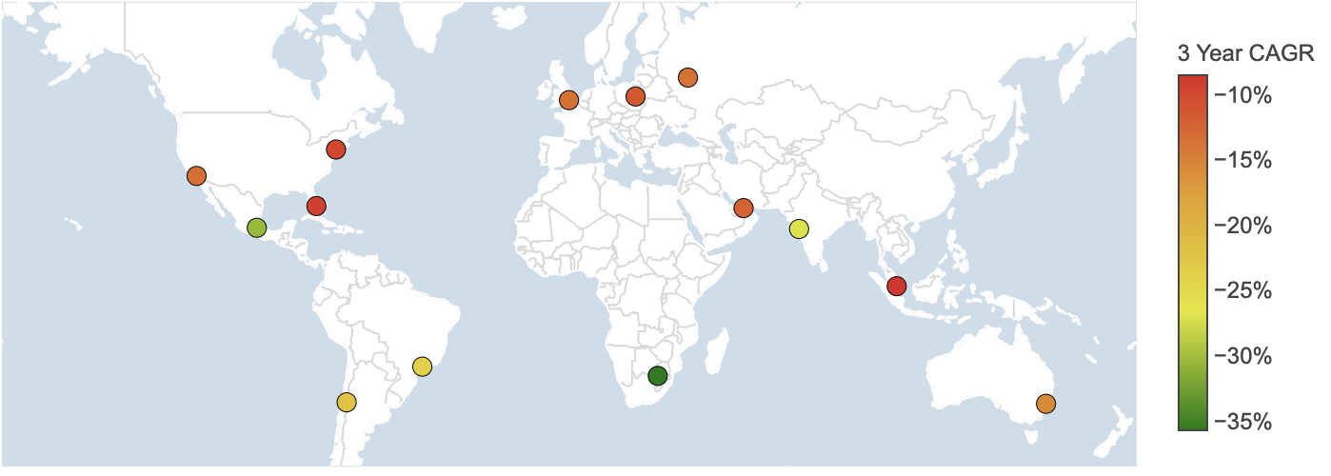
IP Transit Prices in Major Global Cities
Three Year CAGR Decline in Major Global Cities
Source: TeleGeography, IP Networks

Slide 11
Inter-Regional Trends

Slide 12
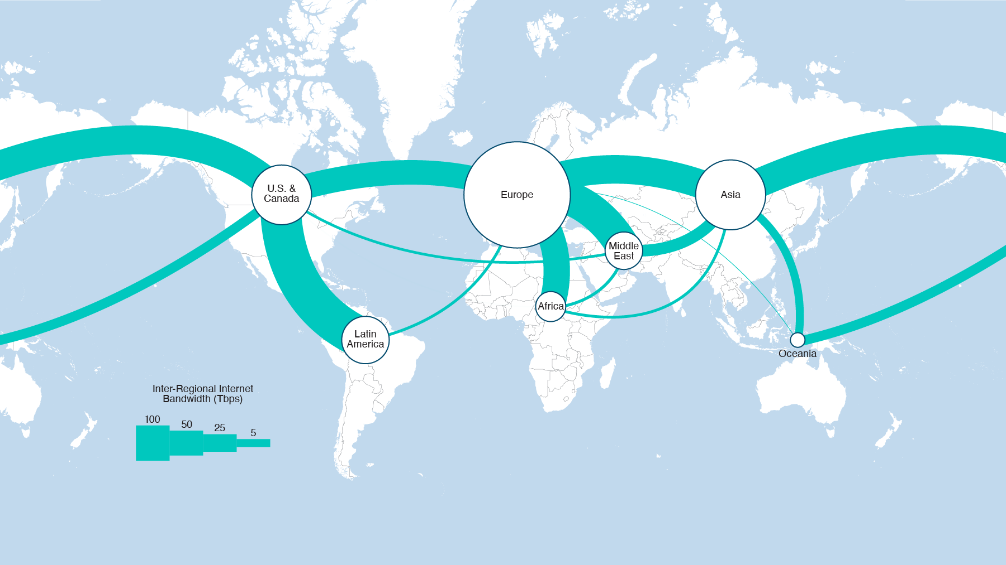
Global interregional routes, 2024
Source: TeleGeography, IP Networks
www.telegeography.com

Slide 13
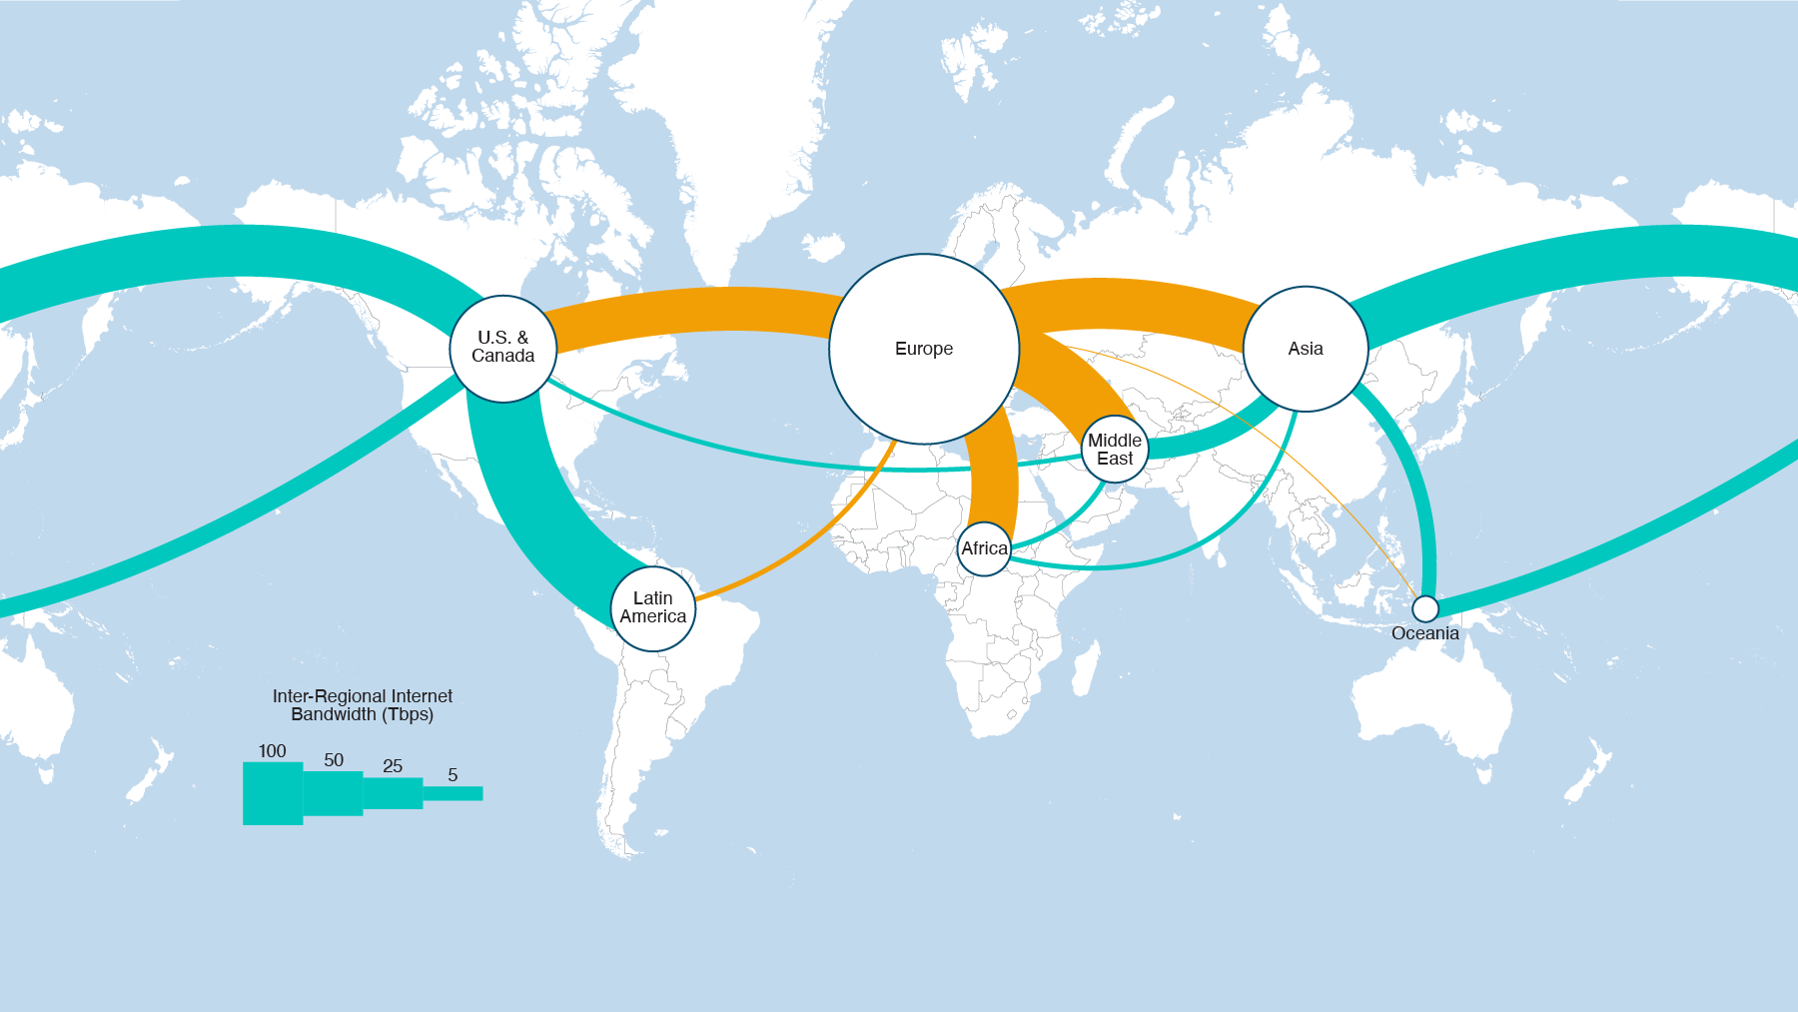
Global interregional routes, 2024
Source: TeleGeography, IP Networks
www.telegeography.com

Slide 14
2021-Present
www.telegeography.com

Slide 15
2021-2027
www.telegeography.com

Slide 16
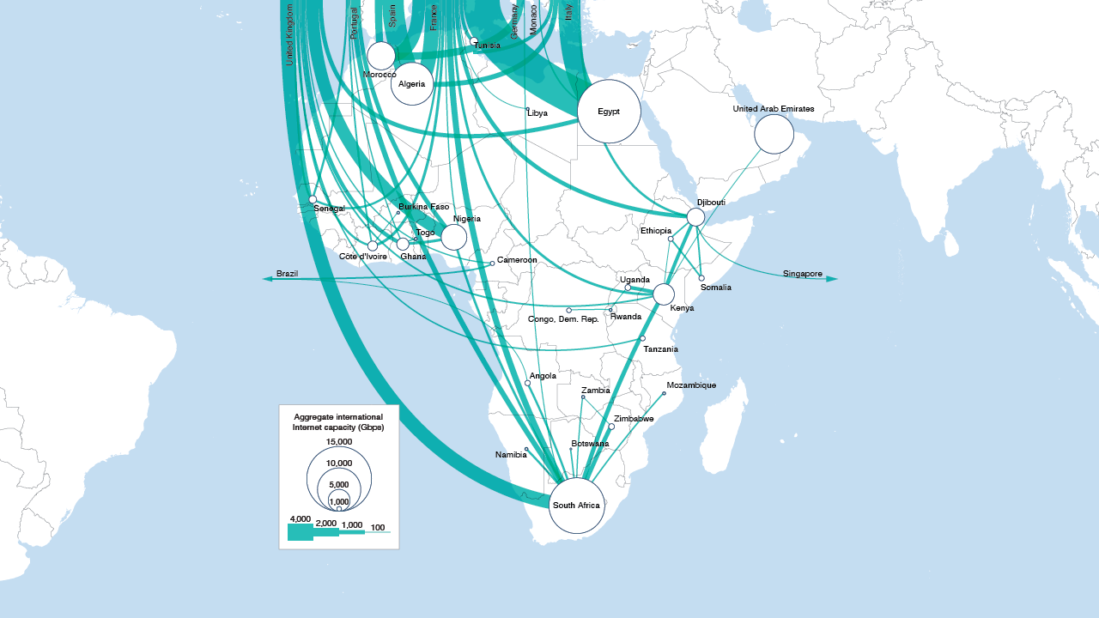
Connecting to Europe
Major International Internet Routes in Africa, 2024
Source: TeleGeography, IP Networks
www.telegeography.com

Slide 17
Connecting to Europe
Major International Internet Routes in Middle East Area, 2024
www.telegeography.com

Slide 18
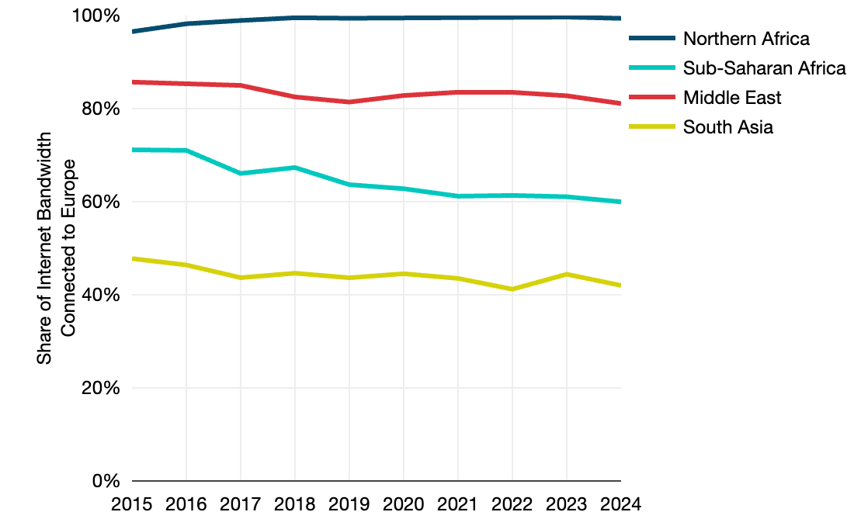
Europe as a hub
Top 3: North Africa, Middle East then Sub-Saharan Africa
Total Africa-Europe connectivity has hovered around 80% for the past 5 years
North Africa’s international connectivity is almost 100% to Europe
While Sub-Saharan Africa’s share of connectivity to Europe has dropped to 60%
Source: TeleGeography, IP Networks

Slide 19
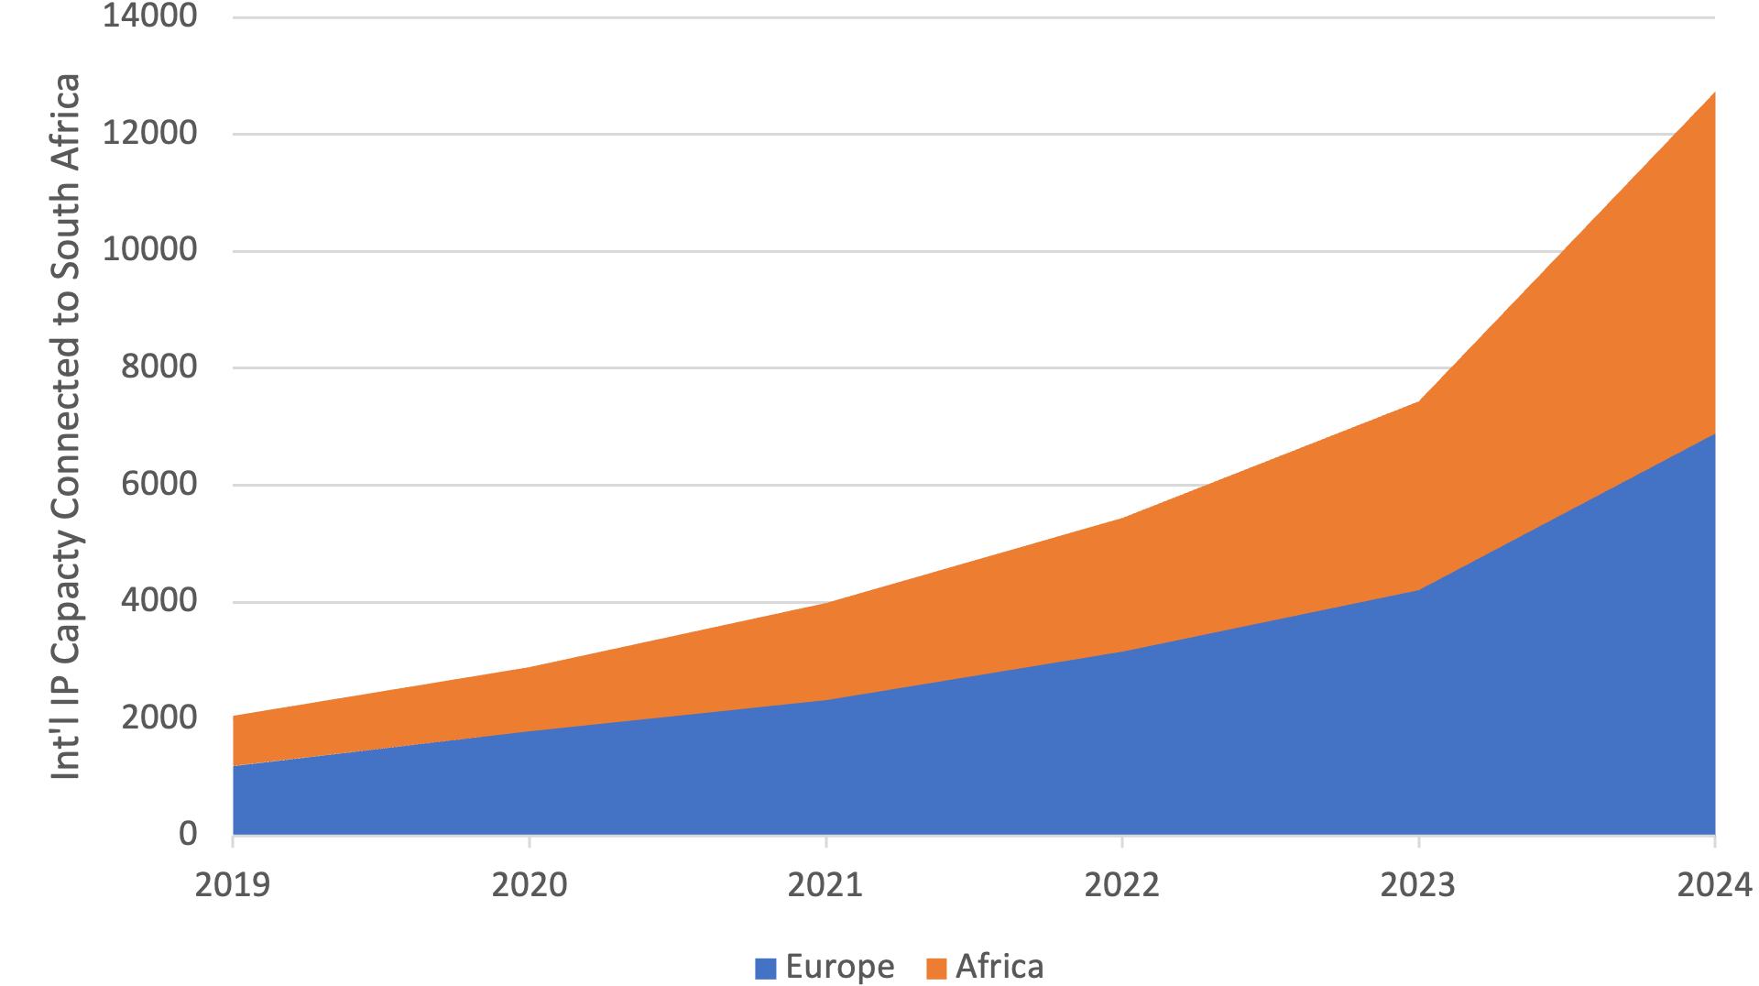
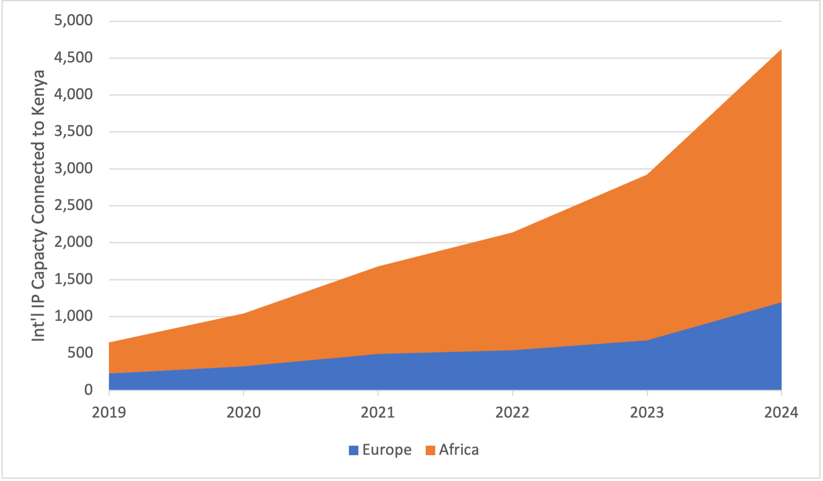
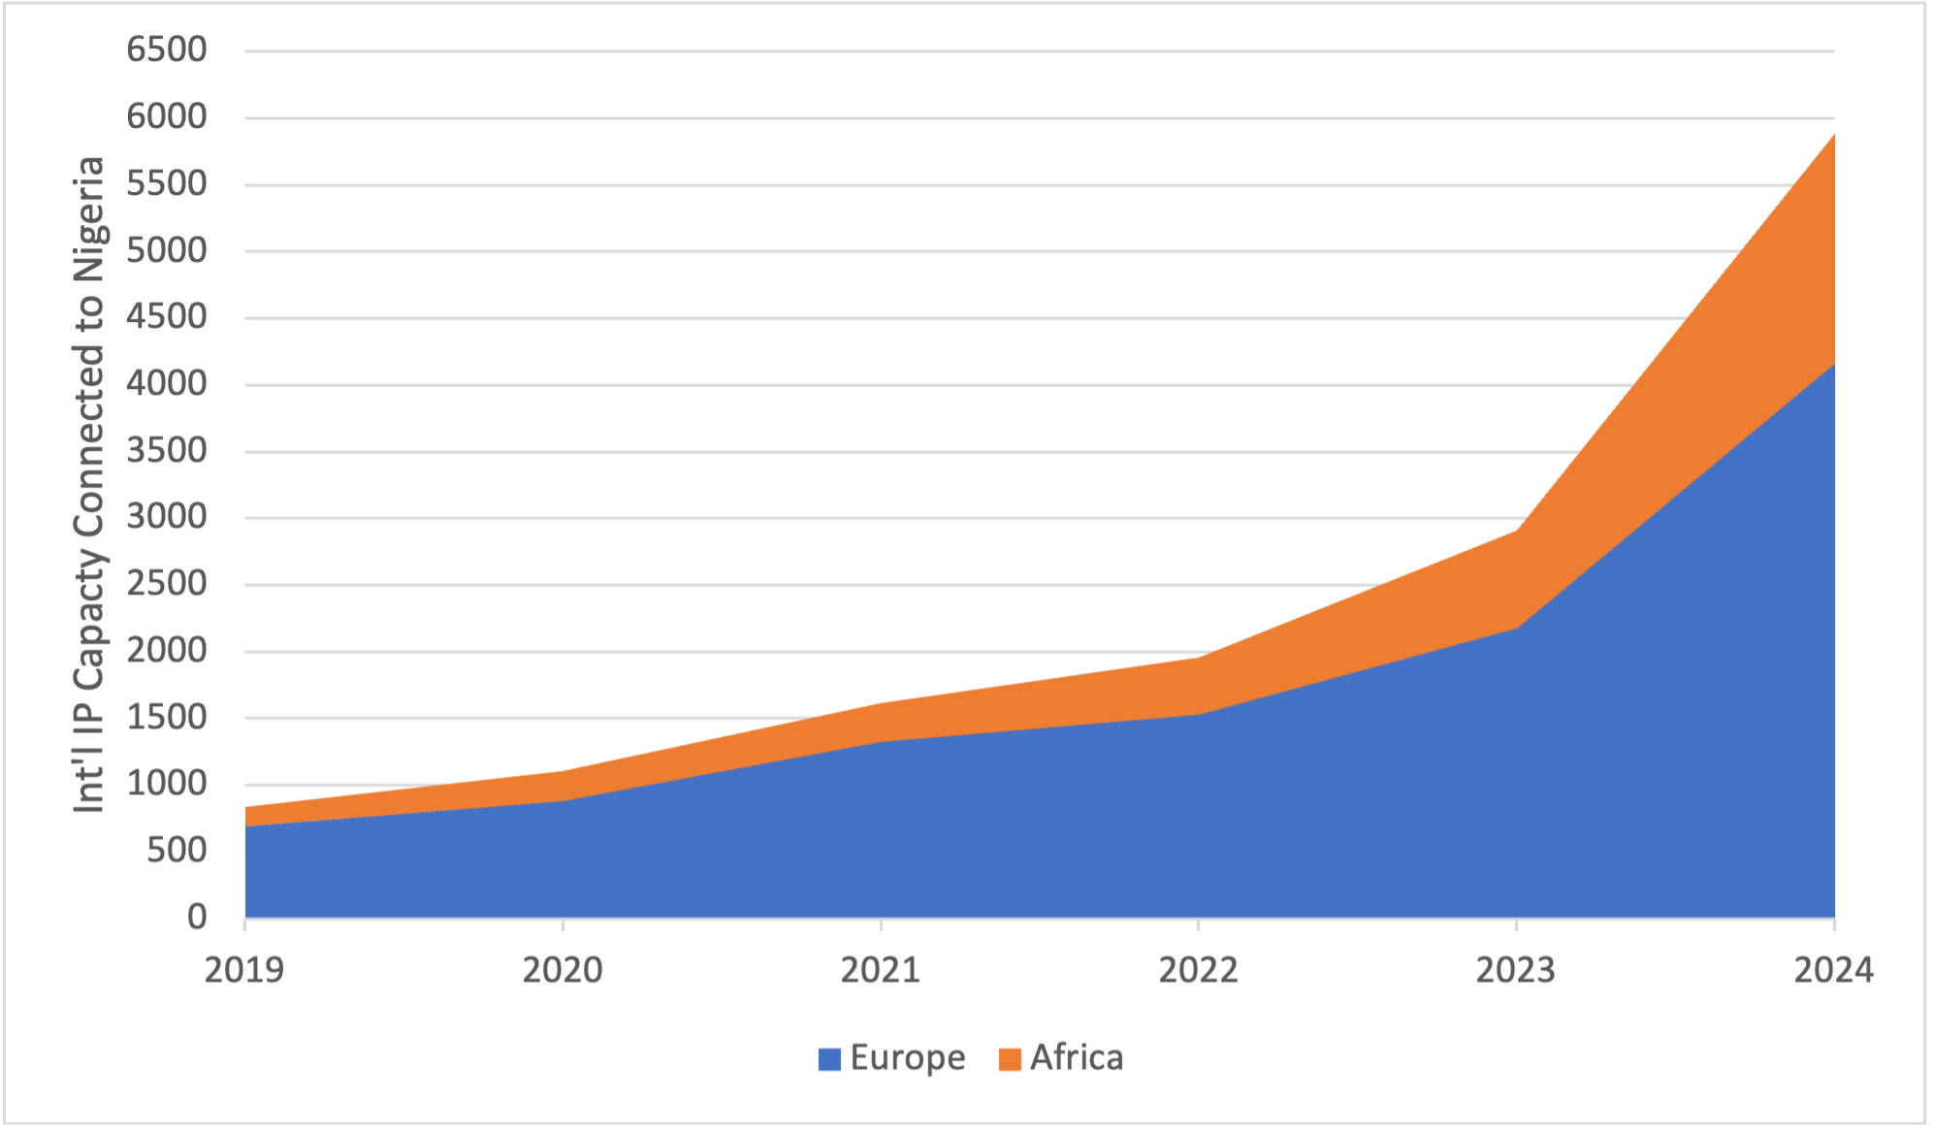
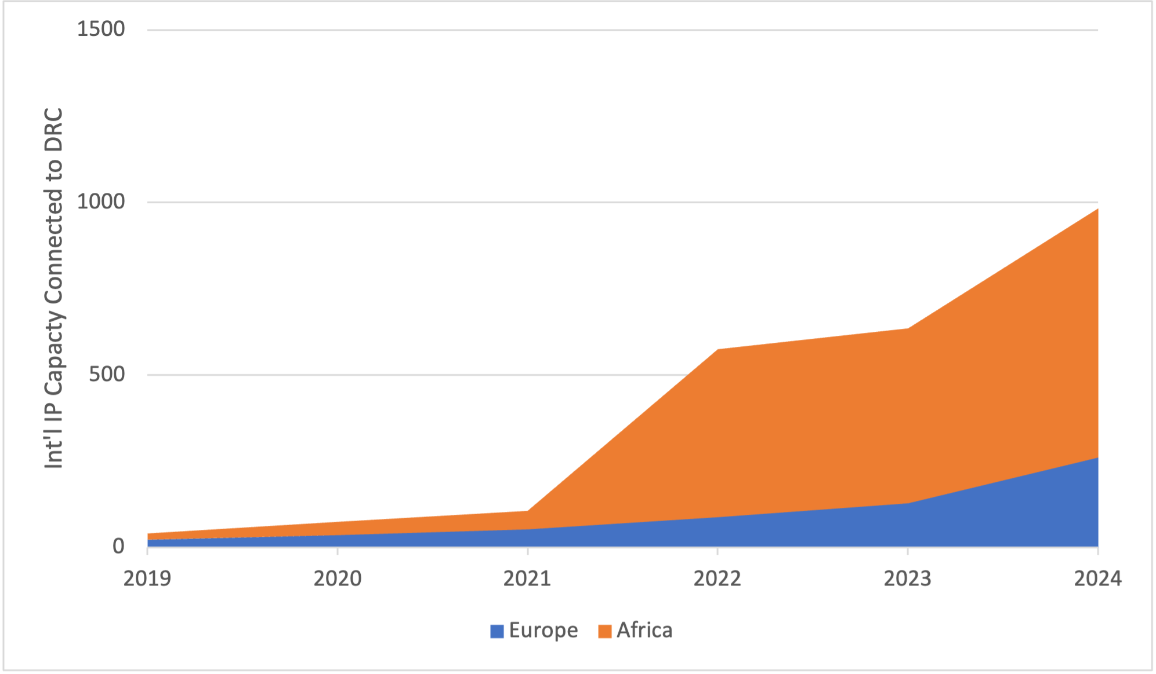
Int’l IP capacity connected to ZA, Kenya, Nigeria & DRC
South Africa
Kenya
Nigeria
DRC
Source: TeleGeography, IP Networks

Slide 20
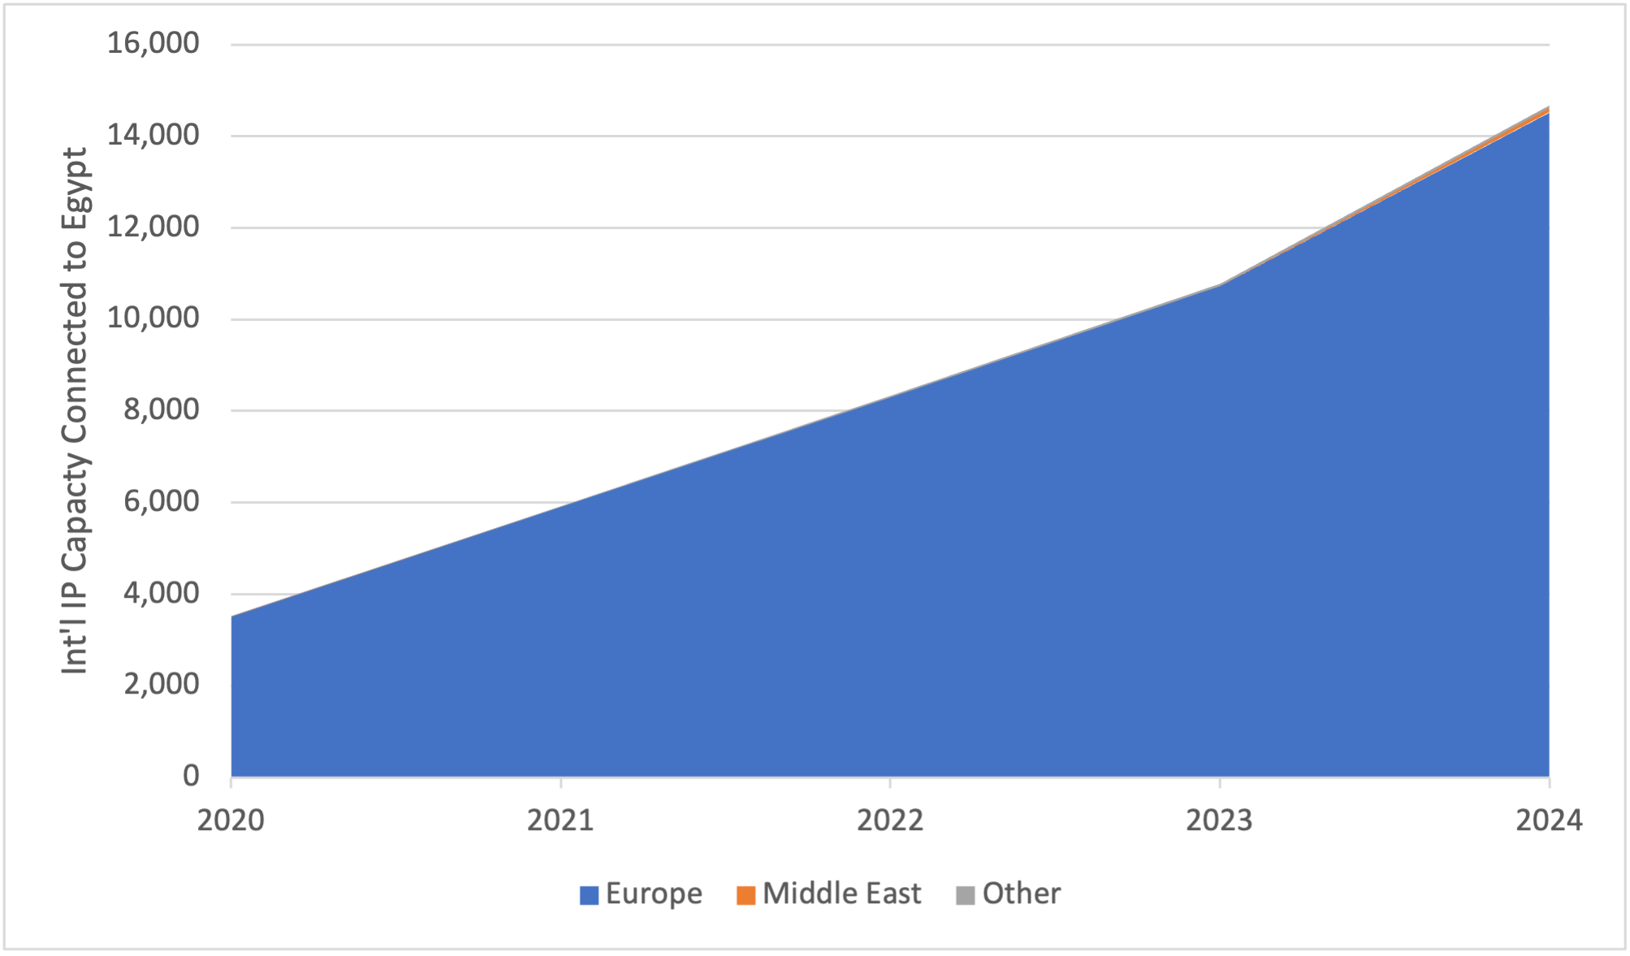
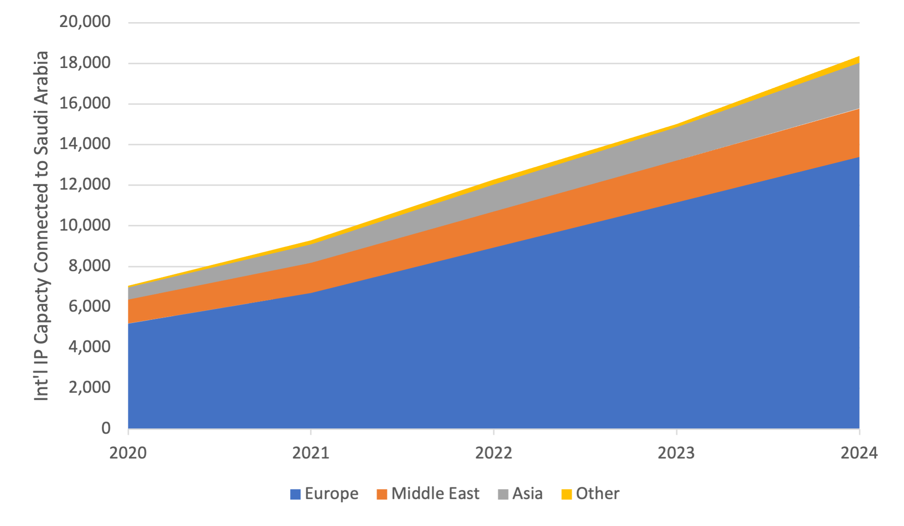
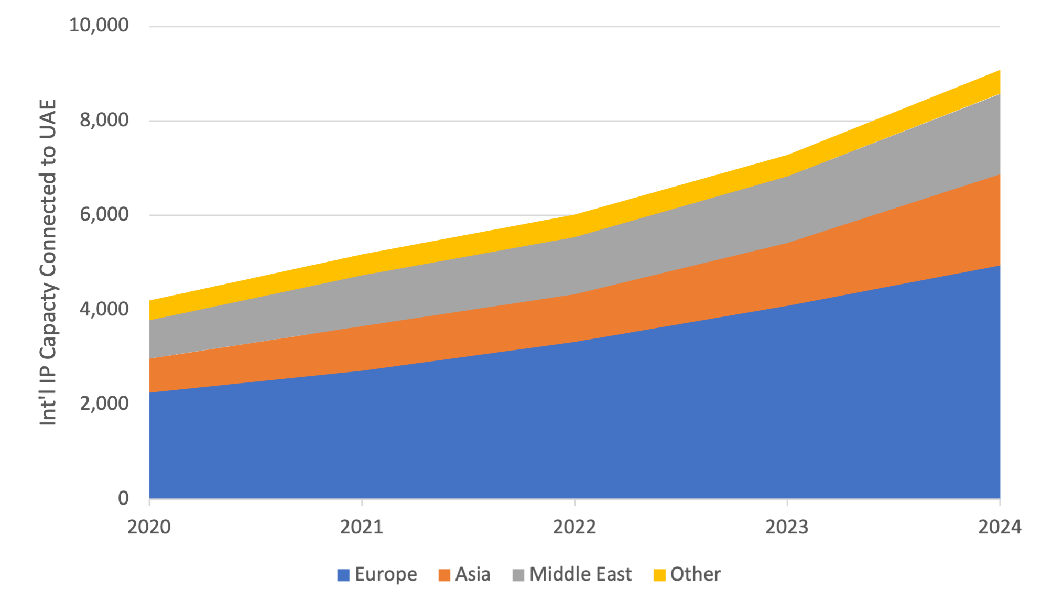
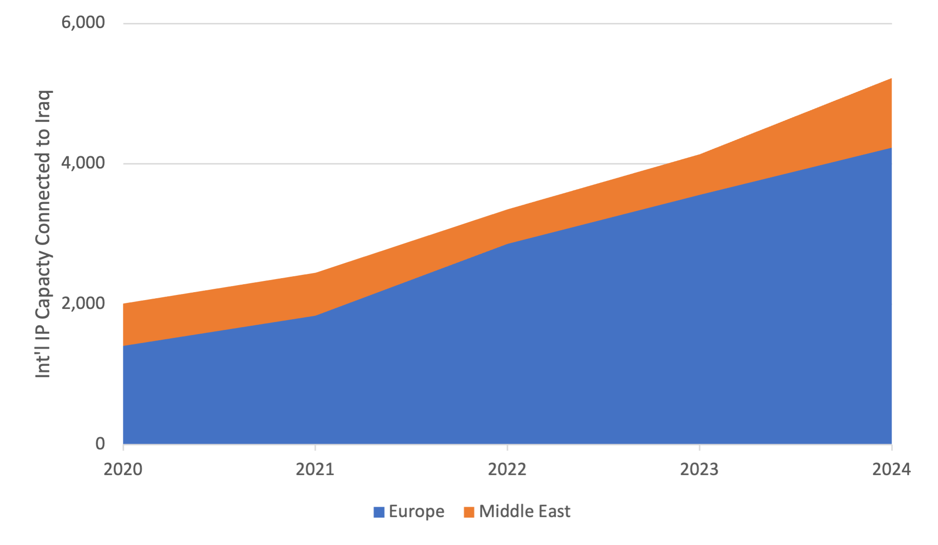
Int’l IP capacity connected to Egypt, KSA, UAE & Iraq
Egypt
KSA
UAE
Iraq
Source: TeleGeography, IP Networks

Slide 21
Intra-Regional Trends

Slide 22
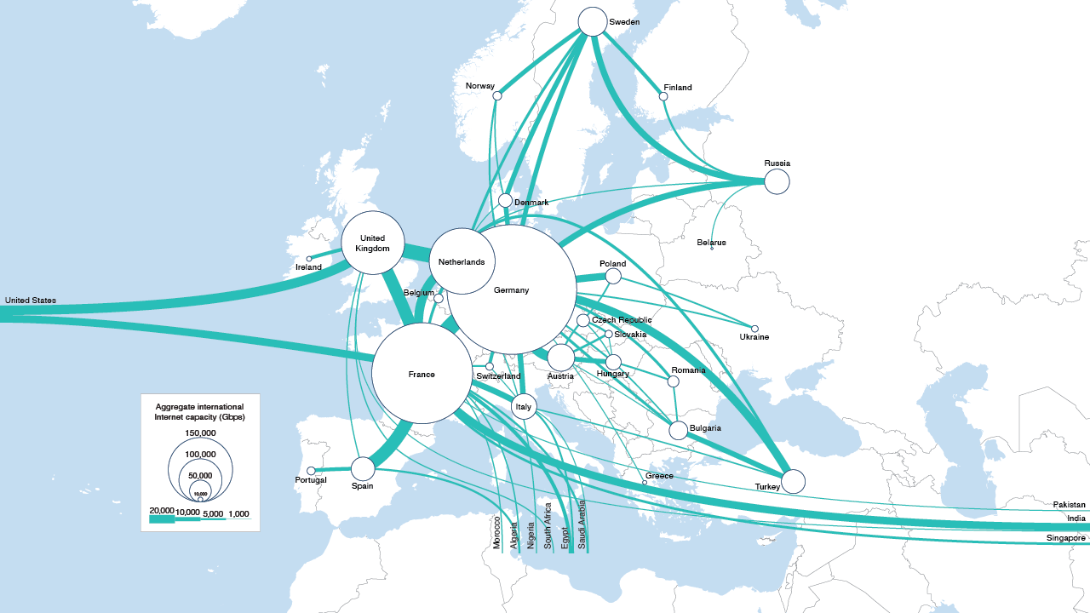
Europe’s top int’l routes
Major European International IP Connectivity, 2024
Source: TeleGeography, IP Networks
www.telegeography.com
www.telegeography.com

Slide 23
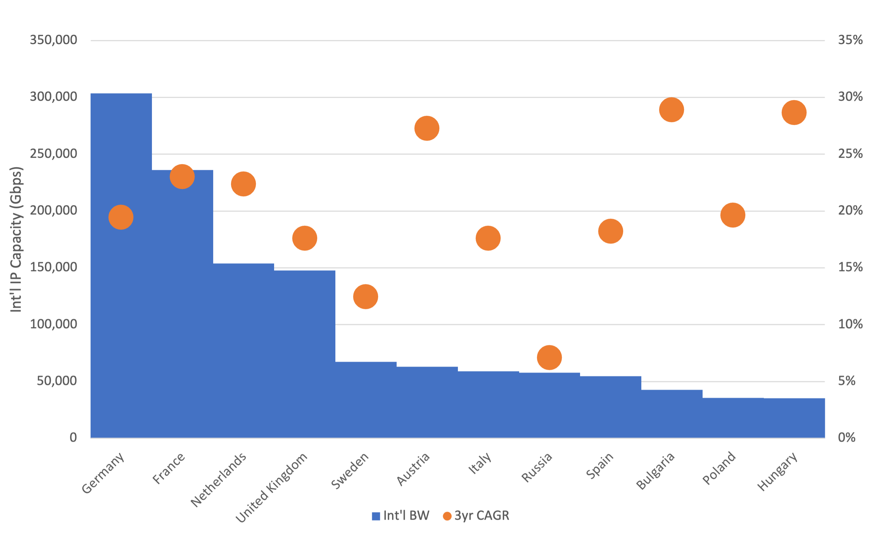
Top countries int’l IP capacity in Europe
Source: TeleGeography, IP Networks
www.telegeography.com

Slide 24
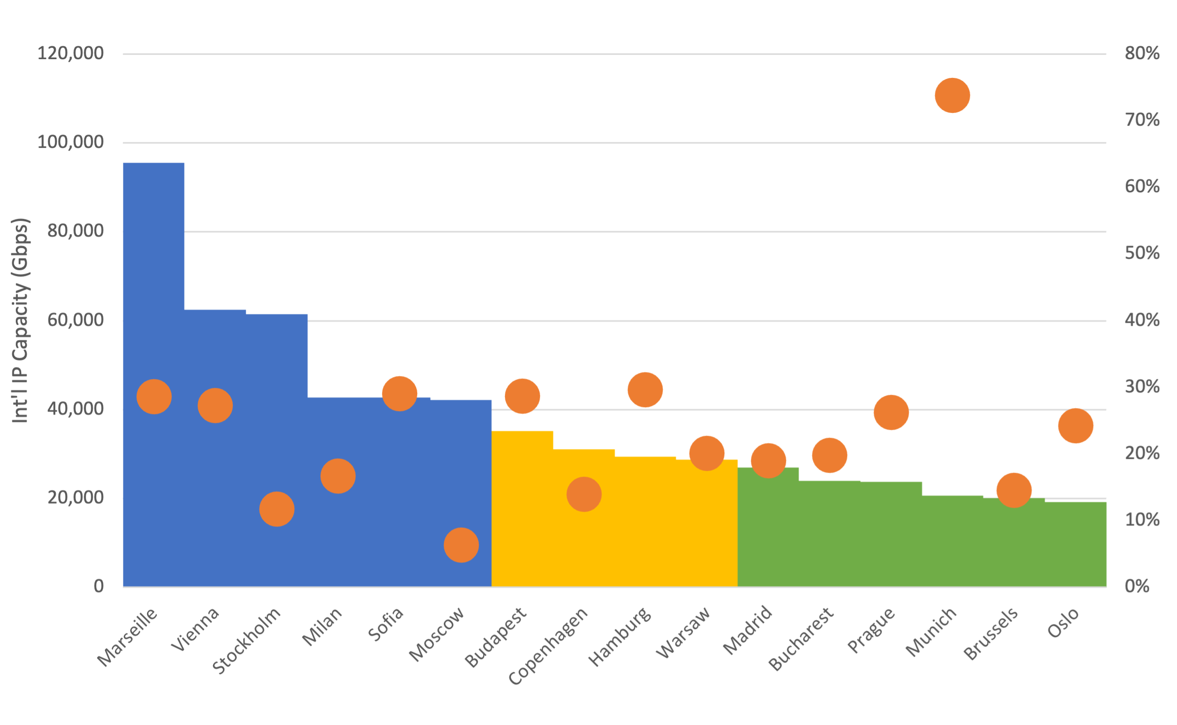
Top metros int’l IP capacity in Europe
Source: TeleGeography, IP Networks
www.telegeography.com

Slide 25
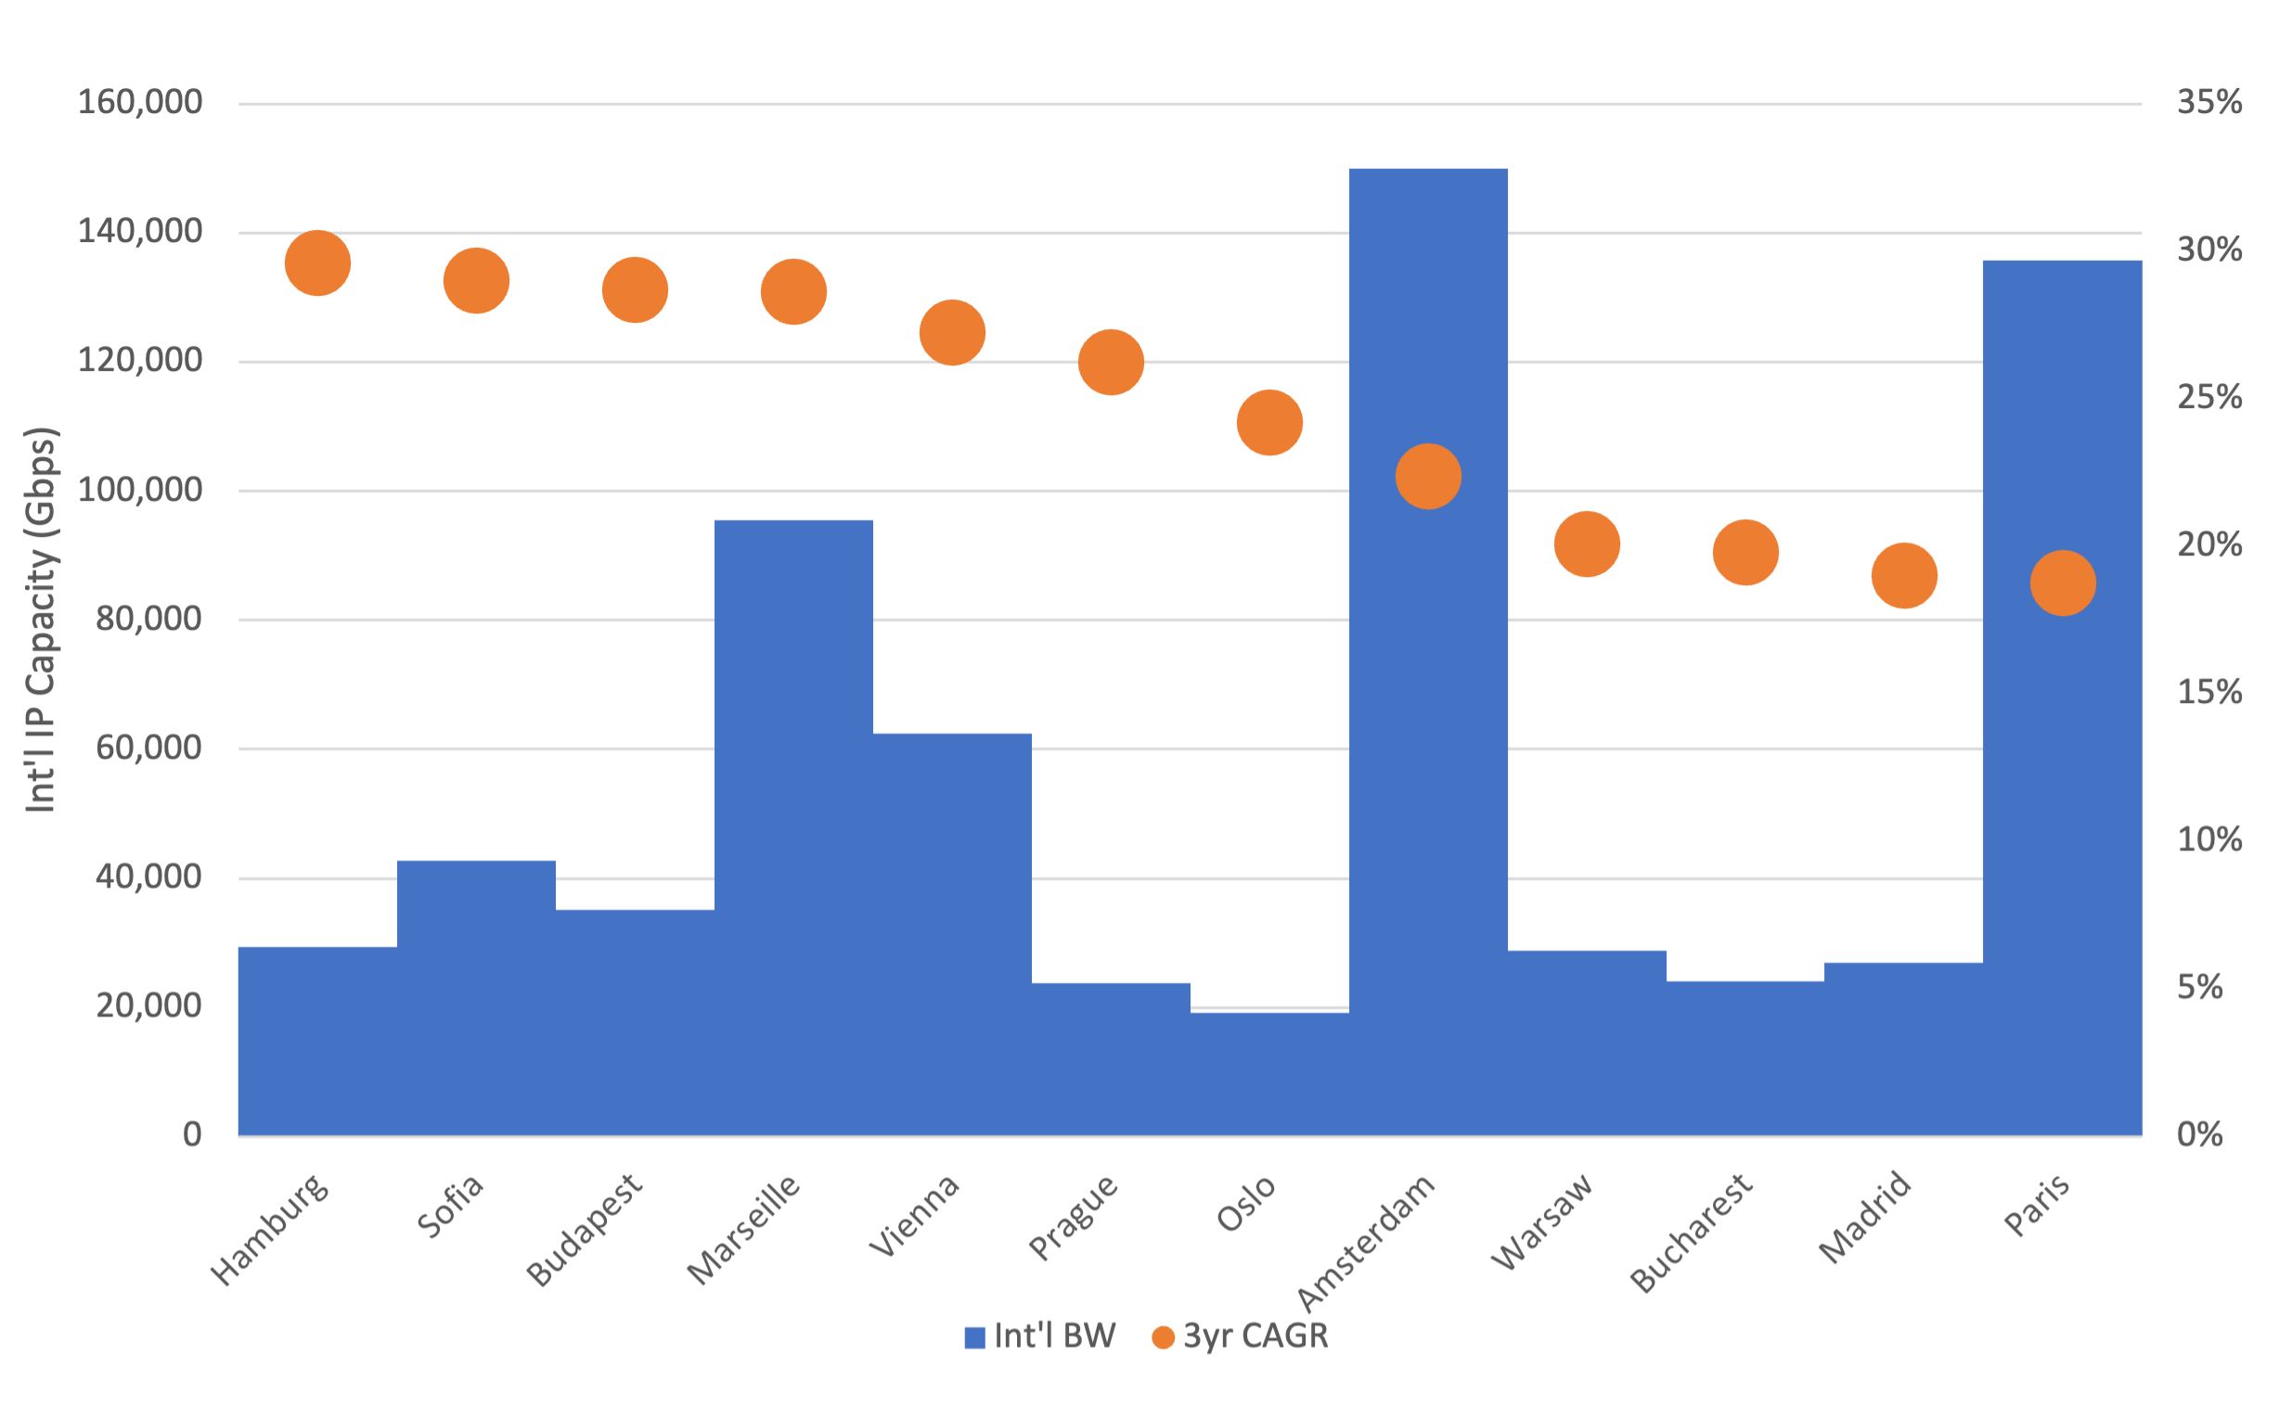
Top metros in Europe by growth
Source: TeleGeography, IP Networks
www.telegeography.com

Slide 26
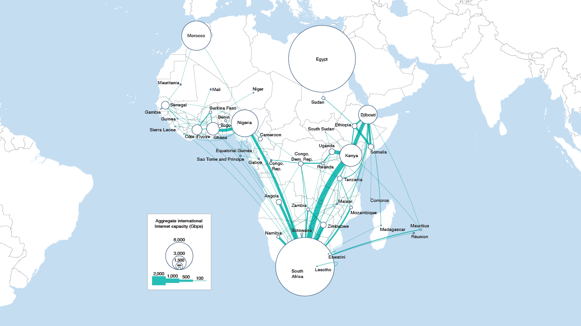
Intra-African routes, 2024
Source: TeleGeography, IP Networks
www.telegeography.com

Slide 27
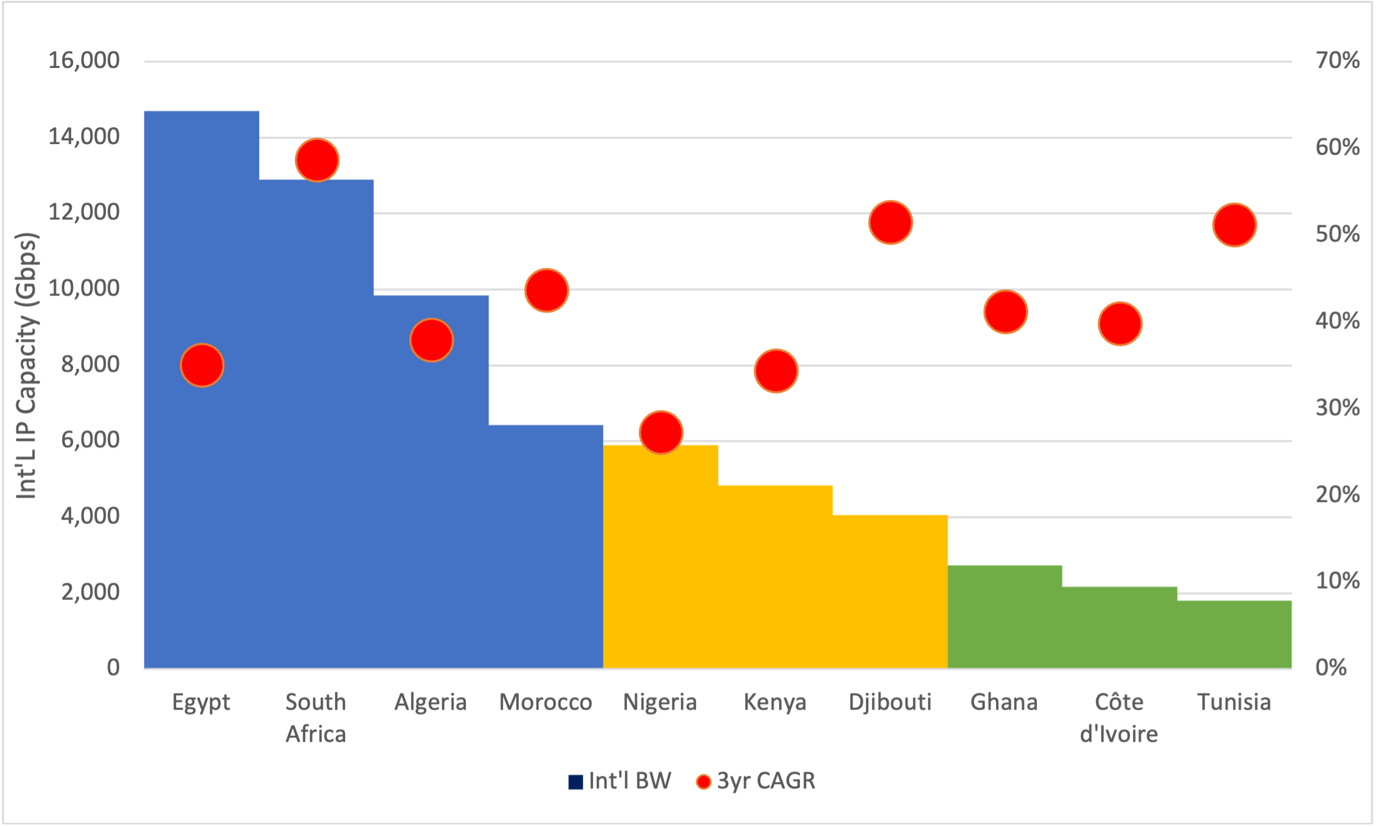
Top 10 countries int’l IP capacity in Africa
Three groups:
North African + ZA – a lot of int’l capacity to Europe
Second group - major hubs connecting Europe and Africa
Third group – growing hubs for sub-Saharan Africa + Tunisia
Source: TeleGeography, IP Networks

Slide 28
Intraregional
www.telegeography.com

Slide 29
Market Connectivity Score

Slide 30
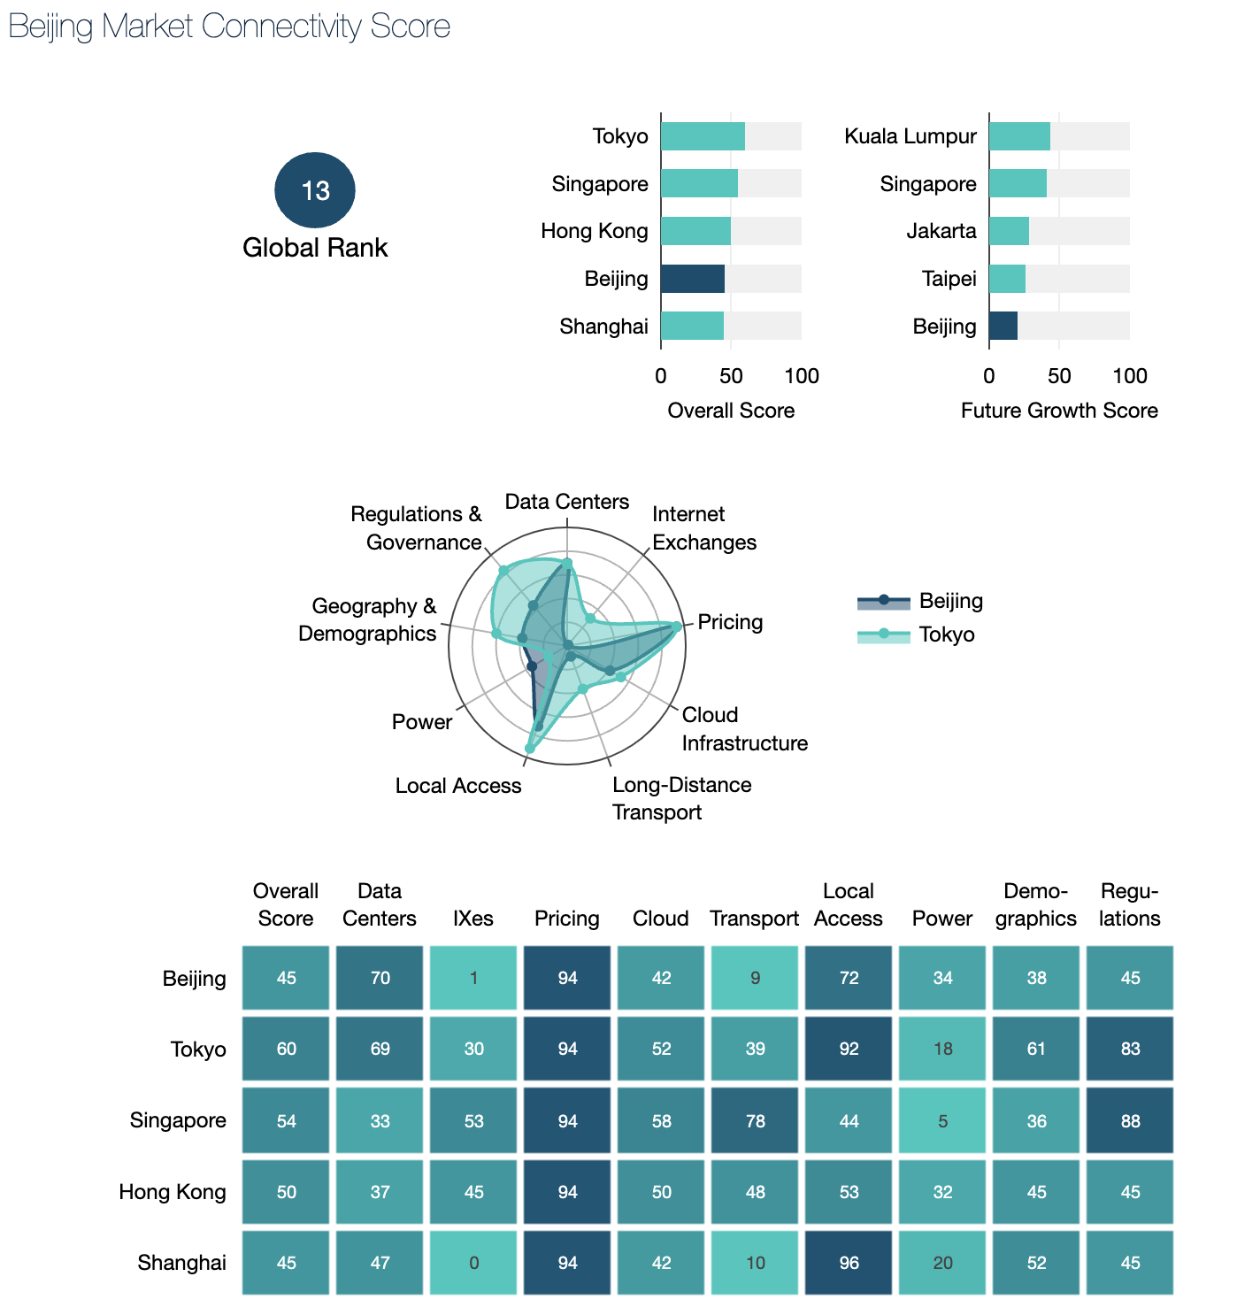
The Market Connectivity Score can help
This tool captures 43 distinct market health metrics to help users diagnose the competitiveness of 3,000 global network and data center markets.
Source: TeleGeography’s Data Center Research Service

Slide 31
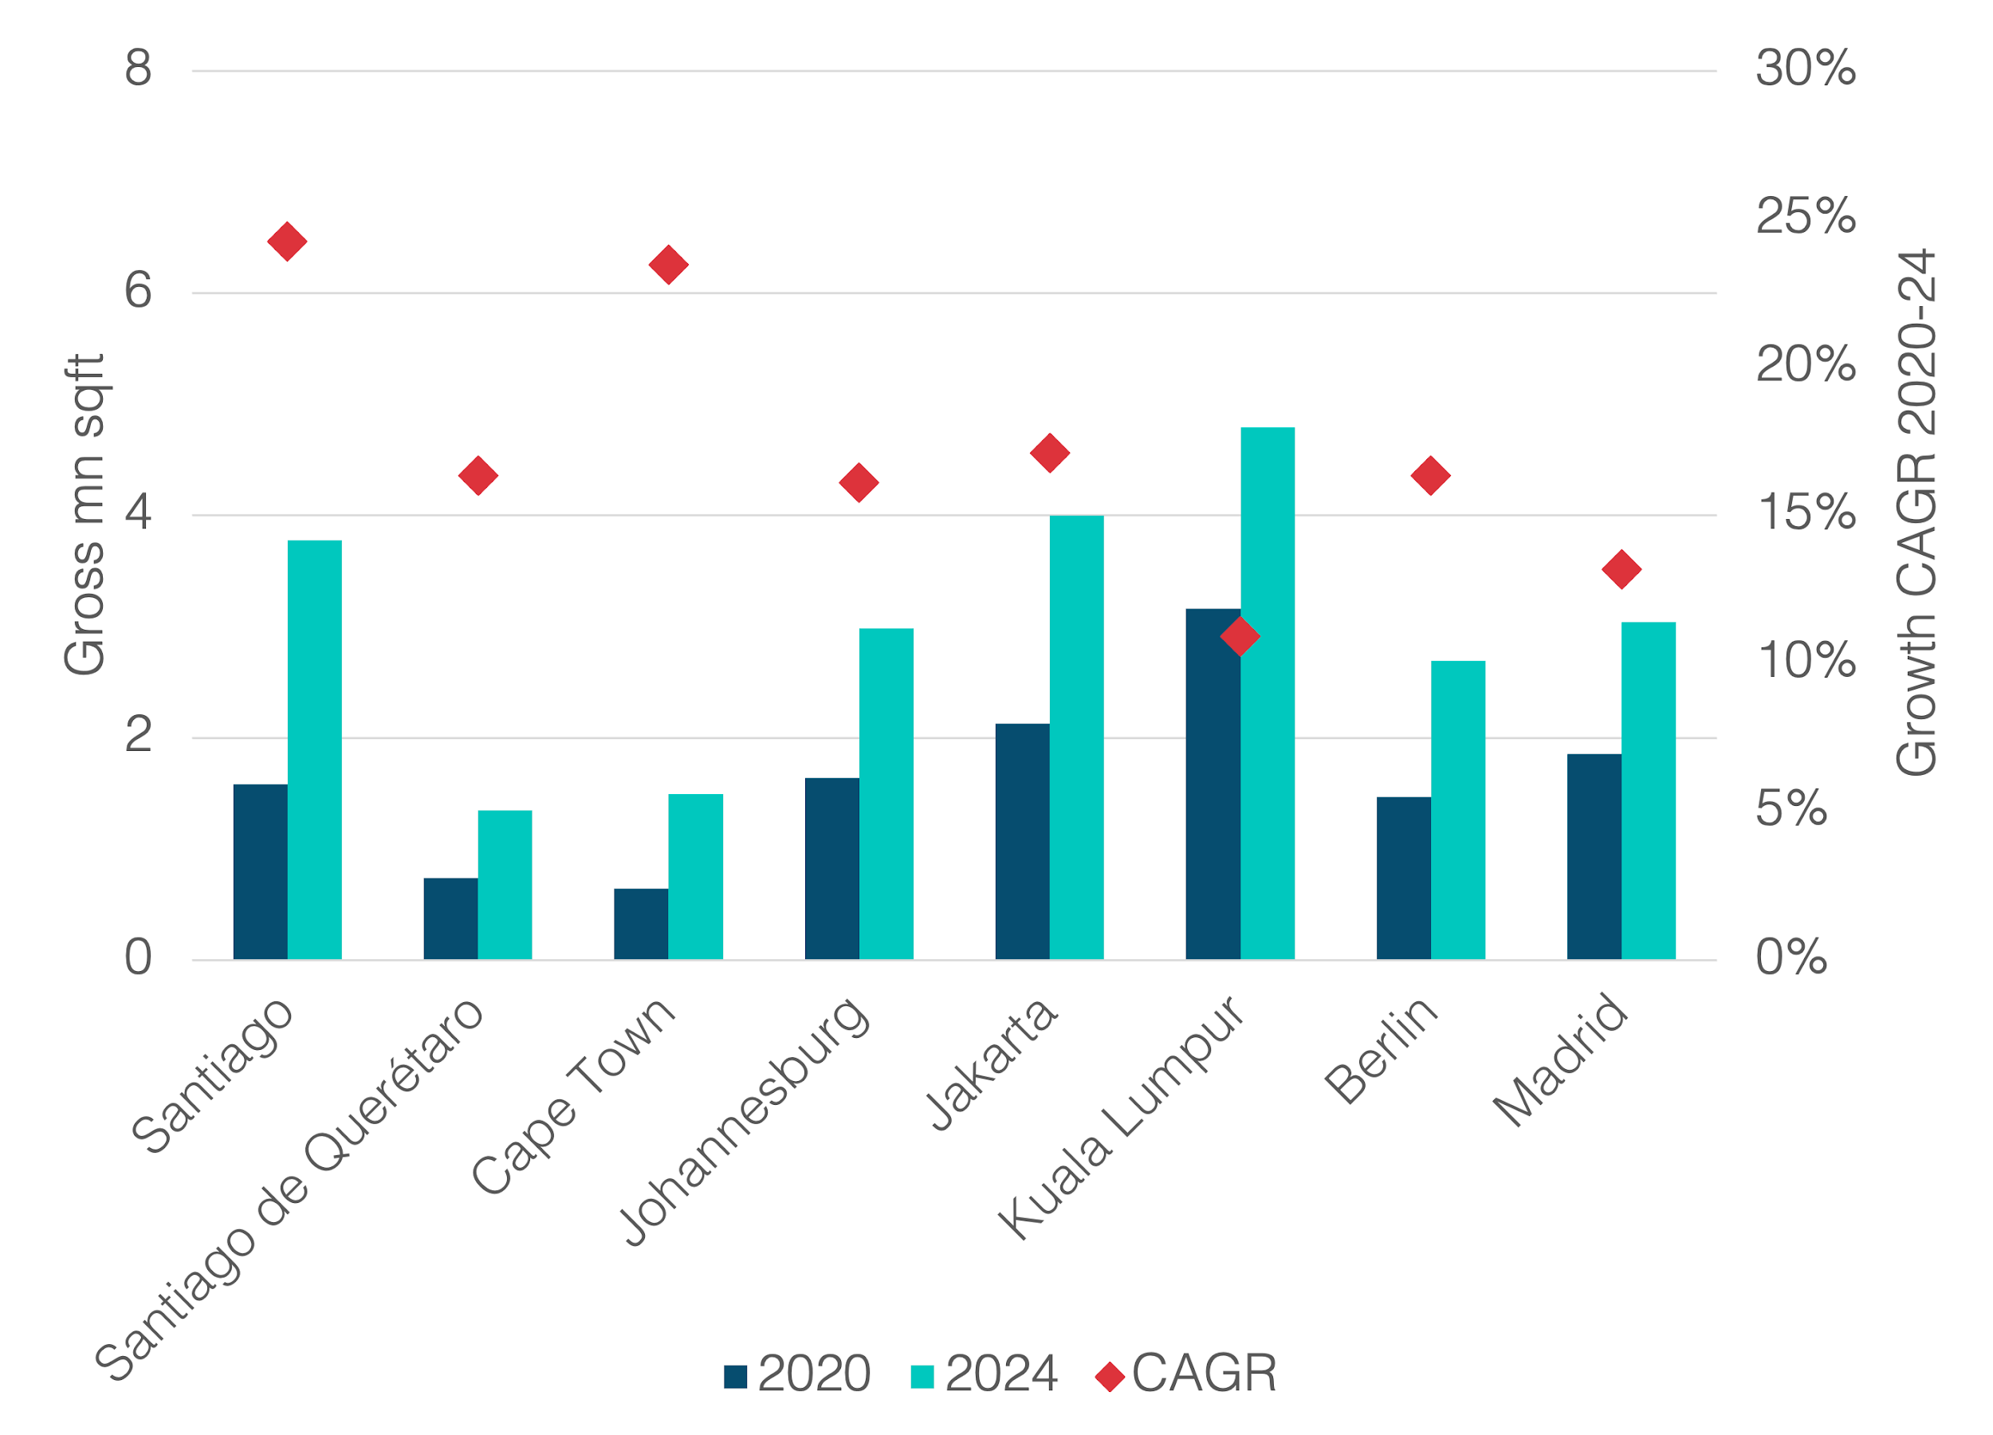
Some markets to compare
Looking at a sampling of fast-growth data center markets
Each has more than 1 million square feet of space in operation and more than 10% CAGR growth
Select High-Growth Data Center Markets, 2020-2024
Source: TeleGeography’s Data Center Research Service

Slide 32
Jakarta and Kuala Lumpur
JK has more than 700 local peers
Comparable rankings and similar strengths and weaknesses
Jakarta has stronger IX market with 7x the local peering membership of KL
KL has advantage of more competitive network pricing
IPT:
JK 2x the weighted median of KL
Source: TeleGeography’s Data Center Research Service

Slide 33
Berlin and Madrid
Madrid has more cloud deployments and a higher share of clean power
But Berlin is a fast-growing data center market with more than 10 sites in the near pipeline
MAD: 12 onramps, 5 regions, 1 planned
MAD: 94% of overall capacity is clean power
Source: TeleGeography’s Data Center Research Service

Slide 34
Santiago de Chile and Santiago de Querétaro
Chile has more clean power planned and higher governance score
Mexico has more competitive network pricing
Source: TeleGeography’s Data Center Research Service

Slide 35
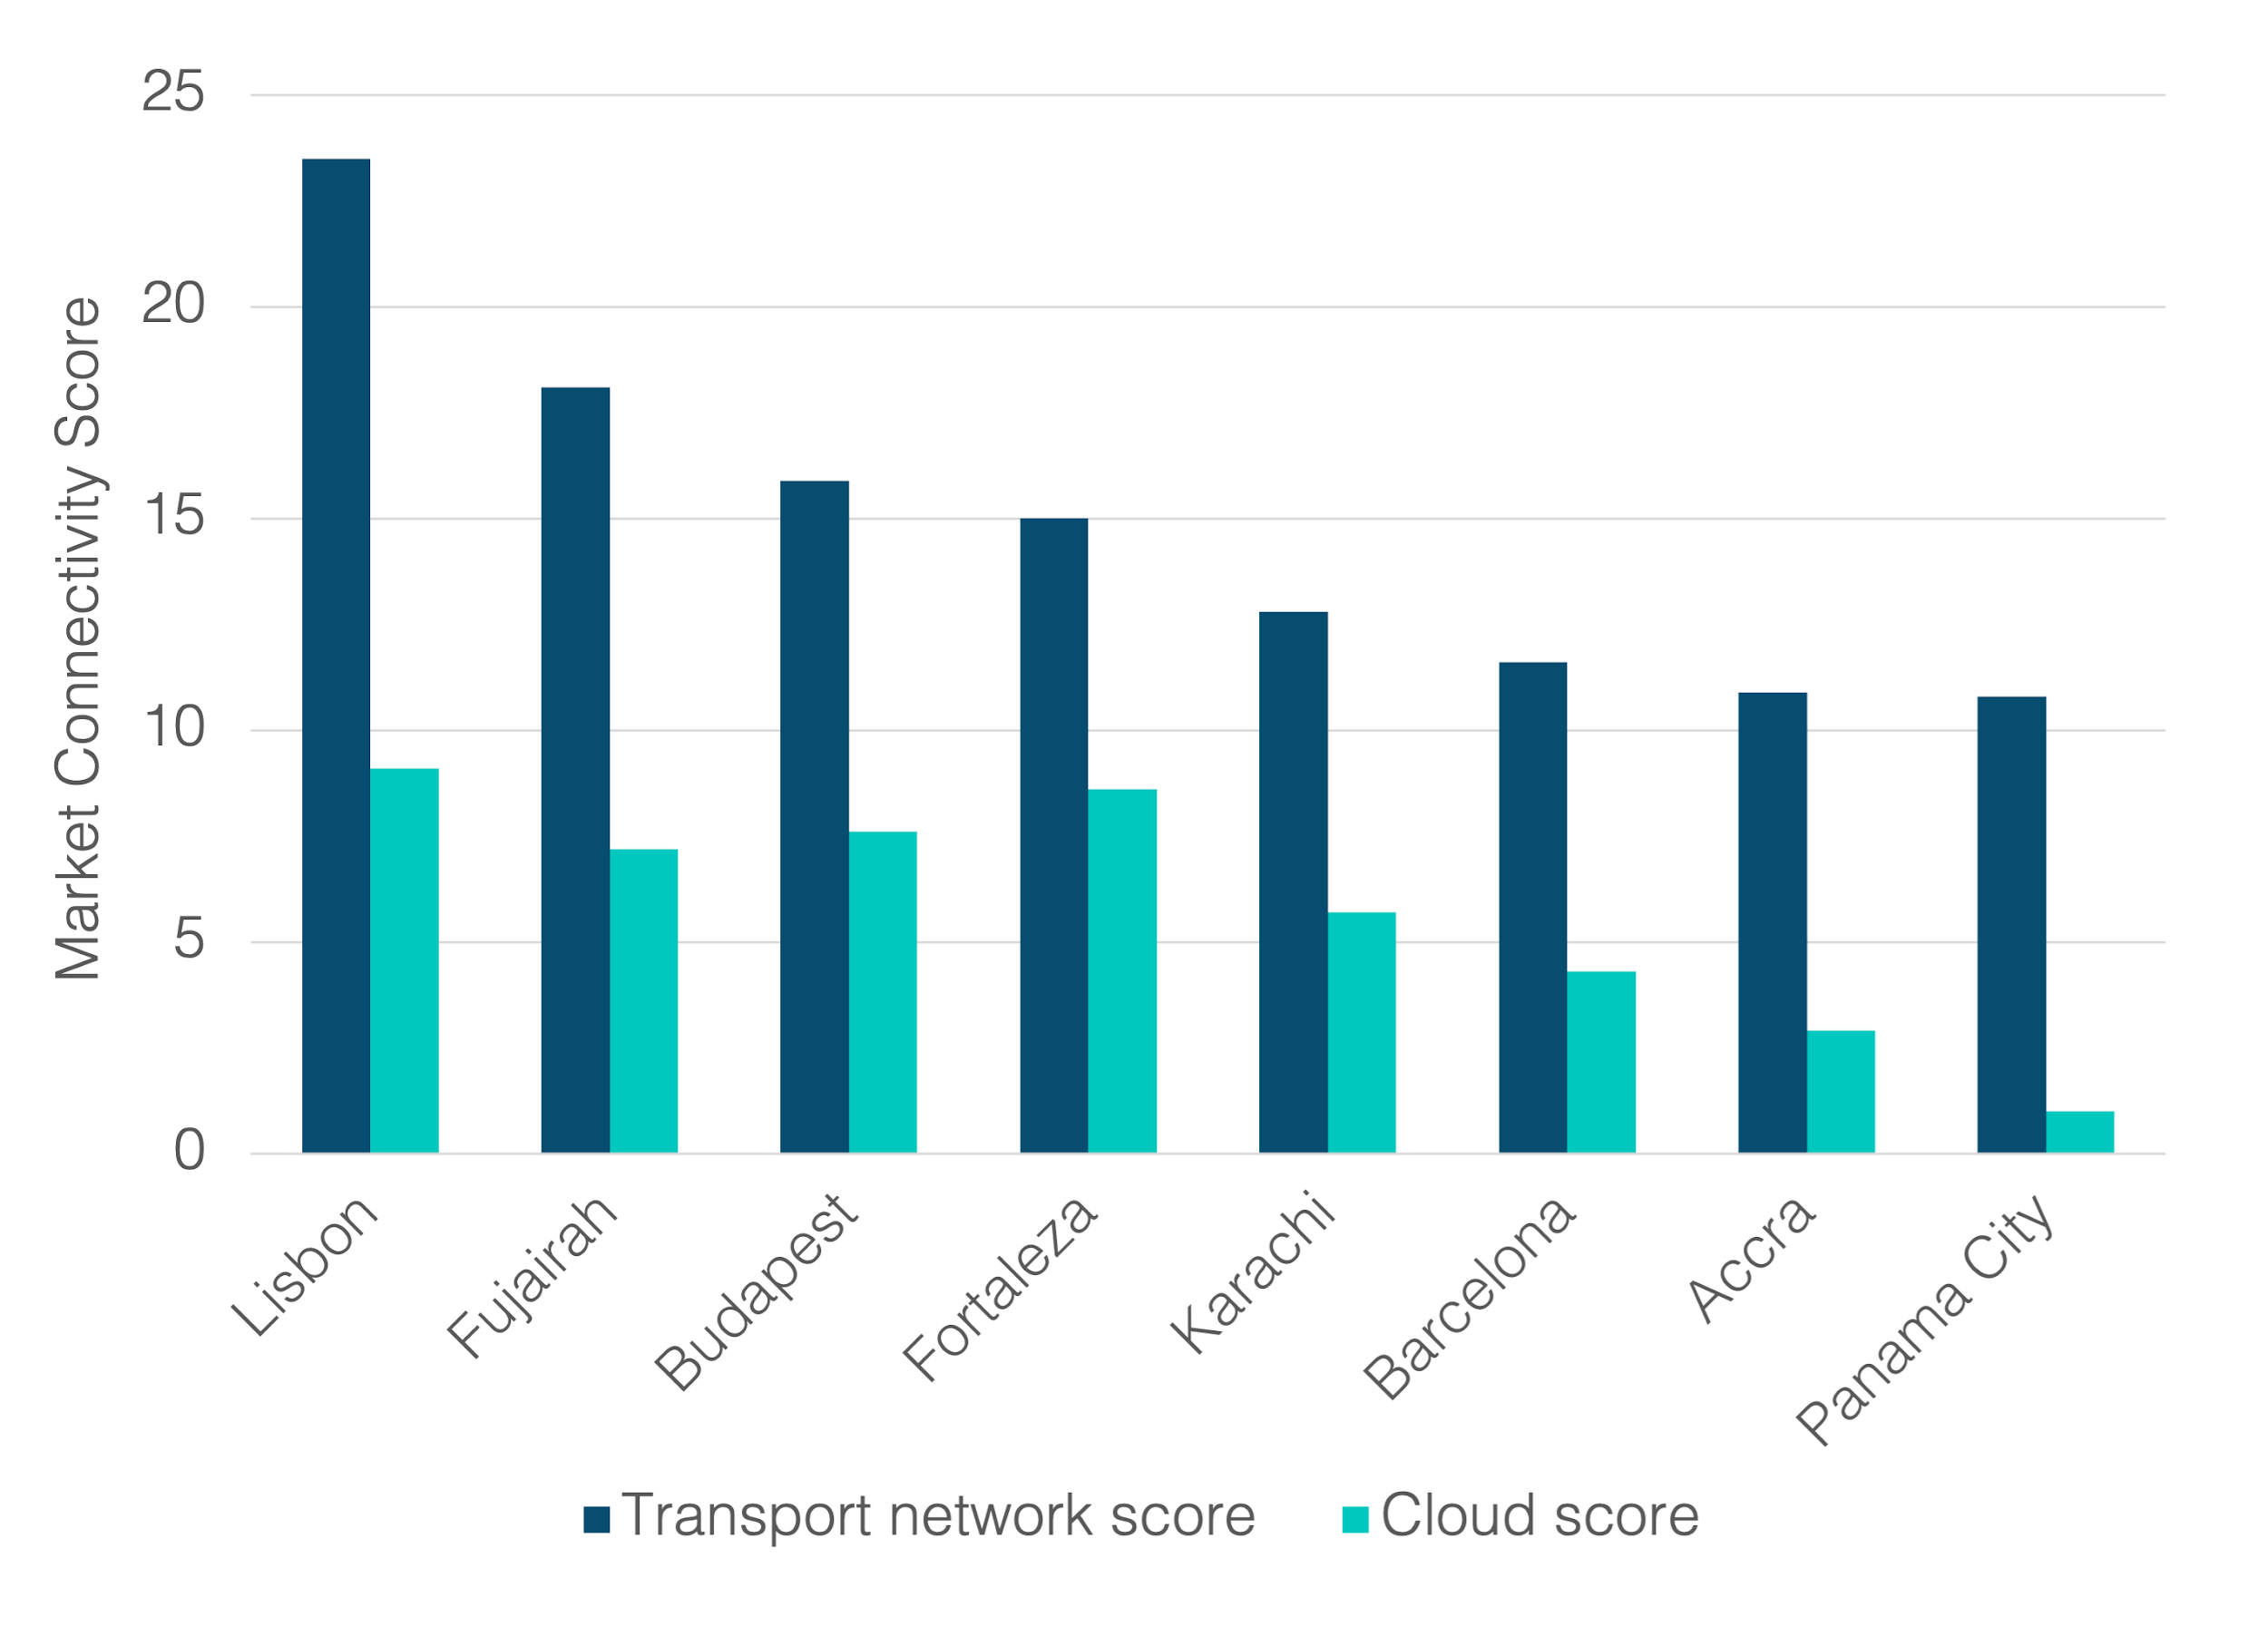
Strong network but lack of cloud…
Lisbon directly connects with more than 40 international cities and has 13 subsea cables…
Budapest has more than 35 Tbps of international internet capacity…
Fortaleza has over 10 Tbps of international internet capacity and 10 subsea cables in service…
But local cloud provisioning in all of these locations is limited to a few onramps at most
Transport and Cloud Market Connectivity Scores, Select Markets
Source: TeleGeography’s Data Center Research Service

Slide 36
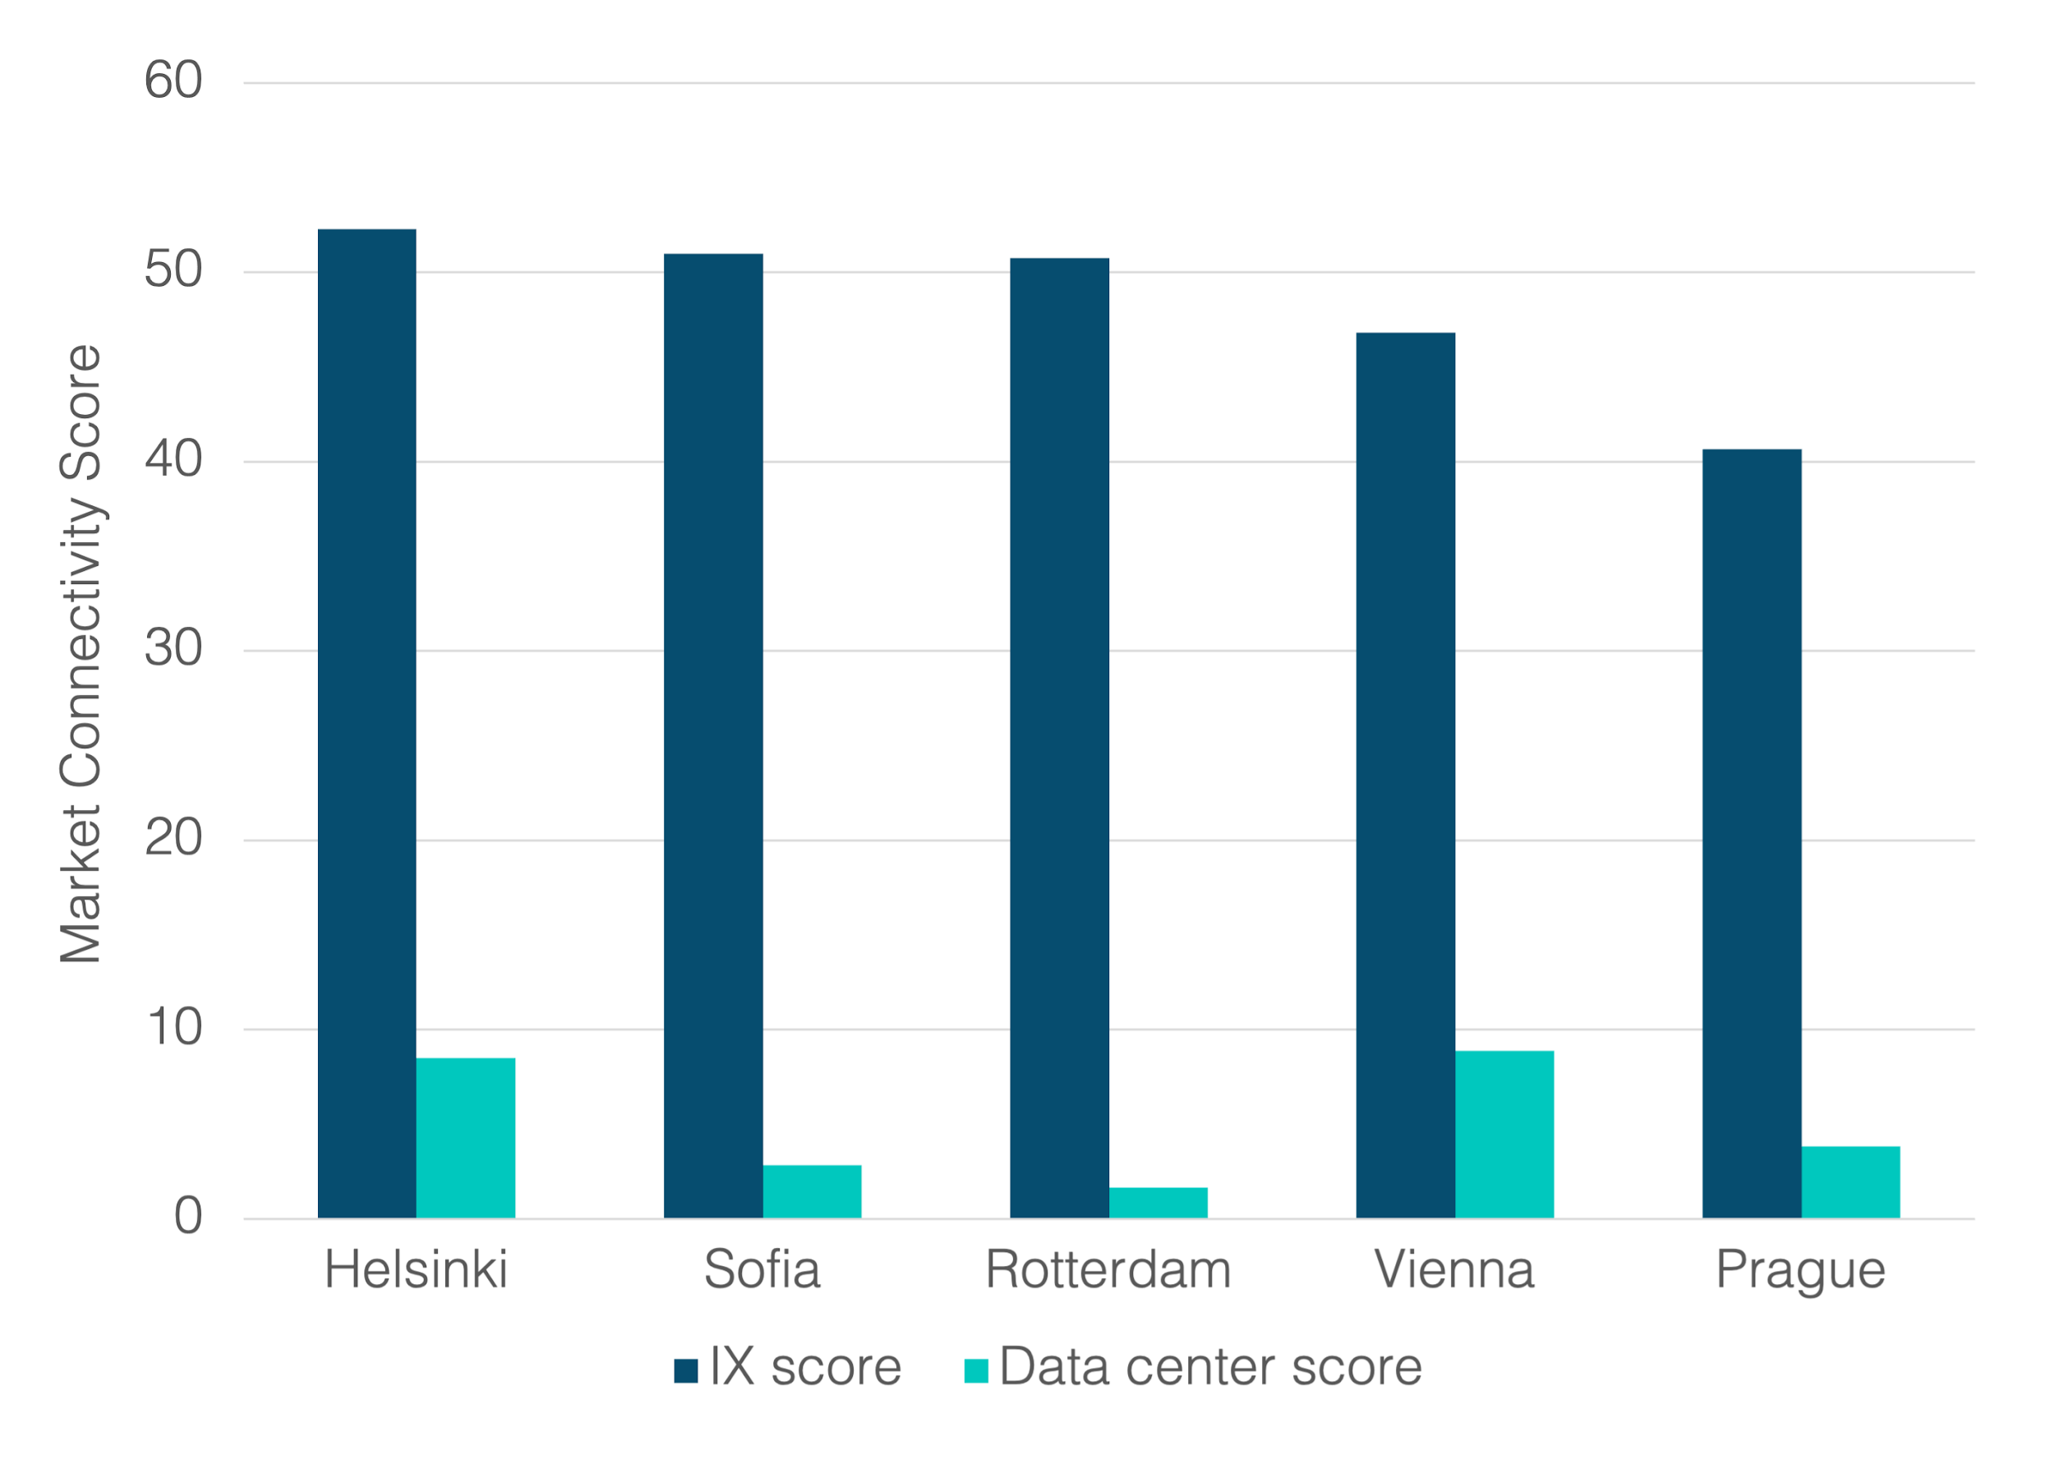
Strong IX but lack of DC space…
IX and Data Center Scores, Select Markets
Each market has:
multiple exchanges
hundreds of ASNs
high concentration of international ASNs…
…but relatively little data center capacity
Source: TeleGeography’s Data Center Research Service

Slide 37
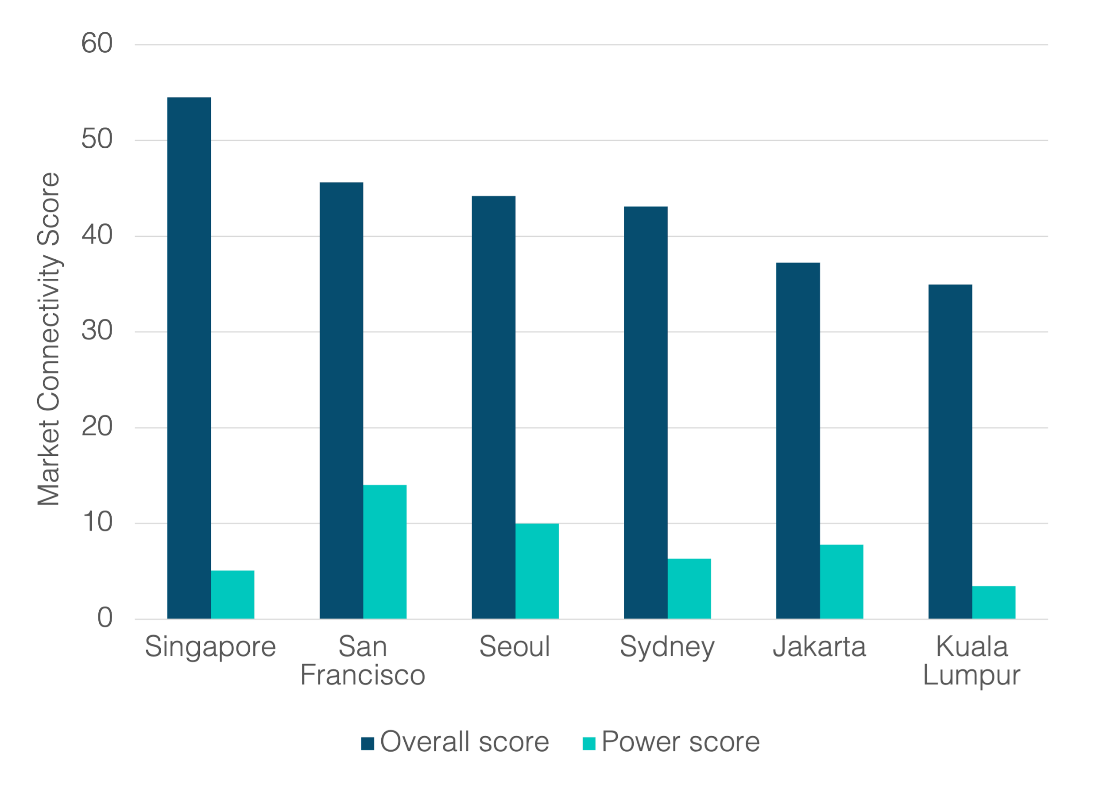
And some key markets with no major clean power plans in the pipeline…
Market Connectivity Scores, Select Markets
APAC is home to several of the strongest connectivity markets with the weakest scores for clean power provisioning
Source: TeleGeography’s Data Center Research Service

Slide 38
Looking ahead
Increased competition, redundancy, access to capacity in Africa
New sub cables offering lower prices and more capacity
More cables means more redundancy and better performance
Growth of terrestrial cross-border connectivity in Africa & ME?
Less dependency on Europe in Africa
Uptick in data centers, CDNs, IXP traffic in Africa, slower in ME
Increase in intra-African capacity vs international connectivity
Carrier-Neutral Data Centers on upswing and Cloud is here
Arrival of DC global players in Africa – Digital Realty, Equinix…
Cloud infrastructure in major hubs – Joburg + CPT but Nairobi Lagos + Cairo & Casablanca

Slide 39
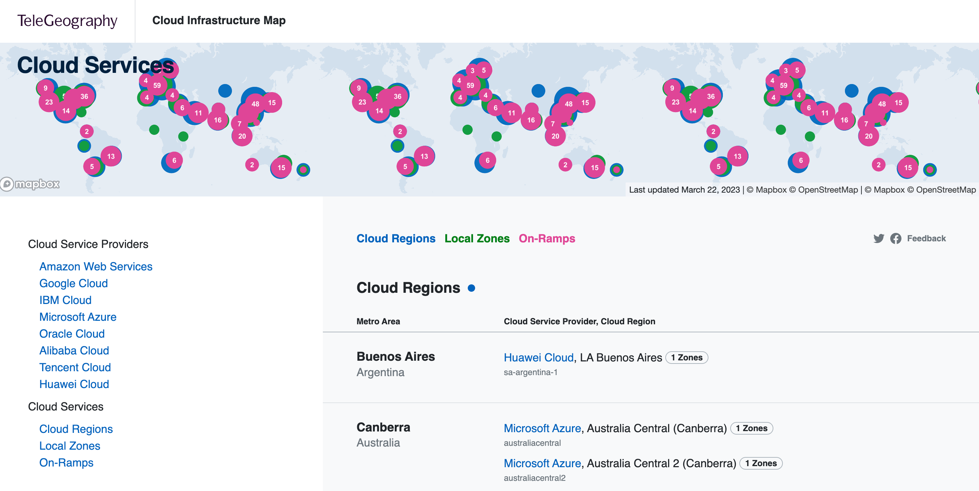
Have you seen the Cloud Infrastructure Map yet?
https://www.cloudinfrastructuremap.com
https://www.submarinecablemap.com
(yeah, you know this one)

Slide 40
Thank you!
Patrick Christian
Senior Research Manager
pchristian@telegeography.com

