Slide 1
Encroaching on
the Incumbents
Chris Rogers Co-Founder @ MorePeering

Slide 2



Who am I?
The bad news:
Where I’m from
Where I live
X
=
Sorry in advance
The good news: I like peering

Slide 3


Slide 4


Slide 5


Slide 6
What happened in San Diego Coronado?
Bar conversations @ NANOG
Topics included:
Existing regional IX outages
No truly neutral IX
International networks don’t always understand regional interconnection
The challenges of having two buildings with dense interconnection

Slide 7
What did I do?
Offered to help build (and fund) an IX
Business registration and bank account were opened before we left Coronado
ARIN tickets were in a few days later
Began lining up equipment
Started playing “peering coordinator”
Discussed current peering challenges with others

Slide 8
What are these challenges?

Slide 9
Neutrality
Cost
PNIs
Build into all major MMRs to maximize peering opportunities
Offer billing terms that work for the customer
Be price competitive against transit
Assist with facilitating PNIs
Sometimes via cross connect; sometimes via metro fiber
But the big challenge…

Slide 10
Redundancy
It doesn’t count for much without diversity
What does transit redundancy look like?
Multihoming from 2+ (or N+1) carriers
What does transport redundancy look like?
Diverse PoE, diverse routes
Probably diverse risers and diverse cross connect pathways
What does equipment redundancy look like?
N+N routers/switches/chassis/etc

Slide 11
The Plan

Slide 12
Start in Los Angeles…
Phase 1: Build a traditional L2 IX
Phase 2: Build a metro fiber network
Phase 3: Take the surplus revenue, and deploy it to help the community
Help support NFP IXs
Build infrastructure in emerging markets

Slide 13
What was this supposed to look like?
Simplified agreement
or be willing to use the customer’s paper
Choose your own pricing adventure
Buy flat rate, or burstable
Remove barriers, negate objections
(Except cross connects)
Aim to decrease prices, rather than offer ancillary services

Slide 14
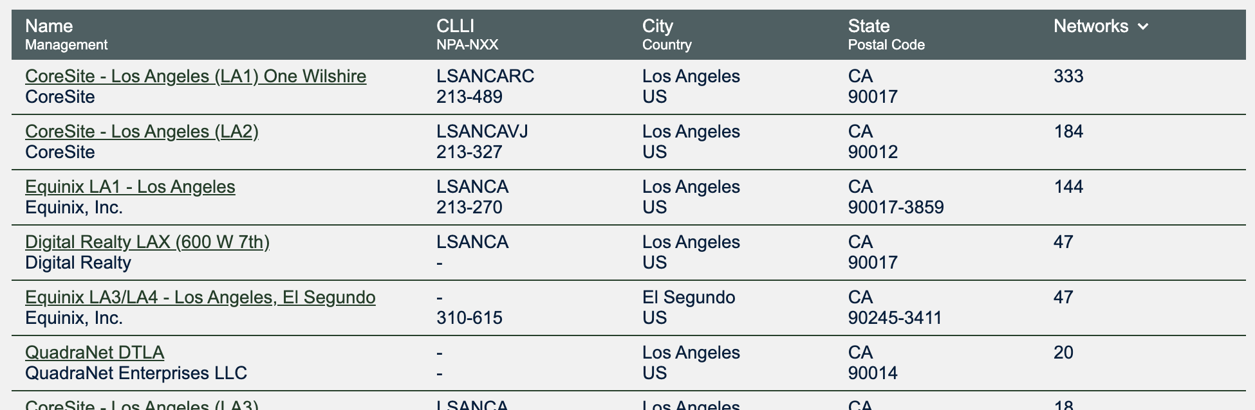
Where was this happening?
Where does PDB think I should do this?

Slide 15
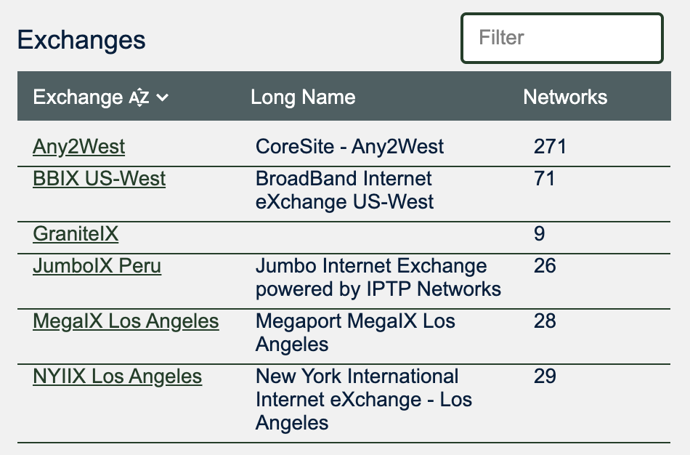
Top 2 Buildings
624 S Grand (One Wilshire)
Offers campus cross connects to:
900 N Alameda
200 Bauchet
Already has several IXs
600 W 7th
DRT owns the building
Is known to be friendly to IXs
Equinix operates the larger MMR
Doesn’t always love IXs
Easy way to serve a second large customer base via risers

Slide 16
Startup Deployment Strategy
Funding
Self funded
Some services donated, or traded for IX ports
Lean operations
Minimize overhead
Friendly Colo
Get space from friends, ideally ones that have multiple peering networks in their cages
Minimize the cross connect expense
Cattle not pets
Topology needs to support large changes as upgrades occur

Slide 17
Where things went wrong

Slide 18
Are new IXs welcome?
DRT: Sure!
Equinix: Yeah, I guess you can come in.
Coresite: Sometimes. But not you.
We initially found out via PDB staff
We got a friend in some trouble

Slide 19
What now?

Slide 20
Enter: Fiber Co
Data centers (generally) don’t like cutting fiber
Pivot
Dedicated space in 600 W 7th
Build a high count fiber cable between the two buildings
Conduits and innerducts already in place
Under 300 meters panel to panel
A stack of blank LOAs

Slide 21
Where things went wrong
(again)

Slide 22
Two Paths Forward
Operate in Stealth
Challenges with issuing third party LOAs
It only takes one customer to say the wrong thing
Challenge on antitrust
Many countries have antitrust legislation
In the US:
Sherman Act (1890)
Clayton Act (1914)
Both have the same problem
They put customers (friends) in the middle

Slide 23
Lessons Learned
Seeding an IX isn’t easy
Verbal commits are unsurprisingly impossible to use
Getting ports up is surprisingly difficult and slow
Being in the business of selling your customers, to your other customers
Sounds great
But trajectory really matters
Trajectory is bad when lawyers have to get involved
(Lawyers are slow)
You can’t sell customers, if you don’t have customers
(Shocking, I know.)

Slide 24
Questions?

