Slide 1
Automation to fight piracy: the Italian experience
Livio Morina - CEO@Airbeam | BM@PeeringDB & AIIP
Livio Morina – GRNOG16
Athens – 19/04/2024
Notes:
This is the only slide where I use Comic Sans
Who am I? I will not discuss the topic from an ethical quality point of view

Slide 2
The Serie A League is putting strong pressure on the Italian Government
Problem
Audiovisual piracy has stolen a turnover of €1.7 billion from all Italian economic sectors
315 million the overall estimate of piracy acts among the adult population
716 million the potential damage on the Italian economy in terms of GDP
9,400 the potential estimate of employment at risk
Livio Morina – GRNOG16
Athens – 19/04/2024
Notes:
I don’t comment the points, I only show the page in a few seconds I Just say: Economic and employment issues, so the Goverment decided to ACT

Slide 3
There’s a need for a fast blocking system, so we created a M2M platform where rights holders compile a list of blacklisted assets and operators SIMPLY have to enforce it
The Serie A’s proposal
Livio Morina – GRNOG16
Athens – 19/04/2024

Slide 4
Right Owners (private entities) define what they want to block: - IPv4/32 - IPv6/128 - FQDN Operators have to run GETs every n minutes, apply the ORDERS, and confirm the execution with POSTs
Basics of the M2M Platform
Livio Morina – GRNOG16
Athens – 19/04/2024

Slide 5
Airbeam Side
IP blackholing
VPN
Brain: PHP / Cron
DNS Blacklist
Livio Morina – GRNOG16
Athens – 19/04/2024
Notes:
One Single VPN Alma creates 3 lists
HA?

Slide 6
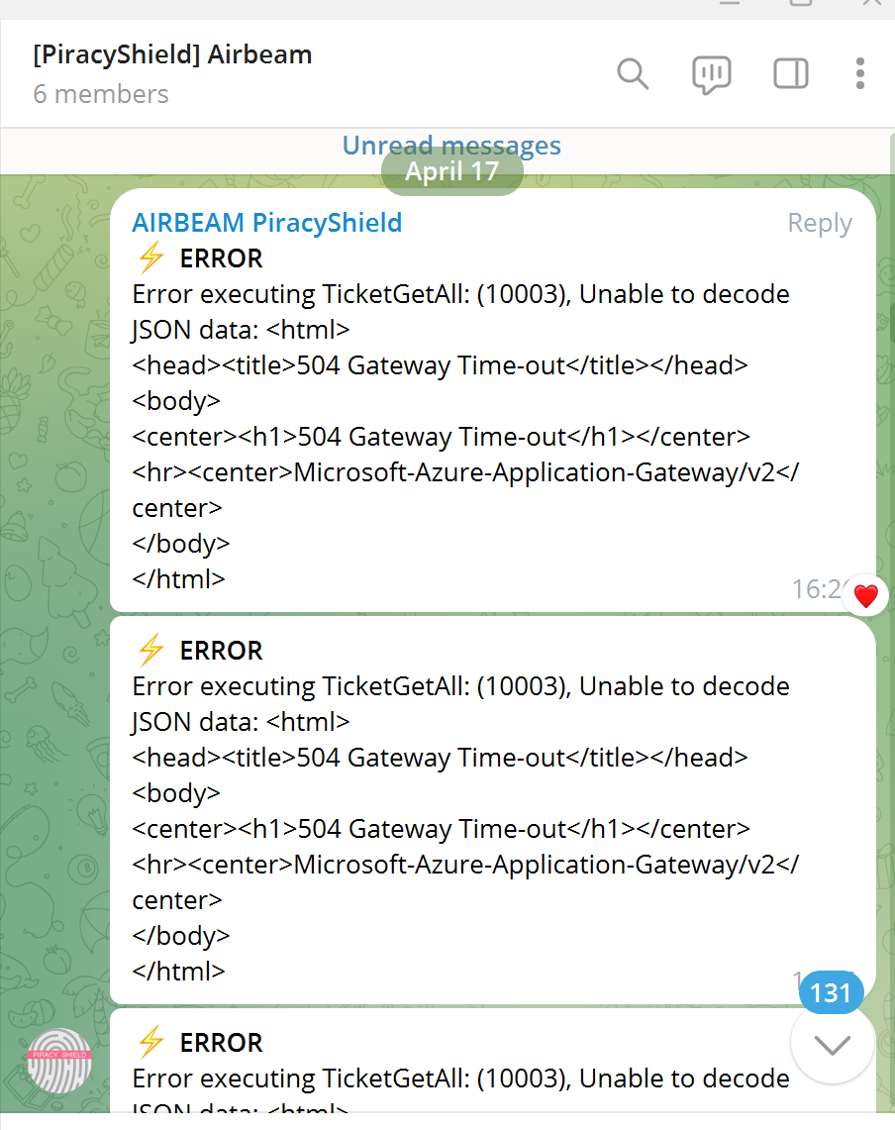
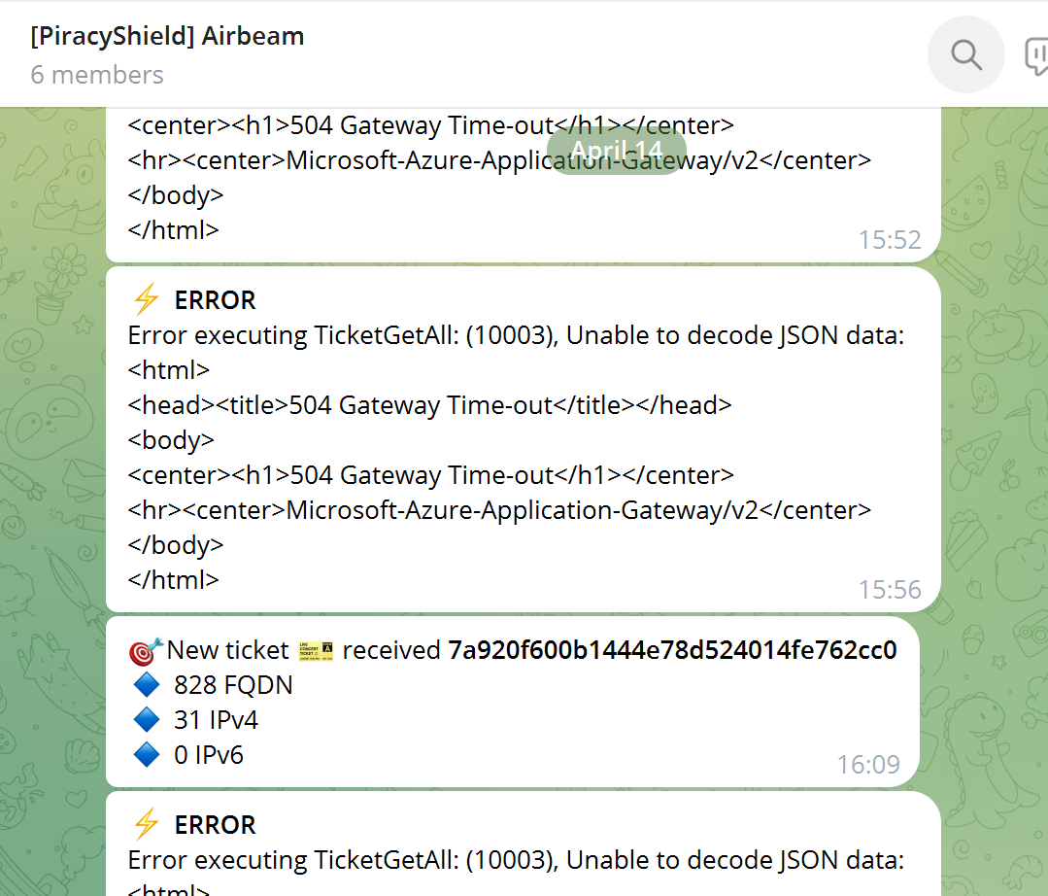
Notifications
Apr 18th 2024
818 tickets
Banned FQDN 9539
BannedIPv4 3123
Livio Morina – GRNOG16
Athens – 19/04/2024

Slide 7
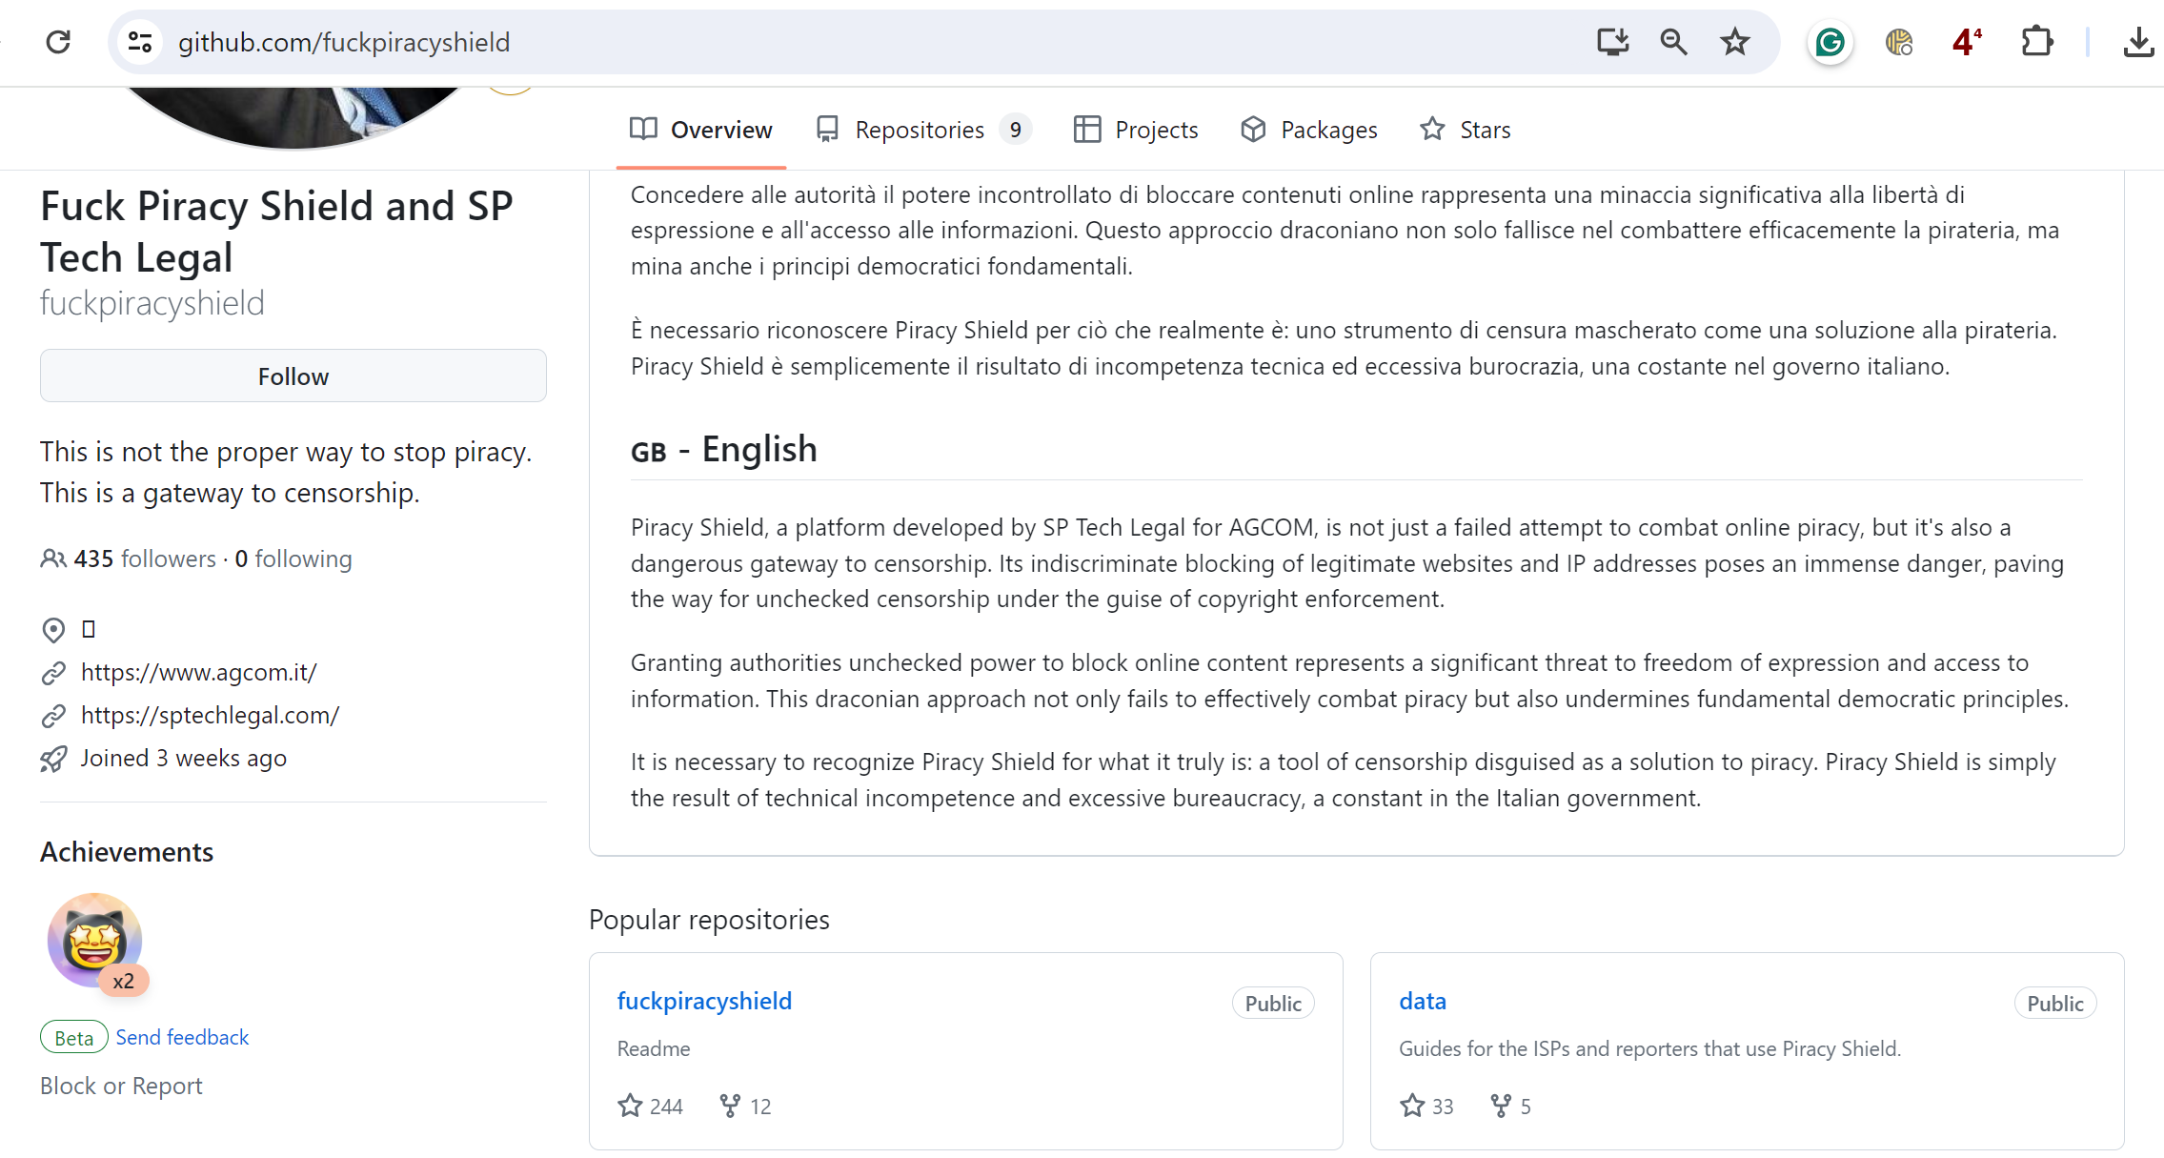
Platform Code
Livio Morina – GRNOG16
Athens – 19/04/2024

Slide 8
Process of making addresses free again
Livio Morina – GRNOG16
Athens – 19/04/2024

Slide 9
Credits
Livio Morina – GRNOG16
Athens – 19/04/2024

