Slide 1
Quantum Internet Alliance
Ruben van den Brink
Amsterdam Internet Exchange
CTO

Slide 2

WARNING
MAY CONTAIN TRACES OF AI

Slide 3

Quantum News
Google announces quantum chip Willow

Slide 4
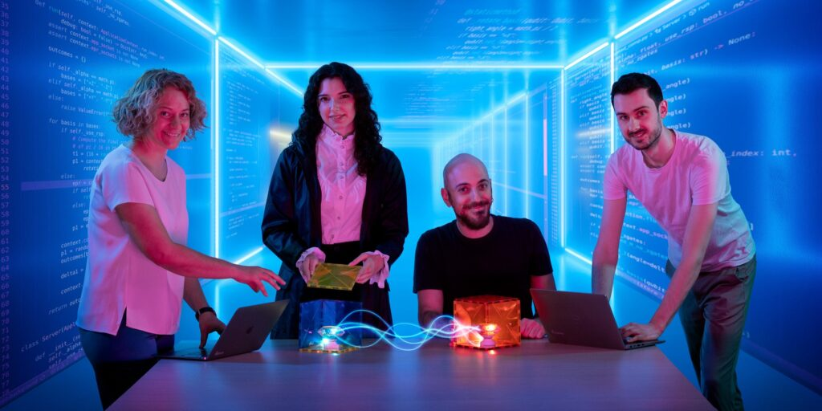
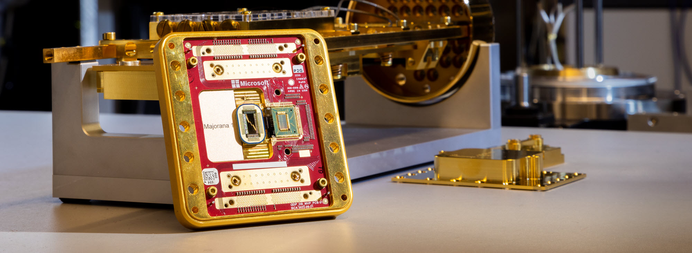
Quantum News
Microsoft announces quantum chip Majorana 1

Slide 5
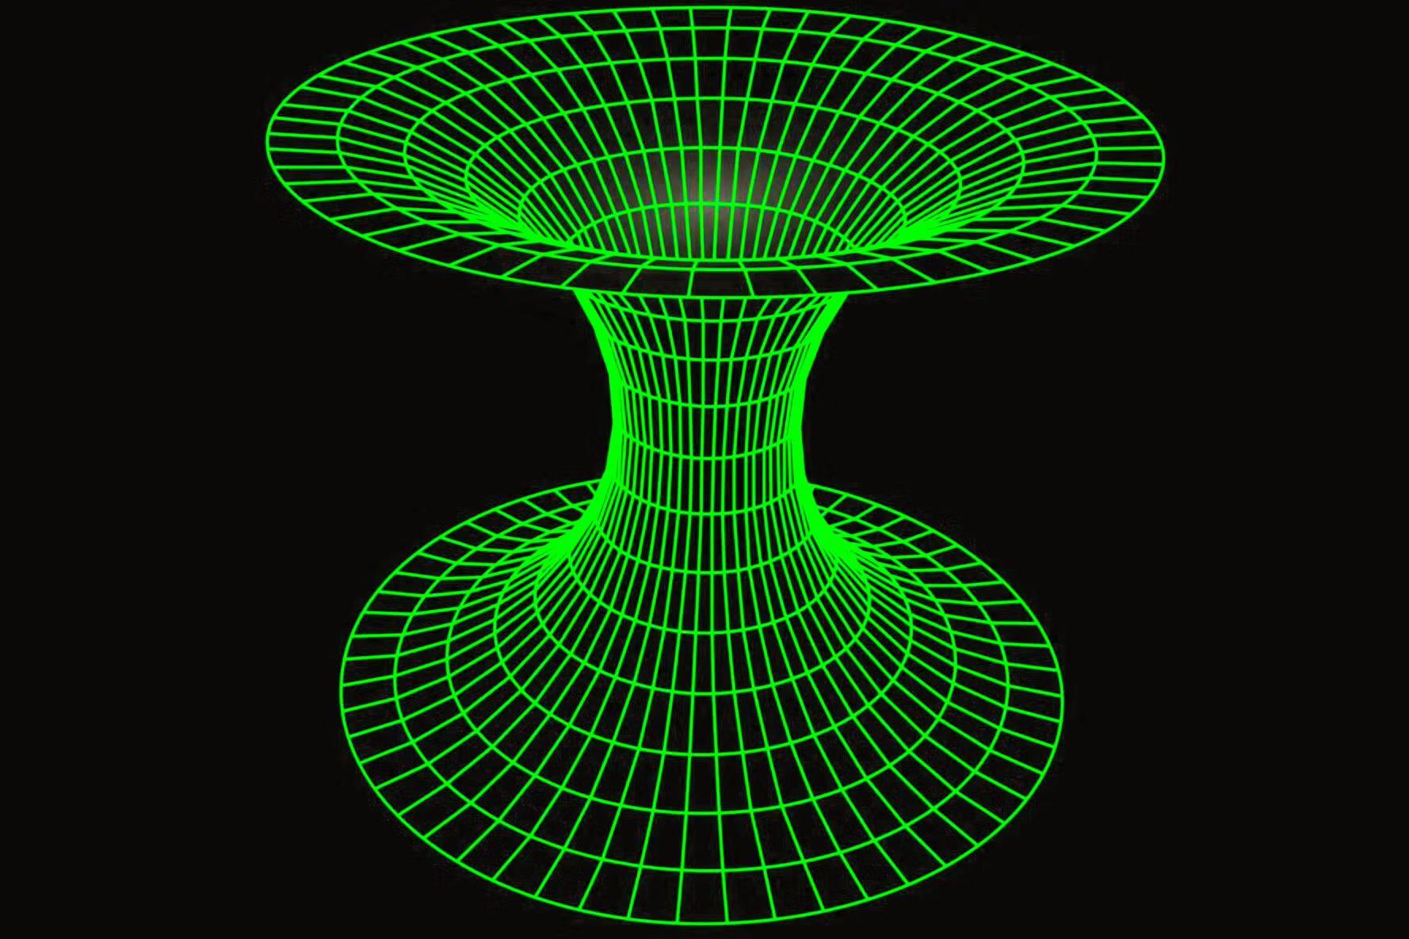
Quantum News
University of Oxford realizes distributed logical quantum gates by teleportation

Slide 6
Quantum News
QNodeOS: QIA announces first Quantum Network Operating System

Slide 7
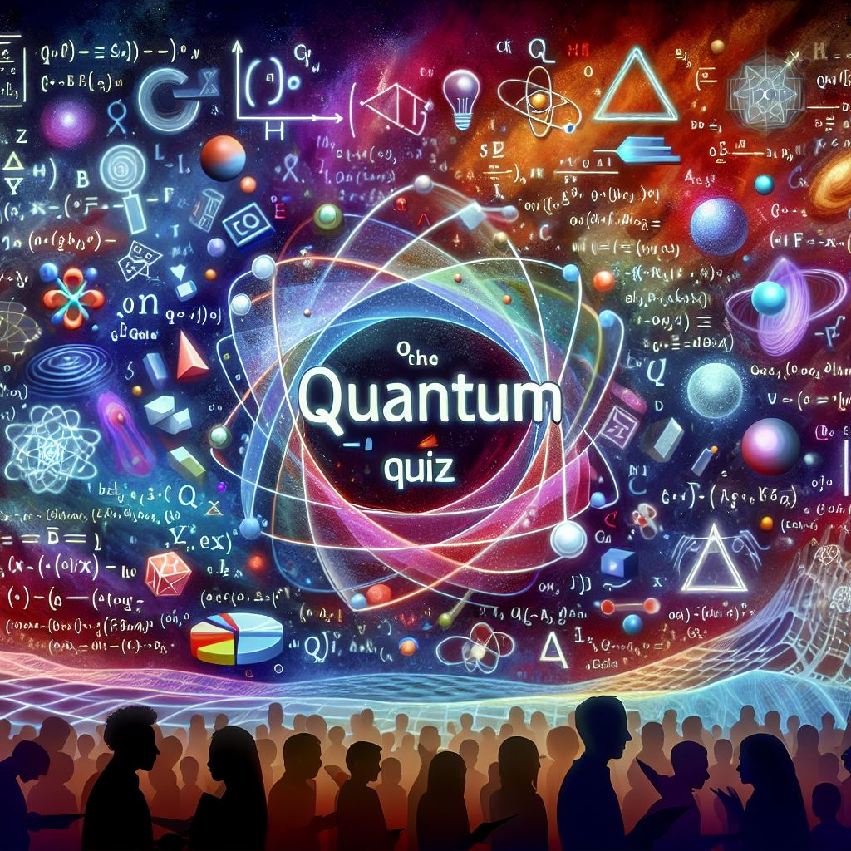
Source: Copilot on a bad day

Slide 8
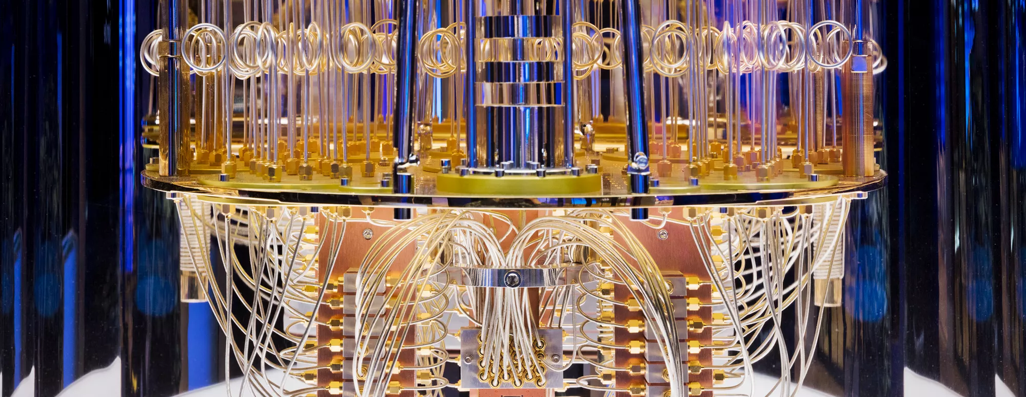
Qubits can only exist at temperatures lower than 4 Kelvin
Source: Cleveland Clinic

Slide 9
Qubits can only exist at temperatures lower than 4 Kelvin
Source: Cleveland Clinic
Notes:
Photonic Qubits
NV (Nitrogen Vacancy) centres in diamond
Operate at room temperature and can therefore be used in a datacenter environment

Slide 10
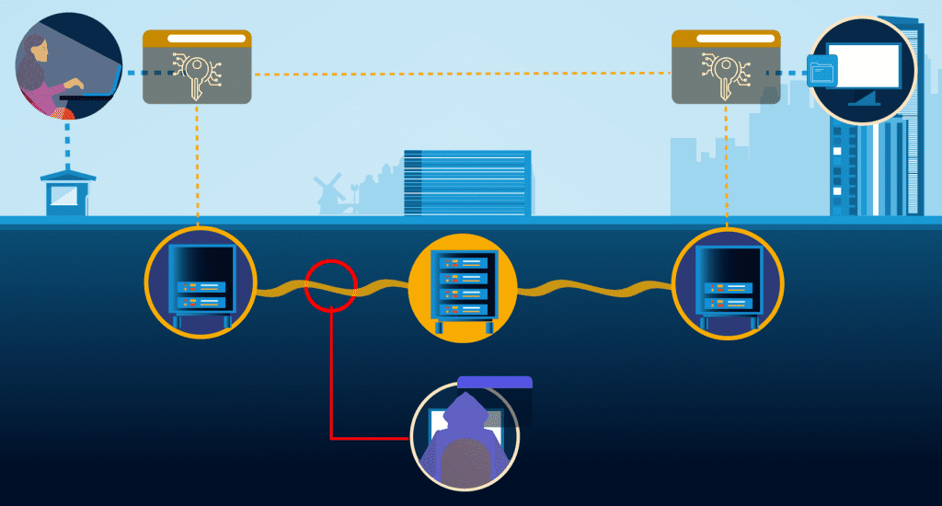
Quantum Key Distribution prevents your encrypted data from being stolen and decrypted later
Source: QuTech

Slide 11
Quantum Key Distribution prevents your encrypted data from being stolen and decrypted later
Source: QuTech
Notes:
QKD supports classical symmetric encryption protocols like AES, which are harder, but not impossible to break through quantum algorithms. QKD protocols ensure that any attempt to evesdrop the distribution of keys between Alice and Bob gets noticed so the compromised key can be discarded.

Slide 12
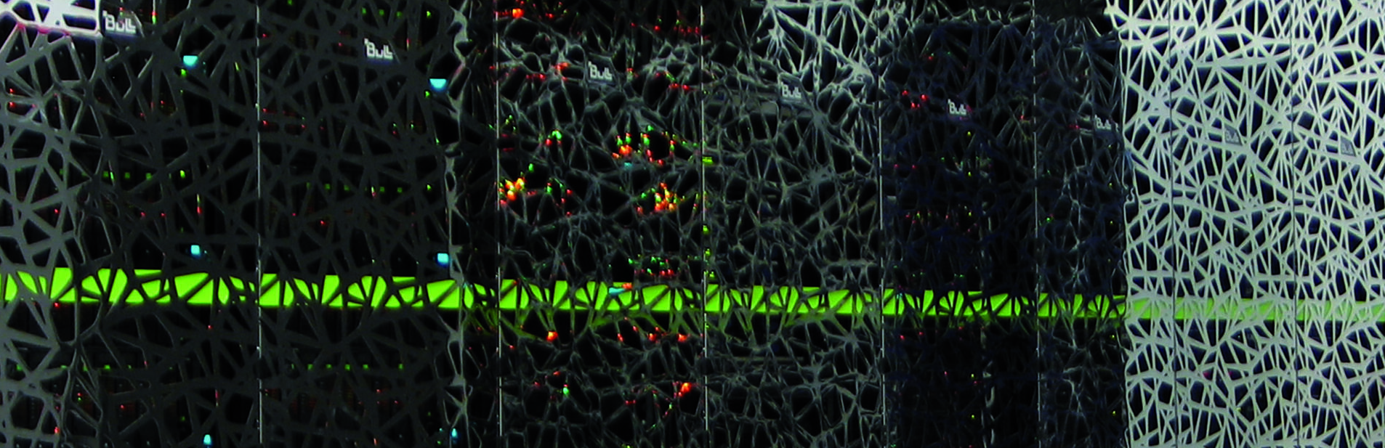
Because of their incredible processing power, quantum computers will eventually replace classical, silicon based processors
Source: SURF

Slide 13
Because of their incredible processing power, quantum computers will eventually replace classical, silicon based processors
Source: SURF
Notes:
Quantum processors will complement computational systems by enabling the execution of an additional class of algorithms: quantum algorithms. As such, a Quantum Processing Unit will support the computational power of CPU’s and GPU’s. Another way to put it: QPU’s only excell at certain specific tasks (like factoring large primes using Shor’s Algorithm)

Slide 14
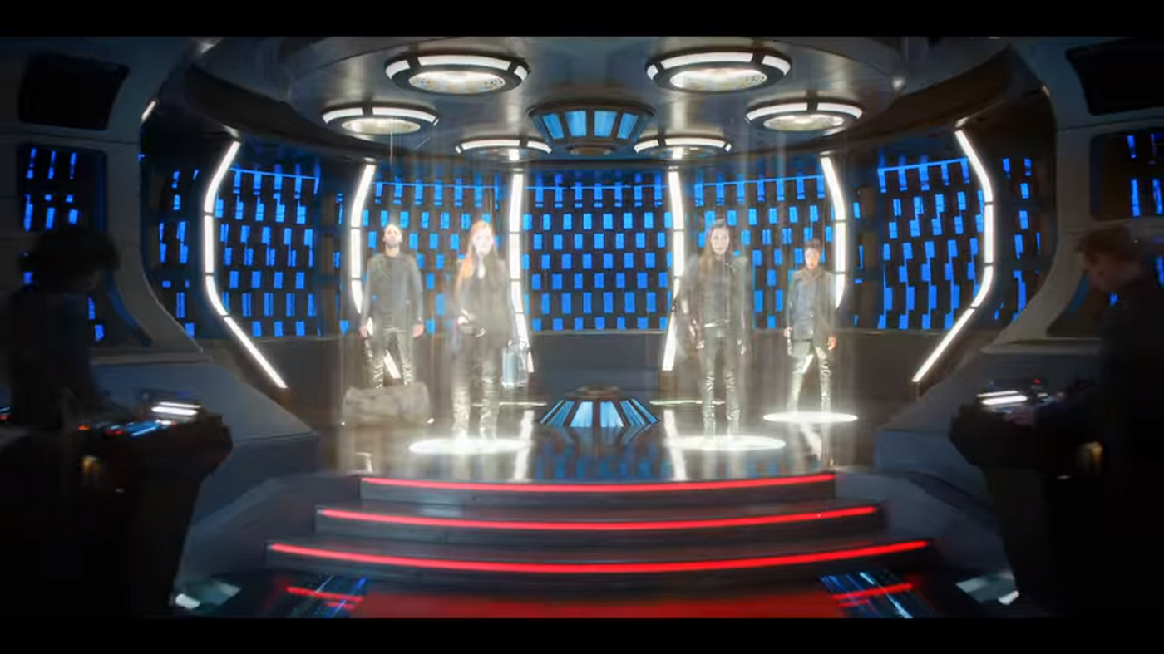
Qubit teleportation is bound by the speed of light
Source: andisama medium
Source: SURF

Slide 15
Qubit teleportation is bound by the speed of light
Source: andisama medium
Source: SURF
Notes:
Qubit teleportation is a technique that transfers the state of a qubit at one location to that of a qubit at a distant locations. It is based on the quantum property of entanglement, but the process of teleportation can not be executed without a separate classical communication channel (like a regular ethernet connection) and is therefore bound by the speed of light.

Slide 16

The BB84 algorithm for secure quantum communication got its name from Orwell’s 1984 because it prevents Big Brother from watching
Source: andisama medium
Source: SURF

Slide 17
The BB84 algorithm for secure quantum communication got its name from Orwell’s 1984 because it prevents Big Brother from watching
Source: andisama medium
Source: SURF
Notes:
BB84 is a quantum key distribution scheme developed by Charles Bennett and Gilles Brassard in 1984

Slide 18
Quantum Technology
Quantum Computing
Quantum Communication
Quantum Sensing

Slide 19
Quantum Technology
Quantum Computing
Quantum Communication
Quantum Sensing

Slide 20
Quantum Technology
Quantum Communication

Slide 21
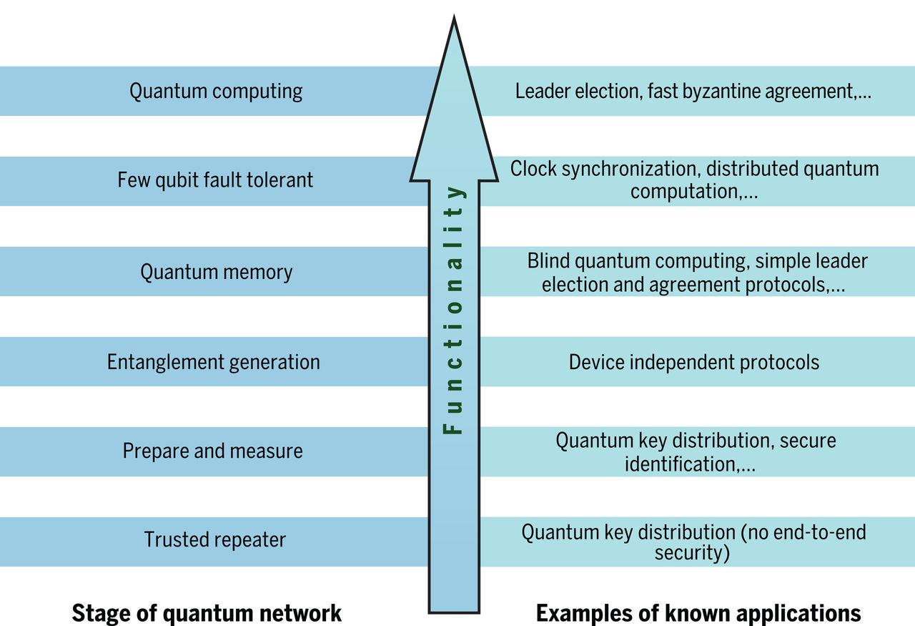
Road towards Quantum Internet
Quantum internet: A vision for the road ahead BY STEPHANIE WEHNER, DAVID ELKOUSS, RONALD HANSON. SCIENCE. 19 OCT 2018

Slide 22
Quantum Algorithm Zoo
Blind Quantum Computing
Entanglement Routing
Quantum Electronic Voting
Quantum Money
Certified Deletion
Teleportation of States and Gates
Leader Election
Coin Flipping
https://wiki.veriqloud.fr/
Notes:
It’s all about the Algorithms!
What are the promising usecases?

Slide 23




European Quantum Projects
Notes:
Quantum Flagship; other funded programmes are:
EuroQCI: European Quantum Communication Infrastructure
Horizon
Quantum Flagship has around 40 projects, of which QIA is one (of the larger, I assume)
QF will fund >1billion euro over 10 years

Slide 24
European Quantum Projects
Notes:
Quantum Flagship; other funded programmes are:
EuroQCI: European Quantum Communication Infrastructure
Horizon
Quantum Flagship has around 40 projects, of which QIA is one (of the larger, I assume)
QF will fund >1billion euro over 10 years

Slide 25
European Quantum Projects
Notes:
Quantum Flagship; other funded programmes are:
EuroQCI: European Quantum Communication Infrastructure
Horizon
Quantum Flagship has around 40 projects, of which QIA is one (of the larger, I assume)
QF will fund >1billion euro over 10 years

Slide 26
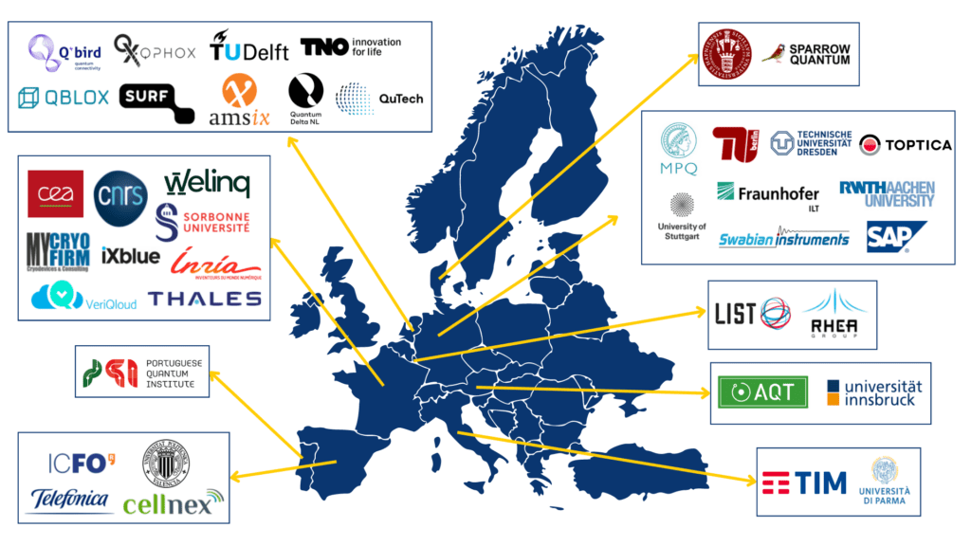
Quantum Internet Alliance
Notes:
42 members
Universities
Research Institutes
Industry Partners
Start ups, Scale ups, Spin outs…

Slide 27
The Moonshot Mission for QIA
Following a systems engineering approach, we are building a full-stack prototype network that can distribute quantum entanglement between two metropolitan-scale networks and over long-distance using quantum repeaters. The system will be based on state-of-the art quantum hardware and software we developed in the past.
The prototype network will include photonic clients – devices that allow future users to run higher stage quantum network applications between distant processing nodes of the network. All elements of the network including our processing nodes and repeaters are designed to be compact and portable to allow for operation outside the lab.
Parallel to the focused effort to build a prototype system, we are also exploring alternative hardware platforms and other technical solutions that have a clear potential to improve the performance, scalability and functionality of the final product.

Slide 28
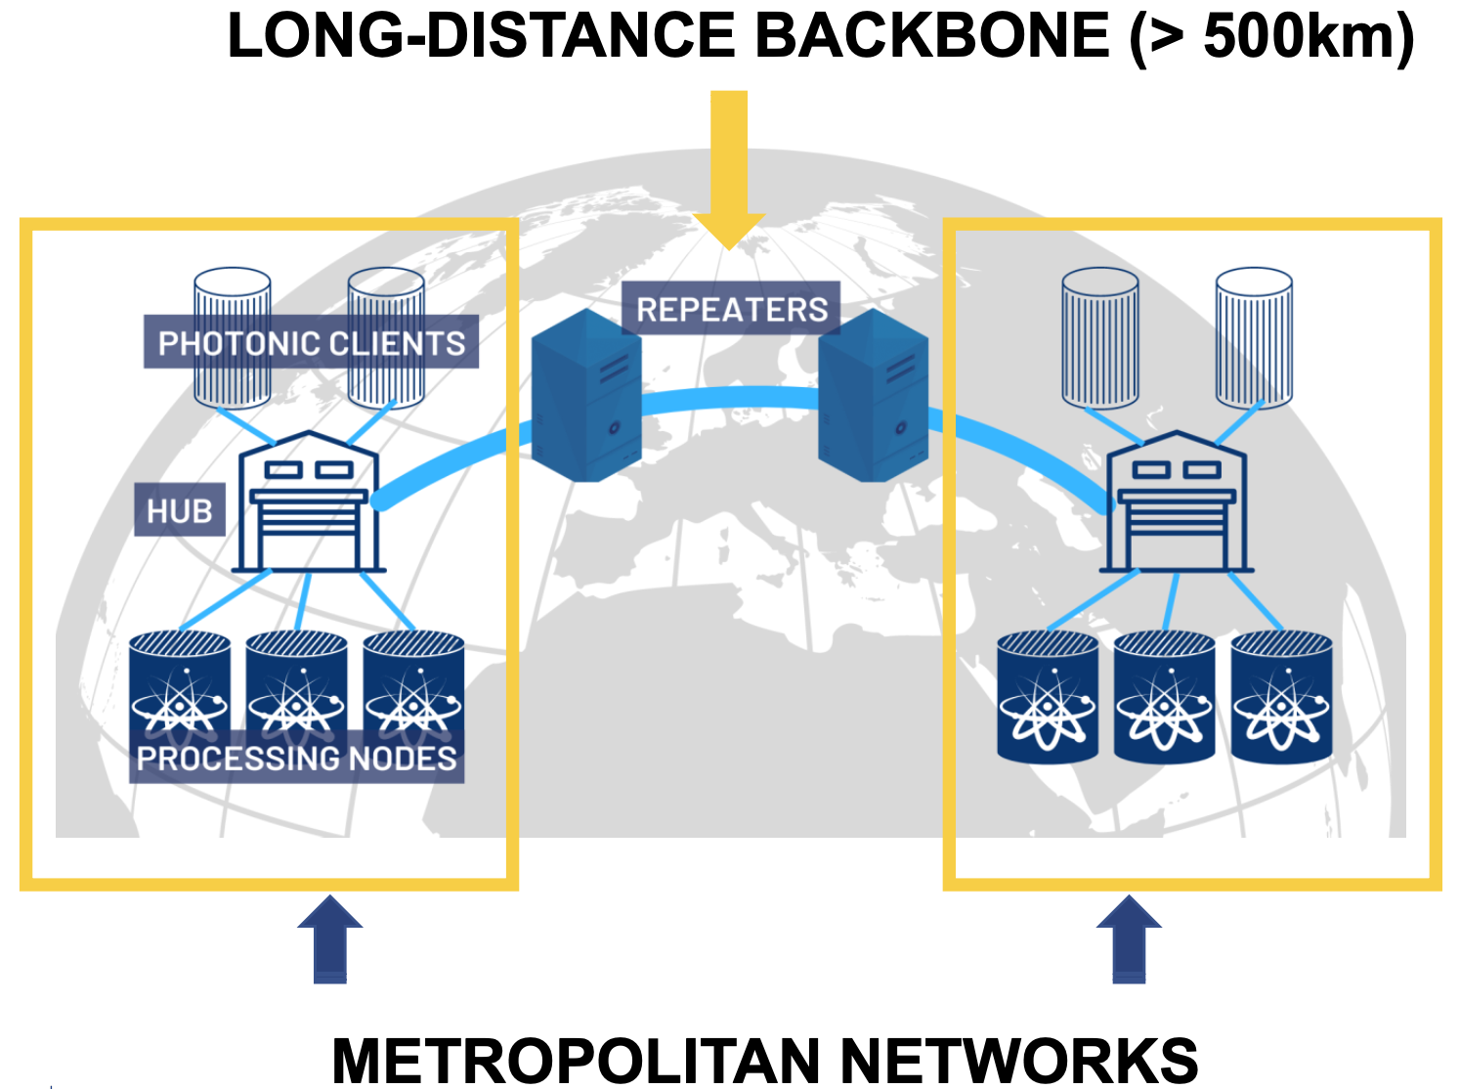
Source: https://quantuminternetalliance.org/
Notes:
Full stack system
• Data Center compatible
• User devices:
• Photonic clients – low-cost access
• Processing nodes – advanced functionality
• Test programs:
• Teleportation above classical limit
• Blind Quantum Computation based

Slide 29
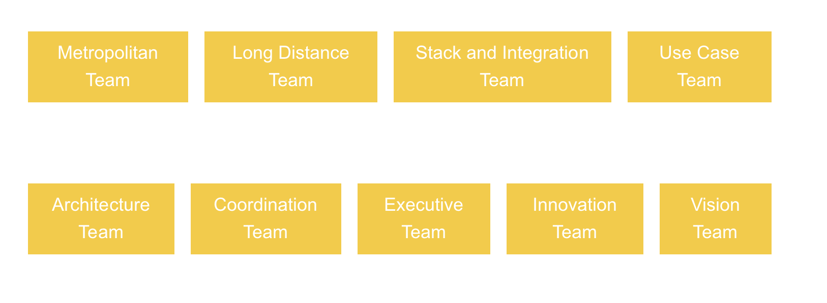
Work teams

Slide 30
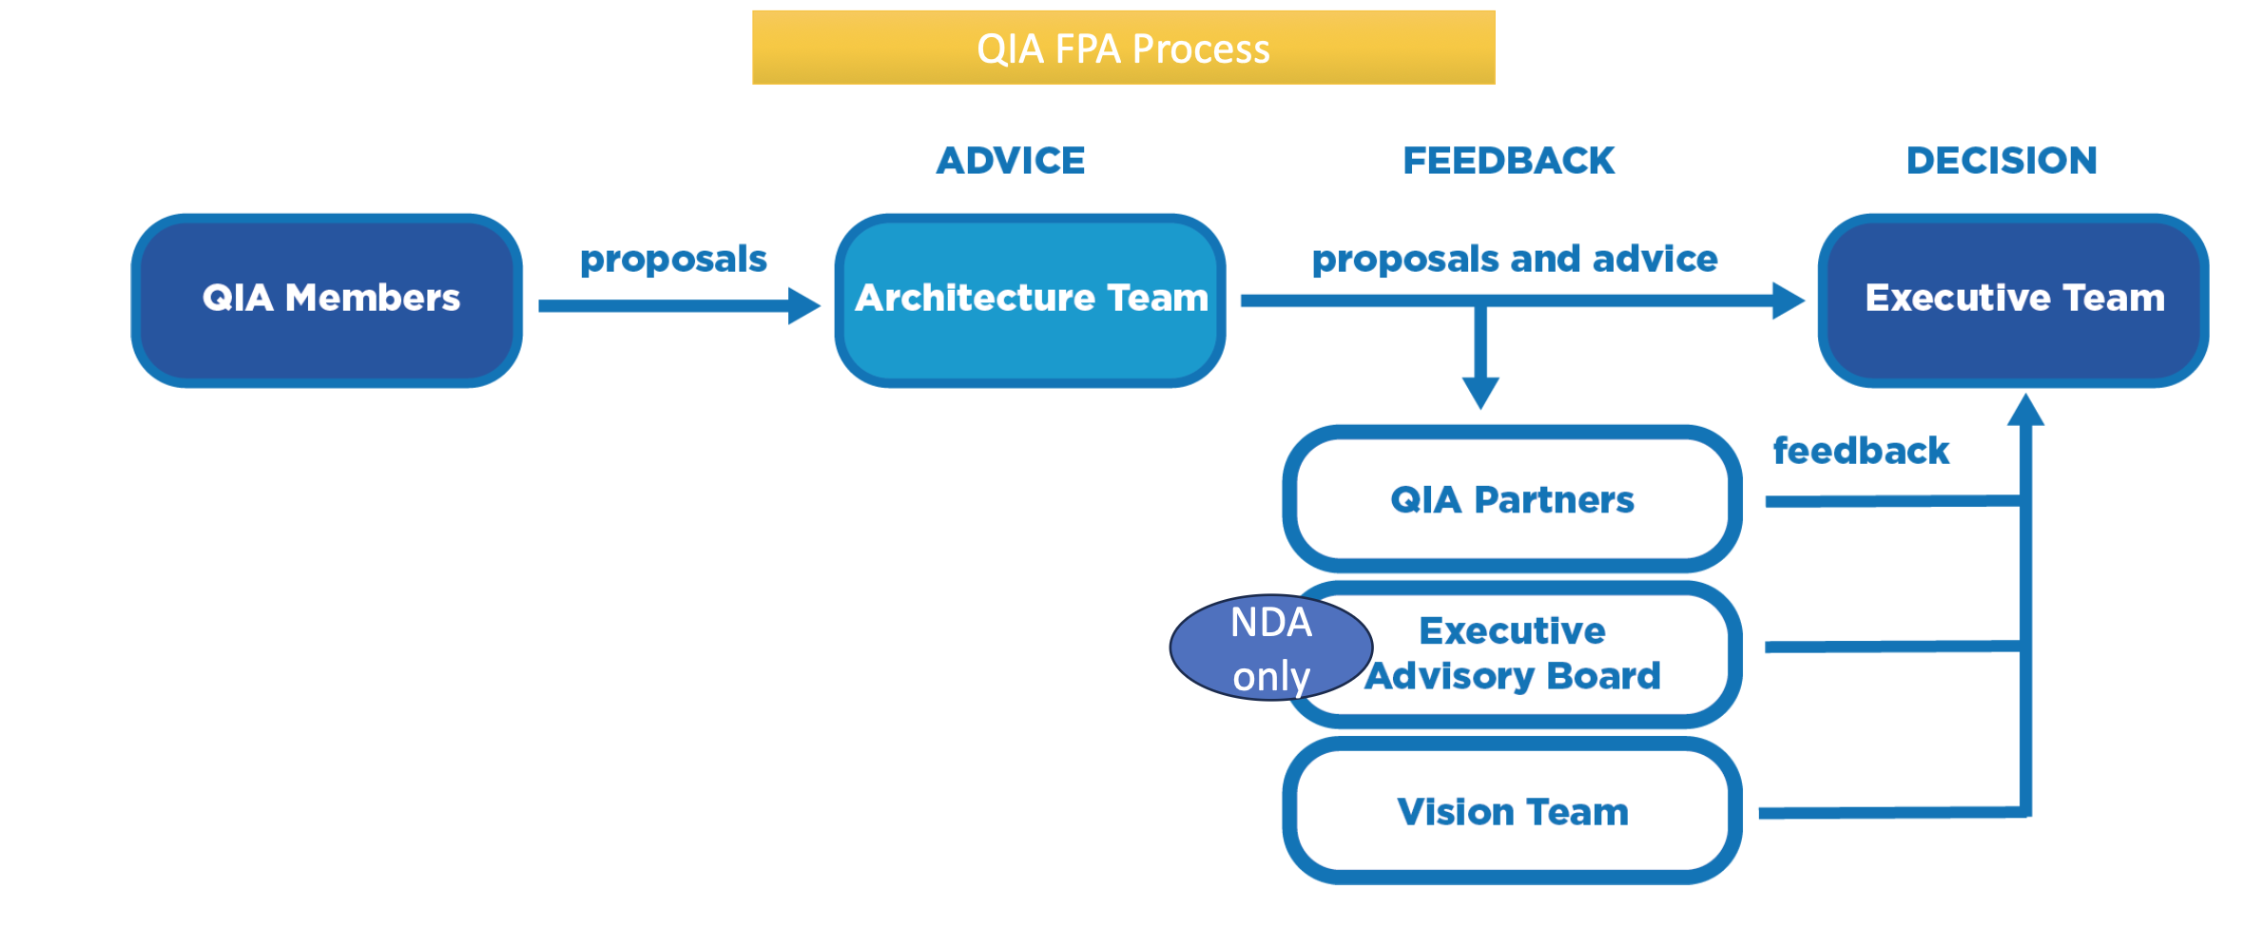
Governance (e.g. proposal selection SGA2)

Slide 31
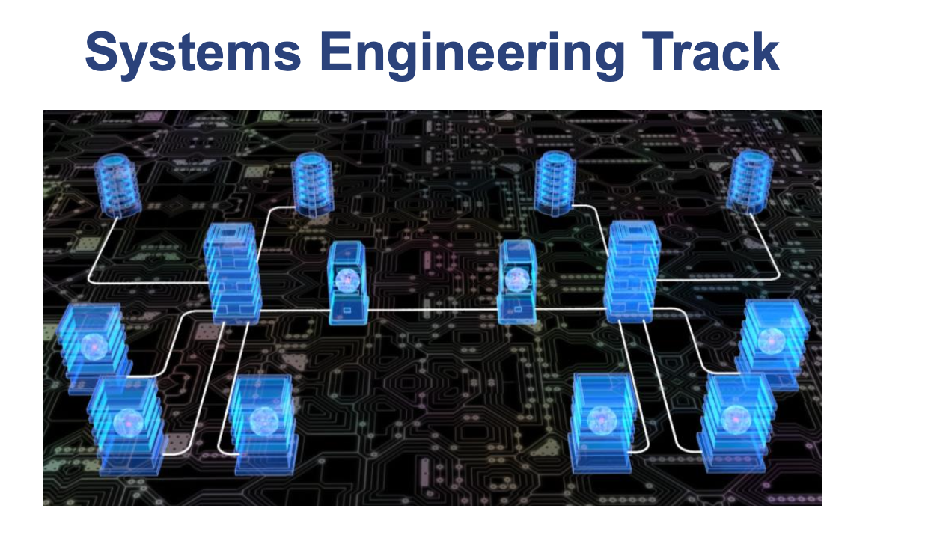

Engineering Tracks
https://quantuminternetalliance.org/
Notes:
Keep an eye out for Innovations
Close contenders of selected technologies: (personal opinion) create a challenge for members that provide “incumbent technology”

Slide 32
Engineering Tracks
Quantum Repeaters
Quantum Memory
Qubit control and readout
Laser systems (19” rack mountable)
Simulation software (SquidASM/Netsquid/SimulaQron)
Notes:
What are the type of technologies the members and work teams of QIA are working on?
Most recent: the first Operating System for Quantum Network Nodes (Nature publication)

Slide 33
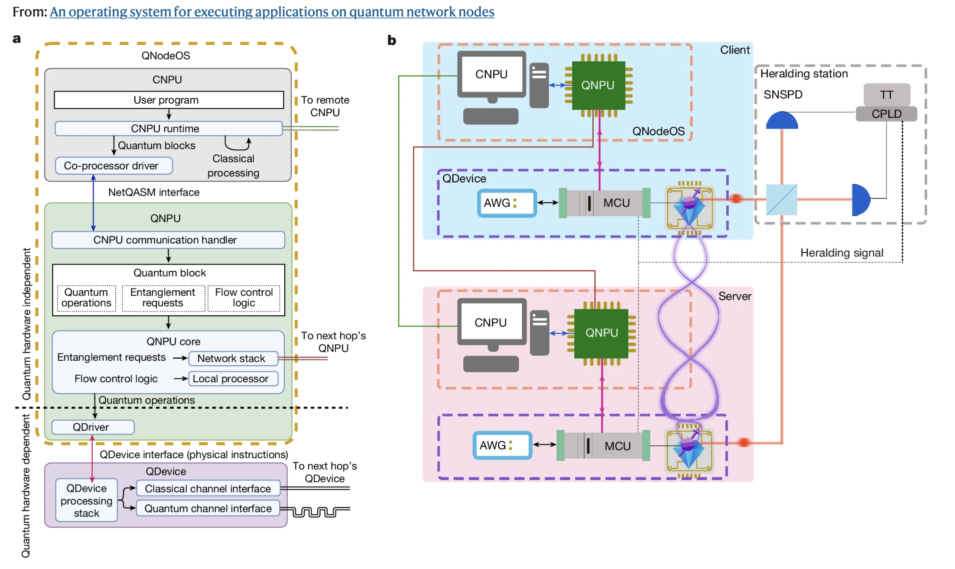
QNodeOS
Source: Delle Donne, C., Iuliano, M., van der Vecht, B. et al. An operating system for executing applications on quantum network nodes. Nature 639, 321–328 (2025). https://doi.org/10.1038/s41586-025-08704-w

Slide 34
QIA Technology Forum
Within the QIATF, Special Interest Groups can be formed to foster interaction between Industry partners and the research community. Participants may qualify as core member, adopter or associate.
SIG space: integration of terrestrial and space quantum information networks
SIG telecom: interactions with network operators (AMS-IX joined the SIG, but still early phase)

Slide 35
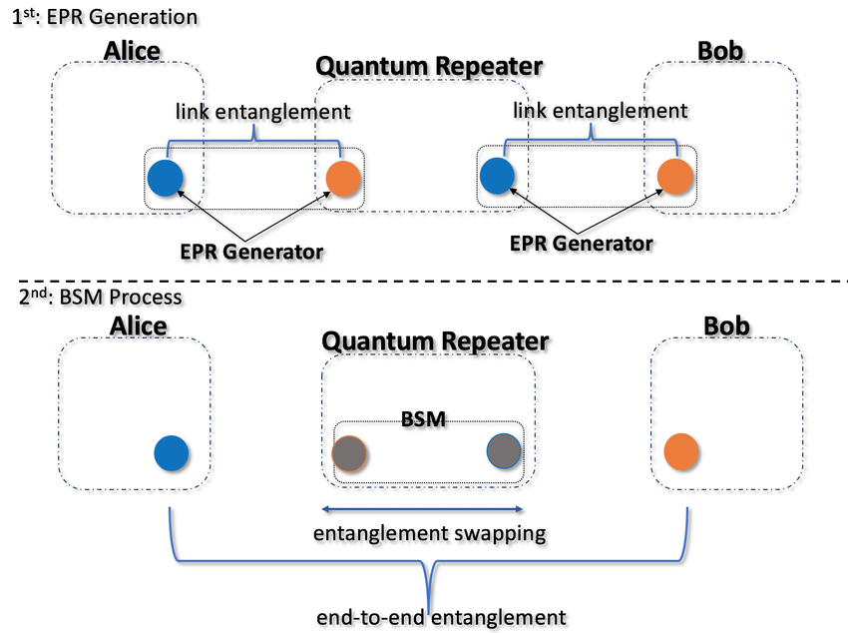
A Quantum Internet Exchange?
Long distance QKD requires trusted nodes in between quantum communication channels (current status)
Quantum repeaters are essential for creating entanglement over long distances (Bell State Measurements, Entanglement Swapping)
To create a quantum network, (time synchronized) classical communication is essential
By connecting qubit systems through quantum channels, a distributed “quantum cloud” is created.
We need trusted, neutral nodes where different quantum domains can be connected…
Notes:
So, if there is going to be a Quantum Internet, will we also need Quantum Internet Exchanges?
What could be the relevance of Quantum Communication Technology for Internet Exchanges?
So far, this is unclear. But by tracking the development of quantum technology and its applications, we may identify opportunities to re-invent IX’s soon.
Offering the execution of quantum communication algorithms as a service…

Slide 36
One more thing…

Slide 37
In a couple of weeks, I will be leaving AMS-IX

Slide 38
It’s not because I no longer like the Classical Internet 😎

Slide 39
Come talk to me if you want to know more…

Slide 40
Or have a great opportunity in mind!

Slide 41
Thank you!
(for being a wonderful community)

