Slide 1
IX Automation
Progress and Adoption of IX-API
Richard Petrie
CTO
April 2025
GPF - Denver

Slide 2
What is this about?
A look back at IX-API, it’s adoption across major EU IXs and what are the current drivers to promote wider adoption in the peering domain.

Slide 3
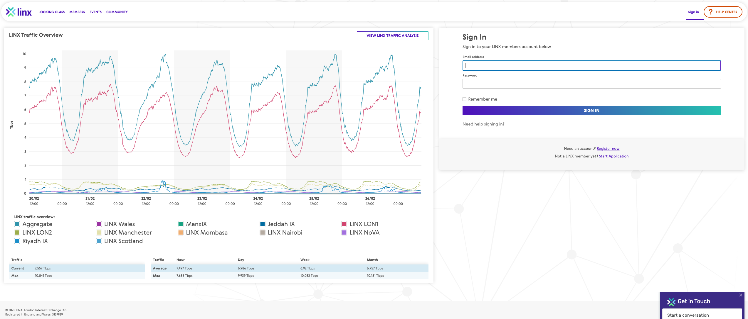
IX-API – A brief recap
Initiative started in early 2019 when we shared API and portal plans
Many of the us were looking at member facing APIs to compliment the user portals

Slide 4
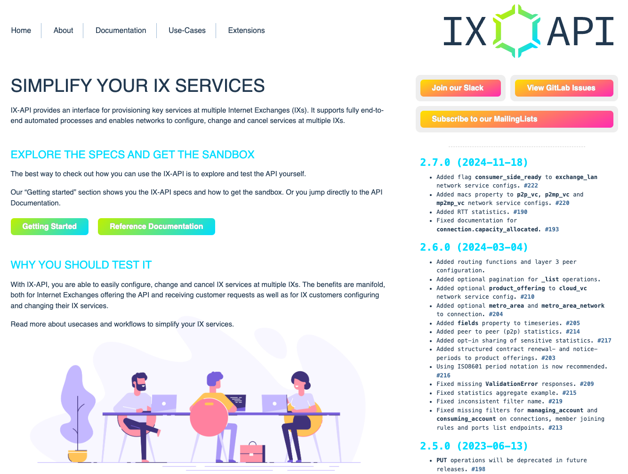
IX-API – A brief recap
LINX, AMS-IX and DE-CIX agreed to collaborate and share any efforts with the IX community
IX-API was established - https://ix-api.net/

Slide 5
IX-API – A brief recap
We did a round of member/customer interviews, which pushed us to a partner first model for the first release
Release version 1 was developed in 2019, we presented at the EPF14 event in September 2019, with version 1 released in 2020
Offering the capability across inventory, member registration and new peering ordering
Version 2 of the standard was presented and released in 2021
Offering ordering and change configuration of peering, route server configuration, route collector, E-LAN and E-LINE services
Notes:
Explain the partner model decision, the member need for stats and more complexed needs

Slide 6
IX API Progress
Iterative release of versions 2.x of the standard have been released across 2022-2024
Offering modular adoption, stats, Terraform extension, interop with Peering Manager, Cloud connectivity and some layer 3 capabilities
During this time and considering the disruption of COVID in attending events we have been promoting to other IXs through presentations and workshops at EPF, Euro-IX events and local in country community events

Slide 7
IX API Challenges
Low member adoption for the traditional IXs
Open sourced, DIY model introduced a barrier to adoption
Full benefits for implementing IXs are only realised if the APIs are effectively integrated with backend systems and automation workflows
Small IXs gravitated towards IXP manager which provides a useful UI and backend workflow
Mid IXs wanted to fix back-end automation and digital workflows
Larger IXs engaged but looked to credible use cases
Uses cases from members focused on stats and traffic performance

Slide 8
IX API What is Next?
Complete version 3 improvements planning in 2025
Investigate use cases for members to analyse the health of an IX in 2025 v2.6-v2.8
Investigate a kick starter program for IXs needing help
Engagement with Network as a service (NaaS) efforts to look for synergies
Support higher level peering automation efforts such as Peering Manager and Peering API

Slide 9
Peering API
https://www.ietf.org/archive/id/draft-ramseyer-grow-peering-api-05.html
Abstract
We propose an API standard for BGP Peering, also known as interdomain interconnection through global Internet Routing. This API offers a standard way to request public (settlement-free) peering, verify the status of a request or BGP session, and list potential connection locations. The API is backed by PeeringDB OIDC, the industry standard for peering authentication. We also propose future work to cover private peering, and alternative authentication methods.

Slide 10
Peering Manager
https://docs.peering-manager.net/integrations/ix-api/
Coupled with IX-API, Peering Manager can display useful information about your connections to an IXP such as services provided by the IXP (route servers), what an IXP knows about your services (such as service IDs) and connections to the IXP that you already have setup or not. It provides a way to quickly import a connection found in IX-API to Peering Manager.

Slide 11
IX-API v3
Laying the Groundwork for IX-API 3.0
A first draft proposal for asynchronicity was introduced, marking a critical advancement toward improving scalability and efficiency
Additionally, efforts have began to rationalise the data structure, ensuring native support for Layer 3 products
These changes set the foundation for a more flexible and robust API, capable of supporting the evolving needs of internet exchanges and cloud networking
v2.x
access, peering, stats, crm, product, etc.
v3.x - Base
CRM
Commercial
Stats
Access
L2
L3
Extensions
Cloud
Contacts
Accounts
Products
Policies
Routing
L3

Slide 12
IX-API v2.6 – 2.8
IX Health
Members requesting health across the IX
Peers requesting far end peer capacity capabilities
peer-to-peer traffic flow
Stats
IX
Stats
CE-A
PE1
PE2
CE-B
100GE
100GE
CE-C
PE3
100GE
n*peer-to-peer traffic flow

Slide 13
Thank You

