Slide 1
Good, Fast, Cheap
Which Two?
Global Peering Forum
April 2025
Notes:
Evaluating opportunities. Your company can spend its money in infinite ways. How to decide among competing priorities?

Slide 2
Good
  Reliable
  White-glove
low cost, great service/reliable
premium with top-tier performance
  Low bill
  Additional services
  TCO
  High bandwidth
  Immediate installation/service
Cheap
Fast
fast and cheap self-service
Notes:
Who are you?
What do good, fast, cheap mean?
Might be bandwidth, reliability, monthly bill
Might be install-time, white-glove, TCO
All of these are valid value propositions.
But if you go too hard in any direction, you’re vulnerable to a competitor on the opposite angle or side.
If you stay in the middle, you’re vulnerable to all competitors—you do everything fine, but nothing well.

Slide 3
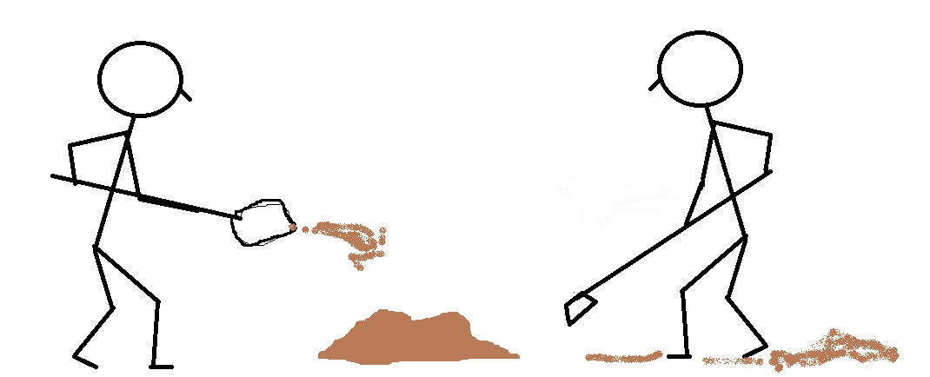
Notes:
Your company is in a game to make the biggest pile of sand.
Revenues are people adding to the pile. Yay!
Expenses are taking away from the pile. Boo!
Everything anyone does in the company is either adding to the pile or taking away from the pile.
If you stop shoveling (adding customers) or increase hoeing (spending more), your pile shrinks, so you have to stay focused on maximizing the shovel and minimizing the hoe.

Slide 4

Notes:
But every once in a while it rains, which washes away some of the pile. So there’s also risk mitigation: making umbrellas, filing legal paperwork, paying taxes.
This is really slowing down the drain, but probabilistic: you don’t know what risks will manifest, or when.
Btw, this is also true of not-for-profit organizations. Your goal may be to break even so you can accomplish whatever your actual mission is, but if you run out of sand, you can’t do that mission.

Slide 5
Notes:
You get an offer for a bigger shovel. Or a smaller hoe. Or a better umbrella.
It costs money. Should you buy it?

Slide 6

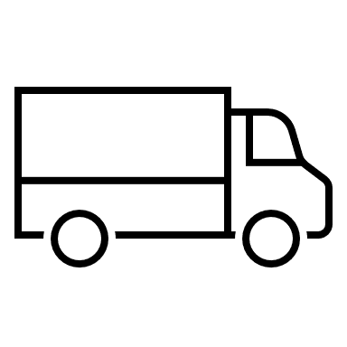


Align Revenues and Expenses
$$$
$$$$$$
?
For any given project, model:
how much additional revenue it is going to generate, and
how much it’s going to cost or save.
Notes:
First, you need to know which customers you’re serving. Do you have a few customers focused on speed and service, or many cost-focused customers?
Then, how are you providing that? Automation, self-service, extra people for support and service, more fiber, more redundancy?
How are your customers deciding that your service is the right mix of good, fast, and cheap, for them?
For any given project, you need to be able to model how much additional revenue it is going to generate, and how much it’s going to cost or save.

Slide 7
Project X
 | Revenues | Expenses
Initial Expense |  | ($500,000)
Annual Maintenance |  | ($20,000)
One-time revenue | $10,000
Incremental ARR | $10,000
New ARR | $50,000
Is this a good use of our money over time?
Notes:
So you’re spending $500K now, plus $20K per year, to add some revenue. For most of us, even how long to break even isn’t intuitive.

Slide 8
Project X
 | Revenues | Expenses
Initial Expense |  | ($500,000)
Annual Maintenance |  | ($20,000)
One-time revenue | $10,000
Incremental ARR | $10,000
New ARR | $50,000
 | 1/1/2025 | 1/1/2026 | 1/1/2027 | 1/1/2028 | 1/1/2029 | 1/1/2030 | Total
Revenues |  | $70,000 | $110,000 | $160,000 | $210,000 | $260,000 | $810,000
Expenses | ($500,000) | ($20,000) | ($20,000) | ($20,000) | ($20,000) | ($20,000) | ($600,000)
Year | ($500,000) | $50,000 | $90,000 | $140,000 | $190,000 | $240,000 | $210,000
Total | ($500,000) | ($450,000) | ($360,000) | ($220,000) | ($30,000) | $210,000 | $210,000
Notes:
Looks like after five years, we’ve made a net of $210,000 on our $500,000.
Yay, the pile is bigger!
But how does that compare to other projects?

Slide 9
Internal Rate of Return
 | Revenues | Expenses
Initial Expense |  | ($500,000)
Annual Maintenance |  | ($20,000)
One-time revenue | $10,000
Incremental ARR | $10,000
New ARR | $50,000
 | 1/1/2025 | 1/1/2026 | 1/1/2027 | 1/1/2028 | 1/1/2029 | 1/1/2030 | Total
Revenues |  | $70,000 | $110,000 | $160,000 | $210,000 | $260,000 | $810,000
Expenses | ($500,000) | ($20,000) | ($20,000) | ($20,000) | ($20,000) | ($20,000) | ($600,000)
Total | ($500,000) | $50,000 | $90,000 | $140,000 | $190,000 | $240,000 | $210,000
=XIRR(B11:G11,B8:G8) =XIRR(values, dates)
IRR | 8.2%
Notes:
So what does 10.2% mean?
Internal Rate of Return, or how much we’re theoretically making on our money, per year, but spread over time.
Is that a good IRR or bad IRR?
It depends.

Slide 10
Spreadsheet – Interest Income
 | Revenues | Expenses
Initial Expense |  | ($500,000)
Interest Income | 4.0% APR
Notes:
APR = Annual Percentage Rate
CPY = Compound Periods per Year. i.e., is it compounding daily, compounding monthly, or compounding annually?
Average Return reflects the average of the revenues as a percentage of the initial deposit
So yes, compared to 4.0% interest income, that Project X shovel is a better use of capital.

Slide 11
Spreadsheet – Interest Income
 | Revenues | Expenses
Initial Expense |  | ($500,000)
Interest Income | 4.0% APR
 | 1/1/2025 | 1/1/2026 | 1/1/2027 | 1/1/2028 | 1/1/2029 | 1/1/2030 | Total
Revenues |  | $20,404 | $21,237 | $22,104 | $23,006 | $23,944 | $110,695
Running Ttl | $500,000 | $520,404 | $541,641 | $563,745 | $586,750 | $610,695
=XIRR(B11:G11,B8:G8) =XIRR(values, dates)
IRR | 4.4%
APY (compounding daily) | 4.1% | =((1+APR/CPY)^CPY)-1
Average Annualized Return | 4.4%
Notes:
APR = Annual Percentage Rate
CPY = Compound Periods per Year. i.e., is it compounding daily, compounding monthly, or compounding annually?
Average Return reflects the average of the revenues as a percentage of the initial deposit
So yes, compared to 4.0% interest income, that Project X shovel is a better use of capital. You’d have to be earning around 10% to be better than a 10% IRR.

Slide 12
Spreadsheet - Leverage
 | Revenues | Expenses
Initial Expense |  | ($500,000)
Annual Maintenance |  | ($20,000)
Interest Expense |  | 10%
One-time revenue | $10,000
Incremental ARR | $10,000
New ARR | $50,000
Notes:
Remember that our initial version had a 10.2% IRR.
But if we have to pay 10% on $500,000, that’s $50,000 per year, and suddenly this looks a lot less attractive!

Slide 13
Spreadsheet - Leverage
 | Revenues | Expenses
Initial Expense |  | ($500,000)
Annual Maintenance |  | ($20,000)
Interest Expense |  | 10%
New ARR | $120,000
 | 1/1/2025 | 1/1/2026 | 1/1/2027 | 1/1/2028 | 1/1/2029 | 1/1/2030 | Total
Revenues |  | $120,000 | $120,000 | $120,000 | $120,000 | $120,000 | $600,000
Expenses | ($500,000) | ($20,000) | ($20,000) | ($20,000) | ($20,000) | ($20,000) | ($600,000)
Total | ($500,000) | $100,000 | $100,000 | $100,000 | $100,000 | $100,000 | $0
Notes:
The astute reader will see that we break even after five years. We’re not in the business of breaking even.
Remember that our initial version had a 10.2% IRR.
But if we have to pay 10% on $500,000, that’s $50,000 per year, and suddenly this looks a lot less attractive!

Slide 14
Spreadsheet - Leverage
 | Revenues | Expenses
Initial Expense |  | ($500,000)
Annual Maintenance |  | ($20,000)
Interest Expense |  | 10%
New ARR | $120,000
IRR
-0.0%
 | 1/1/2025 | 1/1/2026 | 1/1/2027 | 1/1/2028 | 1/1/2029 | 1/1/2030 | Total
Revenues |  | $120,000 | $120,000 | $120,000 | $120,000 | $120,000 | $600,000
Expenses | ($500,000) | ($20,000) | ($20,000) | ($20,000) | ($20,000) | ($20,000) | ($600,000)
Total | ($500,000) | $100,000 | $100,000 | $100,000 | $100,000 | $100,000 | $0
Notes:
Remember that our initial version had a 10.2% IRR.
But if we have to pay 10% on $500,000, that’s $50,000 per year, and suddenly this looks a lot less attractive!

Slide 15
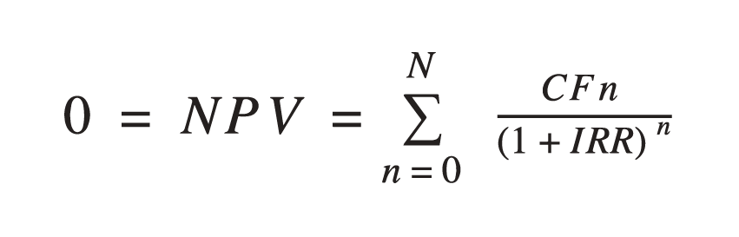
            N = total number of time periods
            n = time period
            CFn = Cash Flow for period n
Net Present Value is the sum of the series of cash flows over time divided by the Internal Rate of Return squared.
Notes:
For the record, here’s the formula. Nobody cares next slide.

Slide 16
Examples
Spend $100,000 on automation
Spend $10,000 on employee retention
Spend $1MM on upskilling customer service
Spend $500K in improving security

Slide 17
Should we spend $100,000 on Automation?
 | Revenues | Expenses
Development Time (300 hours @$100/hr) |  | ($30,000)
Manual Entry Reduction (150 hours $100/hr) |  | $15,000
Reduced downtime (10 hours $150/hr, 80% chance) |  | $1,200
Risk ($) = Probability (%) X Impact ($)
80% X $1500
$1,200 = 80% X $1500
Notes:
I’m pretending that one automation project will save manual entry and reduce downtime. Either preventing an outage, or reducing MTTR.
Can you think of an example that would do that?
Here, I’ve said there’s an 80% chance it’ll eliminate 10 hours of down time per year.
Of course, maybe your project is flipped, and it’ll save 100 or 150 hours of downtime, and only a few hours of troubleshooting labor. Plug in your own numbers.

Slide 18
Should we spend $100,000 on Automation?
 | Revenues | Expenses
Development Time (300 hours @$100/hr) |  | ($30,000)
Manual Entry Reduction (150 hours $100/hr) |  | $15,000
Reduced downtime (10 hours $150/hr, 80% chance) |  | $1,200
 | 1/1/2025 | 1/1/2026 | 1/1/2027 | 1/1/2028 | 1/1/2029 | 1/1/2030 | Total
Revenues
Expenses | ($30,000) | $16,120 | $16,120 | $16,120 | $16,120 | $16,120 | $50,600
Total | ($30,000) | $16,120 | $16,120 | $16,120 | $16,120 | $16,120 | $50,600
IRR | 45.5%
ROI | 169%
Notes:
I’m crediting the Expenses line, since this project is all about avoiding expense, not increase revenue.
This project is clear. I’d probably still do it at twice the price.
Another way to think of IRR is turns per year. My annualized return is 45%, I’m making 45% and I’ve recovered my initial investment in just over two years, and I can go reinvest that original capital in another project.

Slide 19
Should we spend $10K to Keep Employees?
 | Hours | Cost/Unit | Extended
Cost of Prof. Dev. Opportunity | 40 | $10 | $4,000
Cost of Employee Away | 40 | $150 | $6,000
Cost Avoided: Work Undone | 480 | $150 | $7,200
Cost Avoided: Ramp Up | 960 | $50 | $48,000
Chance of Losing Employee |  |  | 25%
Notes:
Should I spend $4,000 a year on professional development for my staff? Maybe this is the NANOG value case.
If an engineer gets no development over time, they’re likely to leave. I’m saying 25% chance per year they leave.
If they leave, work goes completely undone while they’re out, and even when you onboard someone, they aren’t efficient so several months.

Slide 20
Should we spend $10K to Keep Employees?
 | Hours | Cost/Unit | Extended
Cost of Prof. Dev. Opportunity |  |  | $4,000
Cost of Employee Away | 40 | $150 | $6,000
Cost Avoided: Work Undone | 480 | $150 | $10,800
Cost Avoided: Ramp Up | 960 | $50 | $7,200
Chance of Losing Employee |  |  | 15%
 | 1/1/2025 | 1/1/2026 | 1/1/2027 | 1/1/2028 | 1/1/2029 | 1/1/2030 | Total
Revenues |  | $18,000 | $18,000 | $18,000 | $18,000 | $18,000 | $90,000
Expenses | ($10,000) | ($10,000) | ($10,000) | ($10,000) | ($10,000) | ($10,000) | ($60,000)
Total | ($10,000) | $8,000 | $8,000 | $8,000 | $8,000 | $8,000 | $30,000
IRR | 75.1%
ROI | 90%
Notes:
Cost of employee away is $hours * $/hr
Cost of work undone if employee quits is hours * cost * probability

Slide 21
Should we spend $1MM on Customer Service?
 | Hours | Cost/Unit | Extended
Course Development | 300 | $100 | $30,000
CSR Time in Training Annually | 50 | $80 | $4,000
Reduced Ticket Time Annually | 500 | $80 | $40,000
Reduced Cancel + New Sales | 10 | $200 | $2,000
CSR staff churn | 120 | $200 | $24,000
Notes:
Maybe you want to improve the customer experience by having better training for your Customer Service Reps (CSRs).
You have to include the one-time cost to develop the training, and the cost of the CSR being off the phones.
You have to think about what the benefits are. Faster MTTR means fewer CSRs, and fewer cancellations, and eventually, more revenue.
But also, if you give your CSRs great training, they’re either going to want raises, or they’ll go elsewhere for better pay. What does it cost to have an empty seat, and to train a new CSR?
With these numbers it’s a no-brainer. But if the CSR churn is 180 hours instead of 120, (the lost time to replace a CSR) this project is a loser.

Slide 22
Should we spend $1MM on Customer Service?
 | Hours | Cost/Unit | Extended
Course Development | 300 | $100 | $30,000
CSR Time in Training Annually | 50 | $80 | $4,000
Reduced Ticket Time Annually | 500 | $80 | $40,000
Reduced Cancel + New Sales | 10 | $200 | $2,000
CSR staff churn | 120 | $200 | $24,000
 | 1/1/2025 | 1/1/2026 | 1/1/2027 | 1/1/2028 | 1/1/2029 | 1/1/2030 | Total
Revenues |  | $42,000 | $42,000 | $42,000 | $42,000 | $42,000 | $210,000
Expenses | ($30,000) | ($28,000) | ($28,000) | ($28,000) | ($28,000) | ($28,000) | ($170,000)
Total | ($30,000) | $14,000 | $14,000 | $14,000 | $14,000 | $14,000 | $40,000
IRR | 37.0%
ROI | 133%
Notes:
Maybe you want to improve the customer experience by having better training for your Customer Service Reps (CSRs).
You have to include the one-time cost to develop the training, and the cost of the CSR being off the phones.
You have to think about what the benefits are. Faster MTTR means fewer CSRs, and fewer cancellations, and eventually, more revenue.
But also, if you give your CSRs great training, they’re either going to want raises, or they’ll go elsewhere for better pay. What does it cost to have an empty seat, and to train a new CSR?
With these numbers it’s a no-brainer. But if the CSR churn is 180 hours instead of 120, (the lost time to replace a CSR) this project is a loser.

Slide 23
Should we spend $500K Improving Security?
 | Hours | Cost/Unit | Extended
Avoided lost work | 800 | $150 | $120,000
Avoided lost business |  | $100,000 | $100,000
Project Cost |  |  | $500,000
Annual Maintenance |  |  | $10,000
Probability of Attack per Year |  |  | 40%
Notes:
Is it possible to spend more on defense than a project is worth?
Say you’re an IT department, and you worry about DDoS, ransomware, or other company-disabling exploits.
Security. . . Is it going to increase revenues? Not unless it’s a product offering. Decrease costs? Maybe, if a DDoS would incur bandwidth charges, especially from a cloud provider.
But protecting assets might prevent downtime, SLA payments, customer cancellations.
Search “odds of cyber attack”
So yeah, maybe I wouldn’t do this project. If management agrees with the loss avoidance, just spend more on insurance.
If you can get the cost down, or if you judge the risk to be higher, take another look.

Slide 24
Should we spend $500K Improving Security?
 | Hours | Cost/Unit | Extended
Avoided lost work | 800 | $150 | $120,000
Avoided lost business |  | $100,000 | $100,000
Project Cost |  |  | $500,000
Annual Maintenance |  |  | $10,000
Probability of Attack per Year |  |  | 40%
 | 1/1/2025 | 1/1/2026 | 1/1/2027 | 1/1/2028 | 1/1/2029 | 1/1/2030 | Total
Revenues |  | $88,000 | $88,000 | $88,000 | $88,000 | $88,000 | $440,000
Expenses | ($500,000) | ($10,000) | ($10,000) | ($10,000) | ($10,000) | ($10,000) | ($550,000)
Total | ($500,000) | $78,000 | $78,000 | $78,000 | $78,000 | $78,000 | ($110,000)
IRR | -7.7%
ROI | -22%
Notes:
Again, “Revenue” here isn’t revenue, it’s cost avoidance.
So yeah, maybe I wouldn’t do this project. If management agrees with the loss avoidance, just spend more on insurance.
If you can get the cost down, or if you judge the risk to be higher, take another look.

Slide 25
Key Notes
Define your position in the triangle
If you don’t know the value of an activity, you don’t know if is matters
  How much revenue does it add?
  How much does it reduce costs? Can you prove it?
  How much risk does it mitigate?
Risk ($) = Probability (%) X Impact ($)
ROI tells you amount of return
IRR takes the time value of money into account

Slide 26
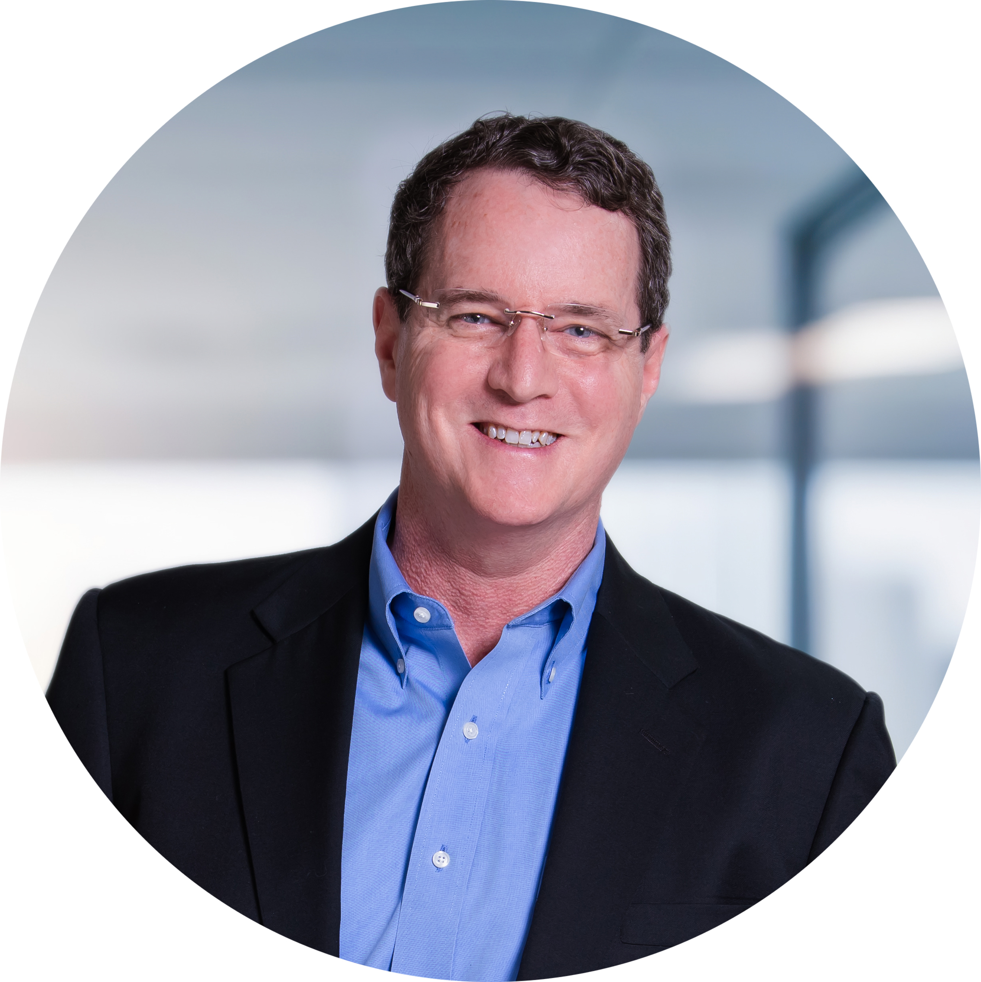
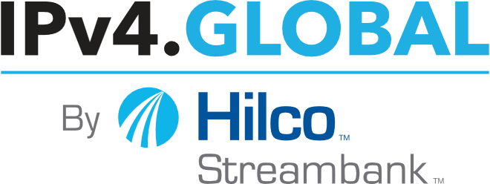
LeeHoward@HilcoStreambank.com
https://www.linkedin.com/in/lee-howard-ipv6/
https://calendly.com/leehoward-ipv4
Notes:
Remember these handouts,
We will send a link to the recording to attendees.

