Slide 1
What’s New and What’s Next
Greg Hankins
ghankins@peeringdb.com

Slide 2
Agenda
Organization updates and information on the 2025 elections
2024 new feature highlights
2025 development focus and roadmap

Slide 3
What is PeeringDB?
Mission statement: “PeeringDB, a nonprofit member-based organization, facilitates the exchange of user-maintained interconnection related information, primarily for Peering Coordinators and Internet Exchange, Facility, and Network Operators.”
A PeeringDB record makes it easy for people to find you, and helps you to establish peering
If you aren’t registered in PeeringDB, you can register at https://www.peeringdb.com/register
We use basic verification for new accounts and require current whois information, so please
Update and maintain your whois information
Register from an email address associated with your ASN /company
?
…

Slide 4
Governance and Membership
PeeringDB is a United States 501(c)(6) volunteer organization that is 100% funded by sponsorships
Healthy organization, building financial reserves and executing the long-term strategic plan
Membership rules
A corporation, limited liability company, partnership or other legal business entity may be a Member of the Corporation
Membership is determined by having both an active PeeringDB.com account and an individual representative or role subscription to the PeeringDB Governance mailing list
503 addresses subscribed to the Governance mailing list (as of April 8, 2025)
Governance list is at https://lists.peeringdb.com/cgi-bin/mailman/listinfo/pdb-gov
More information available at https://docs.peeringdb.com/gov/

Slide 5
Board of Directors and Officers
Shawna Bong – Secretary and Treasurer (Officer) | Aaron Hughes – Vice President (Term Expires 2026) | Rahul Makhija – Director (Term Expires 2025)
Christopher Malayter – President (Term Expires 2025) | Livio Morina – Director (Term Expires 2025) | Job Snijders – Director (Term Expires 2026)

Slide 6
Committees
Admin Committee | Operations Committee | Outreach Committee | Product Committee
Manage administration of user accounts and PeeringDB records Answer support tickets Cleansing and completion of PeeringDB records Leads: Chriztoffer Hansen (Chair) and Peter Helmenstine (Vice Chair) Contact: admincom@ lists.peeringdb.com | Manage PeeringDB infrastructure Leads: Job Snijders (Chair) and Aaron Hughes (Vice Chair) Contact: pdb-ops@ lists.peeringdb.com | Manage marketing and social media Develop and maintain presentations, workshops and webinars Coordinate presentations and attendance at events Leads: Ben Ryall (Chair) Contact: outreachcom@ lists.peeringdb.com | Manage roadmap and development priorities Ask for input from the community on desired features Write SoWs to solicit bids to complete requested features Leads: Jack Carrozzo (Chair) and Matt Griswold (Vice Chair) Product Manager: Leo Vegoda Contact: productcom@ lists.peeringdb.com

Slide 7
New 2024-2025 Strategic Plan
The 2024-2025 strategic direction and organizational objectives were published in January
Maintaining services
Developing new features
Engaging with the community
Ensuring the long-term stability of the organization
Full version is here: https://docs.peeringdb.com/gov/misc/2025-01-23-PeeringDB_Strategic_Plan_2024-2025.pdf
Board also approved a 50% increase is hours available for combined development and operations
Several large projects planned on the 2025 roadmap

Slide 8
2025 Board of Directors elections are now!
5 seats on the Board of Directors
3 of which are up for election this year (Makhija, Malayter, Morina)
A Director term is 2 years
Nomination of candidates closed 14 April 23:59:59 UTC
Voting starts today and ends 29 April 23:59 UTC
HOWTO: Become a PeeringDB Member and Vote:
https://docs.peeringdb.com/howto/member_vote/
2025 Election Guide:
https://docs.peeringdb.com/gov/misc/2025-04-14_election.html
Please vote!

Slide 9
2024 Year in Review
 | 2023 | 2024 | Difference | % Increase
Campuses | N/A | 556 | New | New
Carriers | N/A | 8,164 | New | New
Exchanges | 1,152 | 1,239 | 87 | 8
Facilities | 5,282 | 5,633 | 351 | 7
Networks | 29,148 | 31,597 | 2,449 | 8
Organizations | 27,714 | 30,008 | 2,834 | 10
Users | 41,975 | 46,657 | 4,682 | 11

Slide 10
2024 New Feature Highlights
Users tell us that search and data quality are important to them, and this was a big development area in 2024
Networks whose ASN has been reclaimed by an RIR or NIR are automatically removed now
v2 search
Introduced new v2 search functionality early last year with several enhancements over many releases
Key features
Use natural language queries in combination with the name in a geographic region
Search for a network prefixed with “AS”, partial matches show all relevant networks
Search for exchanges based on the facilities they are in
Search for campuses in in a geographic region, also displays a list of facilities
HOWTO: v2 Search (https://docs.peeringdb.com/howto/v2_search/)

Slide 11
2024 New Feature Highlights
peeringdb-py enhancements
Run queries locally on your infrastructure to avoid query limits and to get the best response time
Reduces PeeringDB load (= cost)
HOWTO: Install peeringdb-py
(https://docs.peeringdb.com/howto/peeringdb-py/)
Keyhole Markup Language (KML) export of geographic data
Very cool and very popular to import into GIS applications
Covered in many PeeringDB Updates presentations last year (https://docs.peeringdb.com/presentations/)
Better Search and Export (https://docs.peeringdb.com/blog/better_search_and_export/)

Slide 12
2024 New Feature Highlights
New Campus object: two or more Facilities owned by the same organization with inter-Facility cross connects
556 object added in 2024
HOWTO: Get Started with PeeringDB as a Facility or Campus Operator (https://docs.peeringdb.com/howto/get-started-facility/)
New Carrier object: for provides offering L1 or L2 services in a Facility
Different from a Network which is for L3 services with an ASN
8164 objects added in 2024
HOWTO: Get Started with PeeringDB as a Carrier Operator (https://docs.peeringdb.com/howto/get-started-carrier/)

Slide 13
2024 New Feature Highlights
VM deployments moved to containerized deployments
Reduced computing costs, adjusts compute resources dynamically and manages spending
Containerized Deployment (https://docs.peeringdb.com/blog/containerize/)
Many other smaller enhancements, bug fixes, and security updates
Refer to the 2024 Release Notes for complete details (https://docs.peeringdb.com/release_notes/release_notes_2024/)

Slide 14
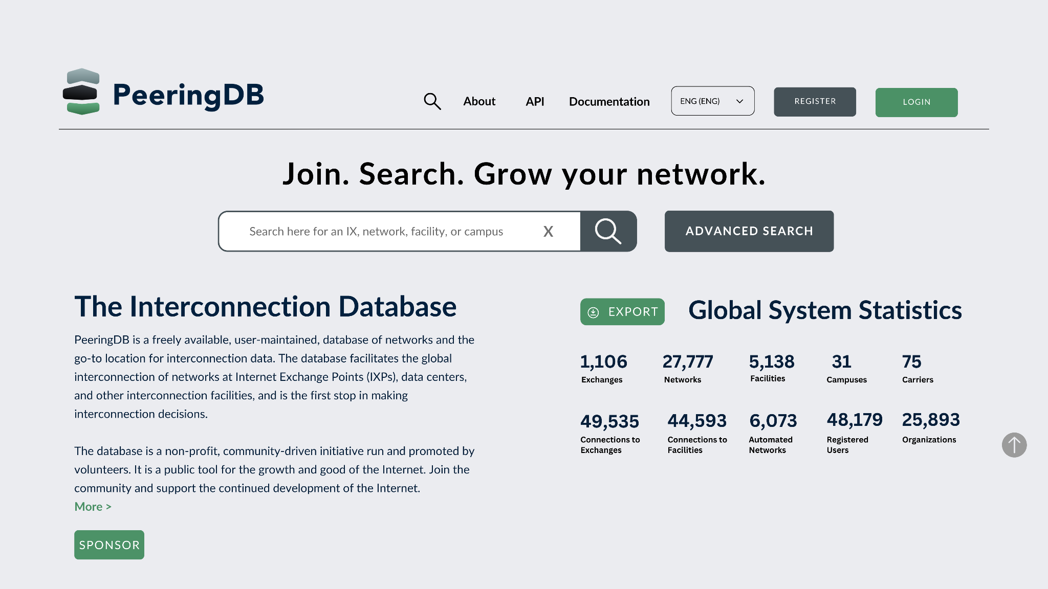
2025 Roadmap: Web UI
We adjusted our web UI rollout process based on feedback
We previewed the new UI on separate site but got no feedback, so are doing a phased rollout:
PeeringDB volunteers
20% of users
Everyone
Users will get an “opt-out” switch in their profile and be encouraged to share feedback on what to adjust

Slide 15
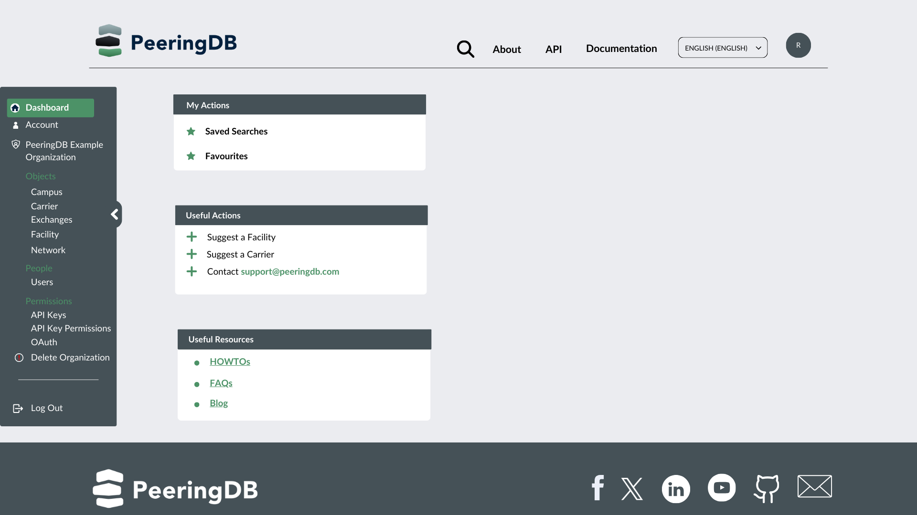
2025 Roadmap: Saved Searches, Notifications
We’re discussing (#1736) adding a “planned” status with a date
It would integrate with notifications
You could share a planned operational date for any object type
Others could be notified of plans they are interested in

Slide 16
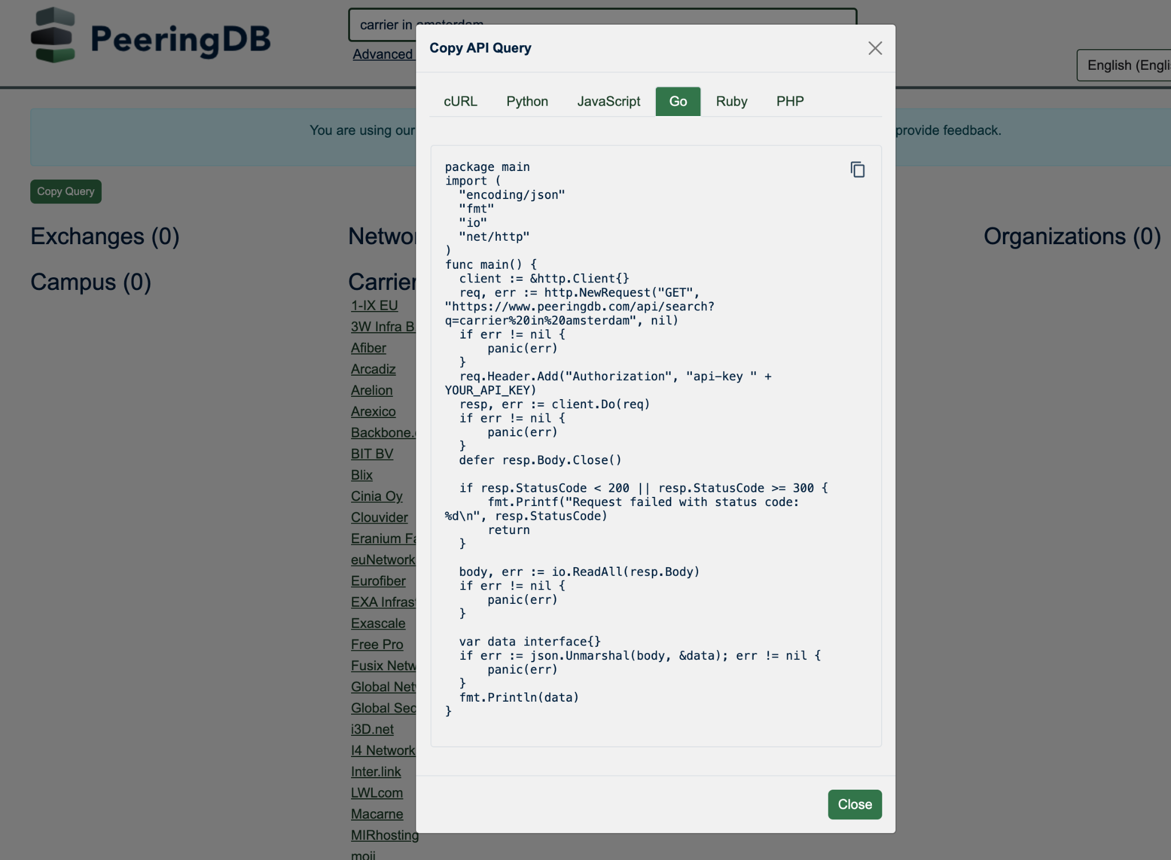
2025 Roadmap: Search
Refactor v2 search code with improved automated testing
Results should be complete and more relevant
Web search → API query link
Help less technical users develop one liners that improve their efficiency
Implement search filters, e.g. hide IXPs without an ixfac
Give users more control over what they see
Will apply to authenticated web and user API Key usage
Once developed, other filters can be added as needed
Implement Advanced Search in v2
Another step towards removing legacy search

Slide 17
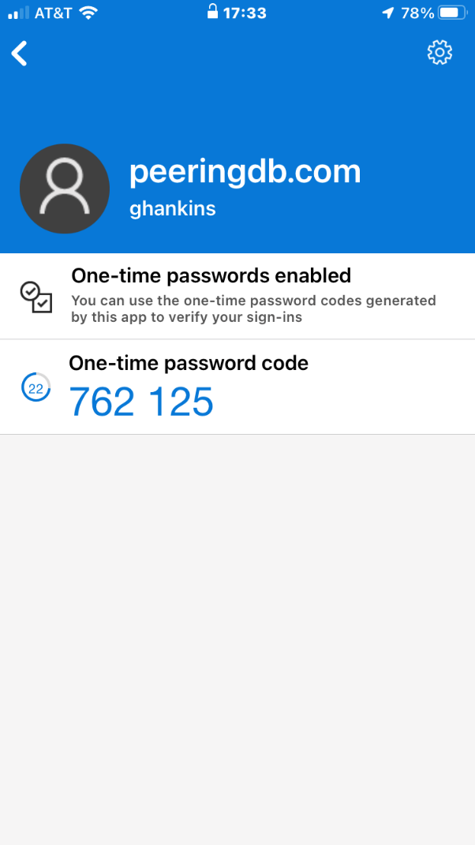
2025 Roadmap: MFA
Multi-factor authentication (MFA) has been available for years and will be mandatory from 1 July 2025 (https://docs.peeringdb.com/blog/mfa_mandatory/)
Two-factor authentication (2FA)
Using time-based one-time password (TOTP) - no SMS, no email
Provision for backup codes and recovery tokens
Fast IDentity Online (FIDO) Universal 2nd Factor (U2F)
2FA support
2FA without relying on a TOTP app
HOWTO: Authenticate to PeeringDB (https://docs.peeringdb.com/howto/authenticate/)

Slide 18
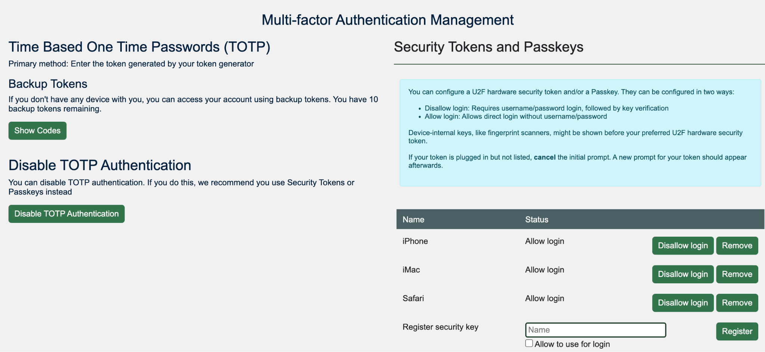
2025 Roadmap: Simplified MFA Management

Slide 19
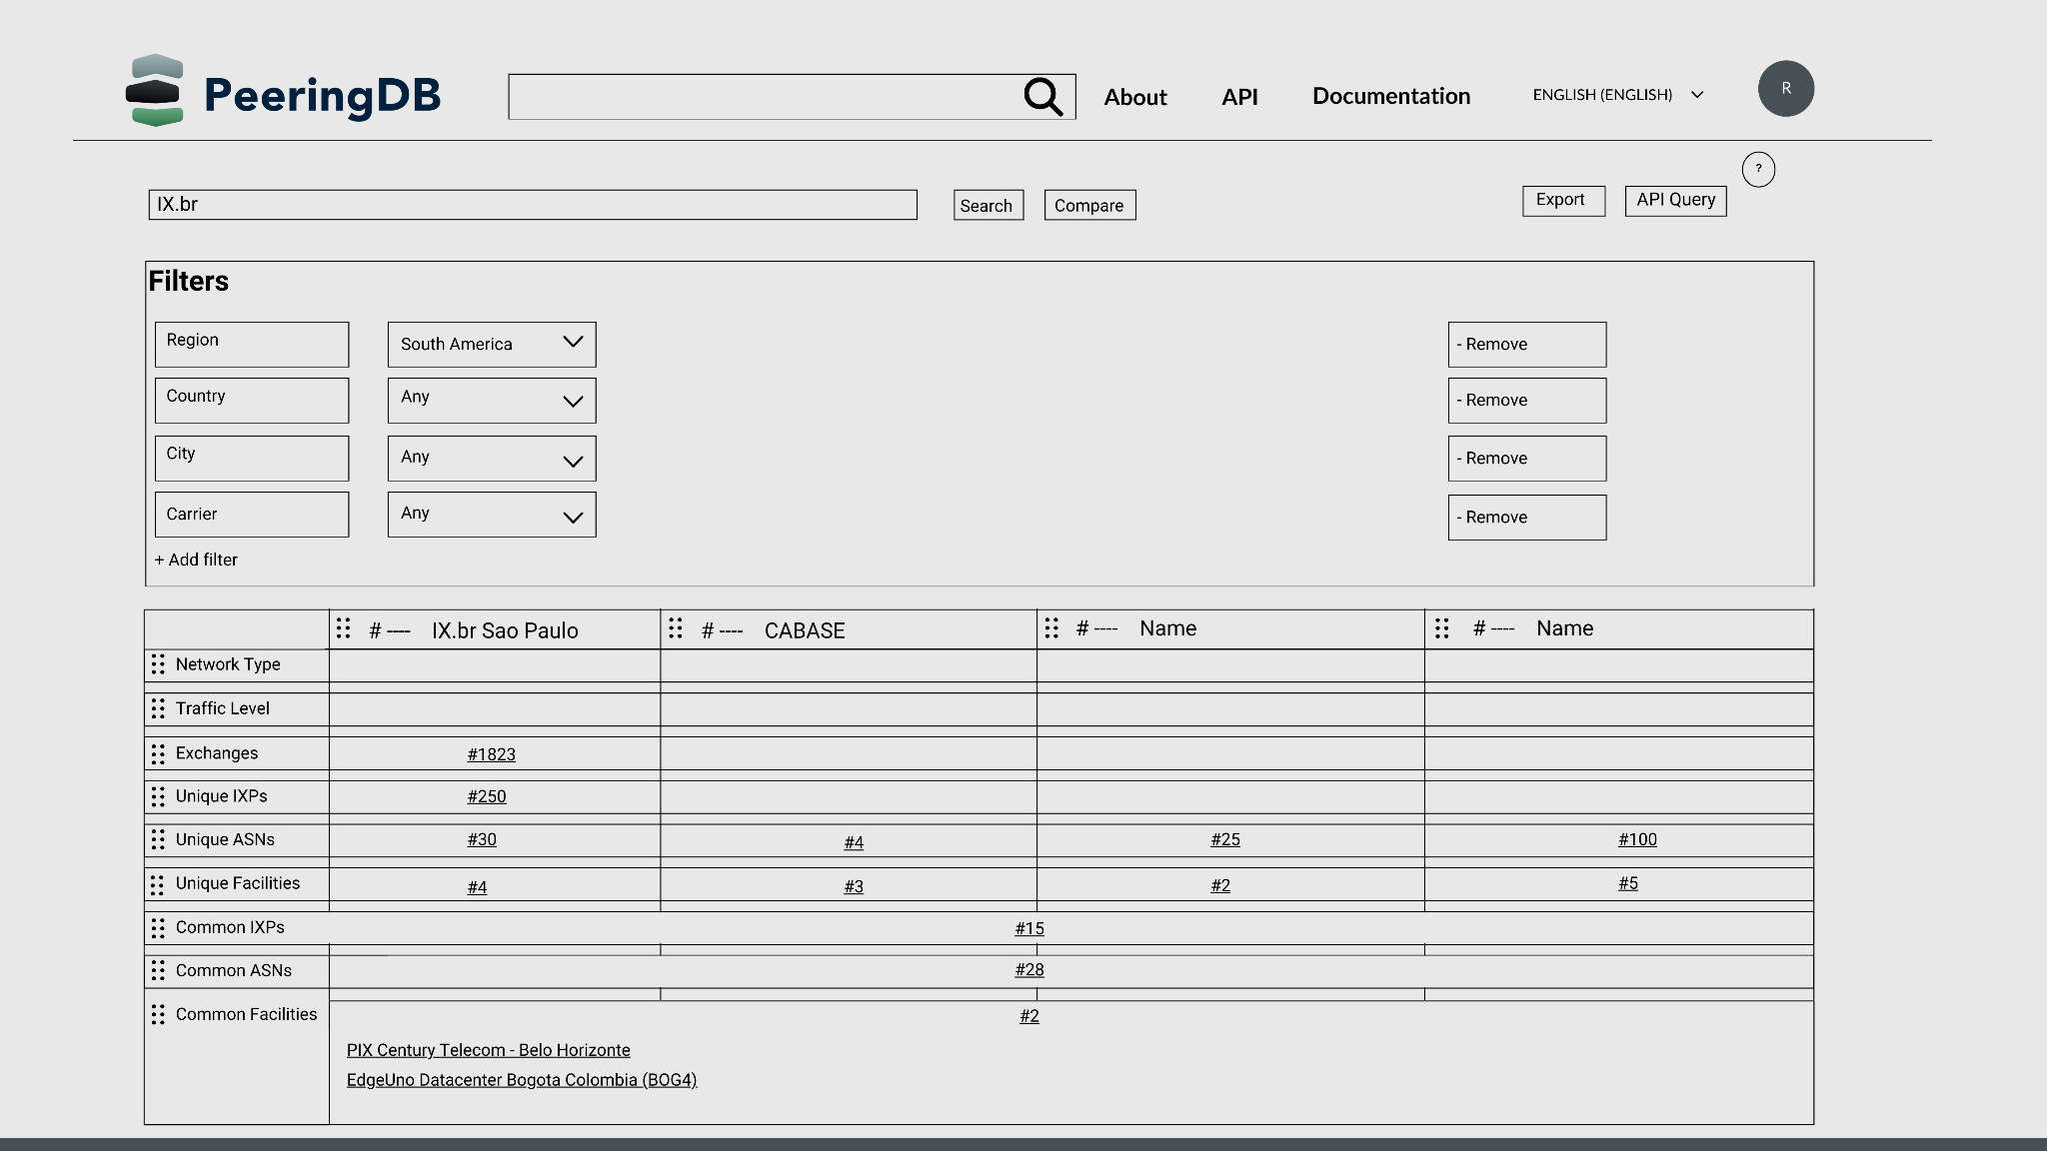
2025 Roadmap: Interconnection Analysis
Adding a web tool to help users compare interconnection opportunities at facilities
Add ASNs, add locations, view and export results

Slide 20
2025 Roadmap: Operations and Bug Fixes
We’re working on making both the API and website more responsive
You can sync using peeringdb-py to keep queries local and integrate PeeringDB data with other sources
We’ll be developing
Additional support tools
Minor features
Bug fixes

Slide 21
Thank you to our sponsors!
Diamond Sponsor
Platinum Sponsors
Gold Sponsors
Silver Sponsors
Notes:
Logo height proportions: 100%, 85%, 65%, 40%

Slide 22
Questions?

