Slide 1


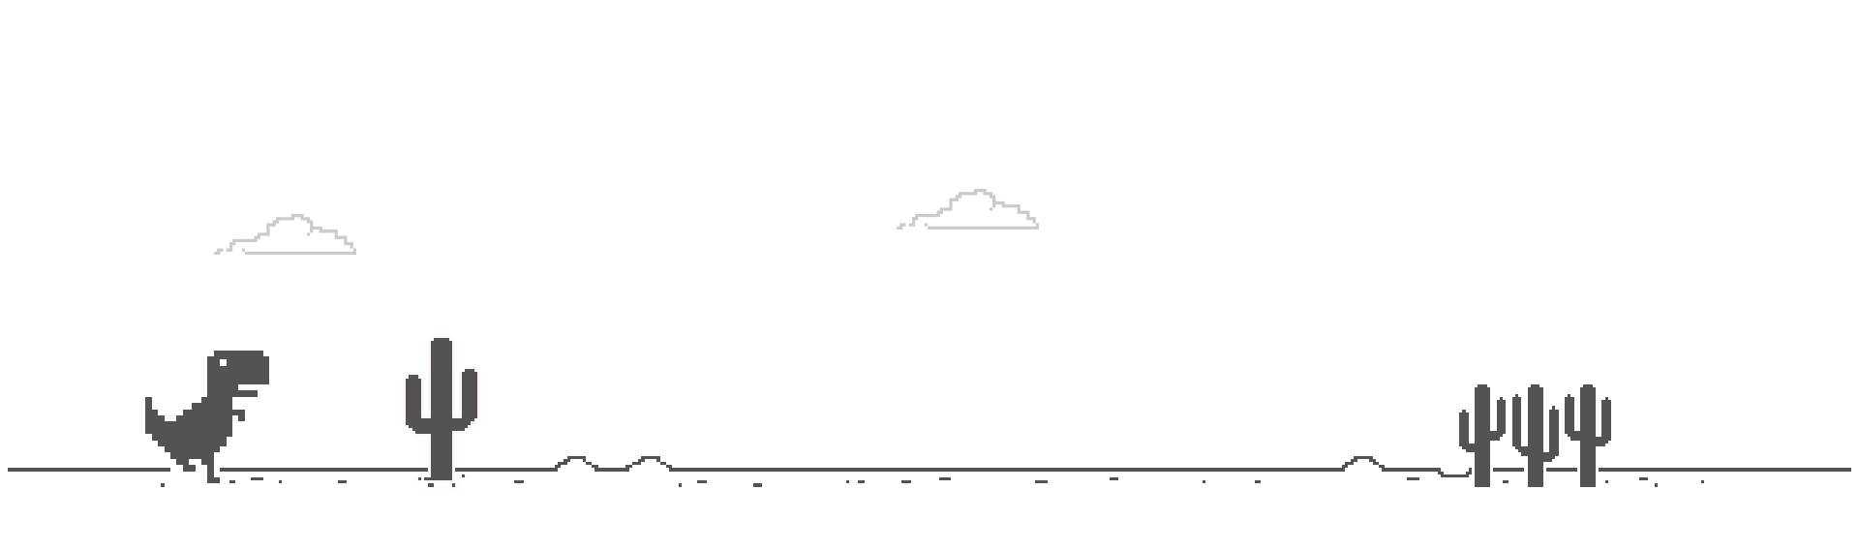
How far behind
are we really?
HI 02023 02257

Slide 2

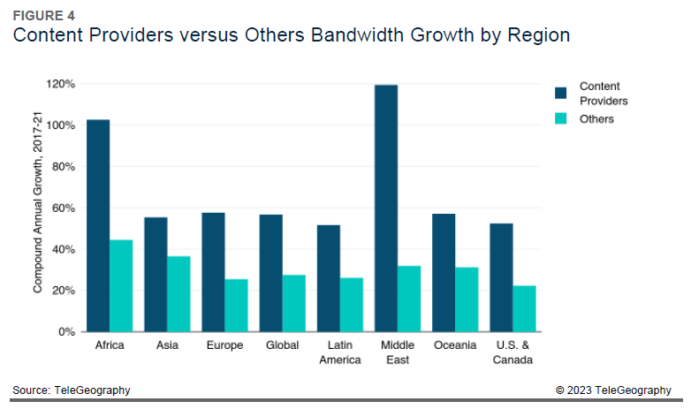
Subsea Cables & Capacity
In 2010 there were 30 cables in service and by year-end 2022 there were 60. If you add planned cables, there will be at least
71 cable systems by 2025.
Total used international capacity in YE2021 is 37.8 Tbps – this includes internet (public IP backbone, content provider capacity and private networks)
Region | Year | Tbps | Annual Change
Africa | 2017 | 7.205792012 | 0.629819522
Africa | 2018 | 10.95351066 | 0.520098088
Africa | 2019 | 15.6251954 | 0.426501137
Africa | 2020 | 25.51540273 | 0.632965353
Africa | 2021 | 37.84567274 | 0.483248105

Slide 3
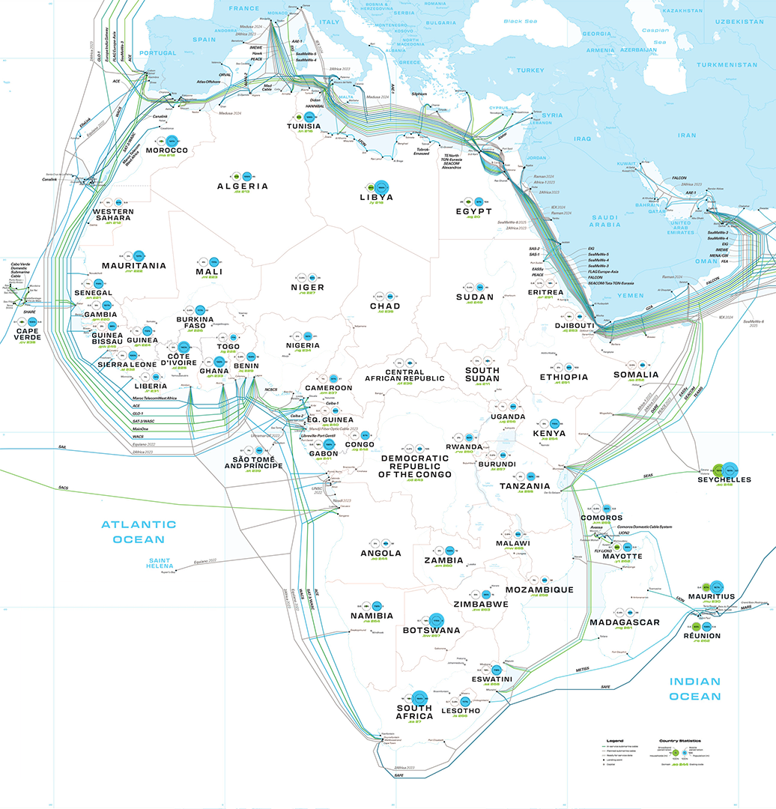
Subsea Cables & Capacity
1,300,000km
As of 2021, it is believed that there are over 1.3 million kilometers of submarine cables in service globally with a total of ~450 submarine cable systems in-service around the world Some cables are quite short, like the 131-kilometer CeltixConnect cable between Ireland the United Kingdom.
45,000km / 33 Countries / 3 Continents
The 2Africa cable initiated by Meta, is the longest cable in the world spanning 45,000 km and will connect 33 countries on 3 continents; Africa, Europe, and Asia, representing 3 billion people, when it is fully operational in 2024. The moon is 384 400 km from earth, which in theory means that we can do two loops around the moon and back to earth.
100 Gbps -20%
Prices continue to decline, but the bigger story this year has been how the pace of price erosion compares to previous years. 100 Gbps wavelength prices decreased an average of 12% between 2018 and 2021. That’s compared to 20% over the past five years.
DQL Index
The 2022 Digital Quality of Life (DQL) Index, a study on the quality of digital wellbeing across 117 countries (92% of the global population), found that South Africa's internet quality remains the best in Africa.
51%
With a penetration rate of 51 per cent of the total population of the country, Nigeria is one of the leading countries with the highest number of Internet users. Egypt ranks second in the number of Internet users. The penetration rate of countries like the South Africa, Kenya and Tanzania is more than 30 per cent.
Notes:
Source: Telegeography

Slide 4

2013
2023
Total ASN Allocated
Filter by Region
Central: 12
Eastern: 21
Indian Ocean: 7
Northers: 12
Southern: 48
Western: 32
Total ASN Allocated
Filter by Region
Central: 111
Eastern: 369
Indian Ocean: 78
Northers: 213
Southern: 959
Western: 527
132
2,257
0-60
60-120
120-180
180-240
240-300
300-360
360-420
420-480
480-540
540-600
0-60
60-120
120-180
180-240
240-300
300-360
360-420
420-480
480-540
540-600
Notes:
Looking at the growth of the peering community in Africa over the past 10 years.
South Africa is far ahead closely followed by Nigeria. The Southern region of Africa has seen the most growth.

Slide 5


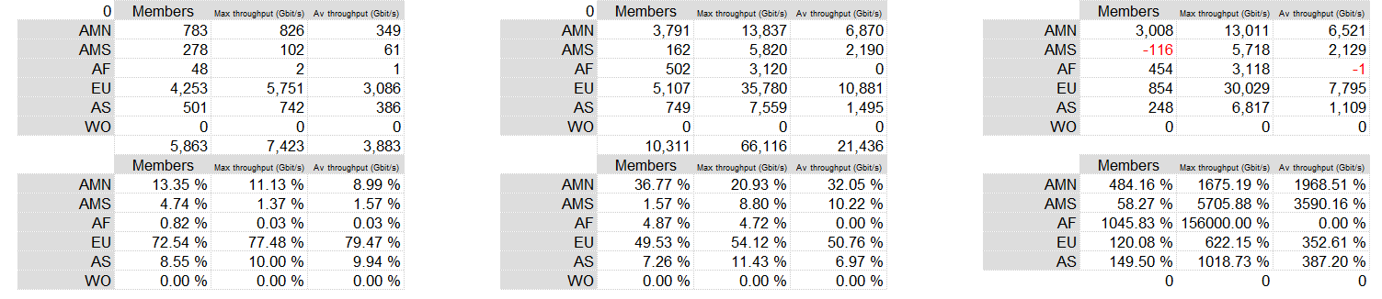
Peering Capacity Growth
2013
2023
10 Years Growth
Notes:
Reviewing the total traffic growth globally, noticing that Africa has seen significant growth over the years, and we anticipate this to increase.

Slide 6

Internet in Africa
52.17 Mbps / 28.62 Mbps / 19.29 Mbps
The average internet download speed in Sub-Saharan Africa was highest in Rwanda, South Africa, and Madagascar in 2022.
These countries registered internet speeds reaching 52.17 megabits per second (Mbps), 28.62 Mbps, and 19.29 Mbps, respectively.
10,9% / 13,7%
South Sudan: Has 10.9% internet penetration.
Somalia: Has 13.7% internet penetration. (Lowest in Africa)
43%
Despite the rising number of users, the internet penetration rate stood at around 43 percent in 2021, below a global average of 66 percent.
88,1%
Morocco has the highest internet penetration rate reaching 88.1 percent, up from 84.1 percent the year before.
80%
As of 2022, the share of the total population of South Africa using the internet was nearly 80 percent. This share is estimated to grow up to 90 percent by 2027.
13%
In 2021, roughly 13 percent of internet users worldwide were located in Africa. The share of internet users in Africa has grown significantly in the last few years. In 2009, only about four percent of internet users worldwide were in Africa. Internet penetration in Africa is about 40 percent. Even if the rates increased considerably in the last year, internet penetration is still under the global average.
Notes:
https://www.statista.com/topics/9813/internet-usage-in-africa/#topicOverview

Slide 7
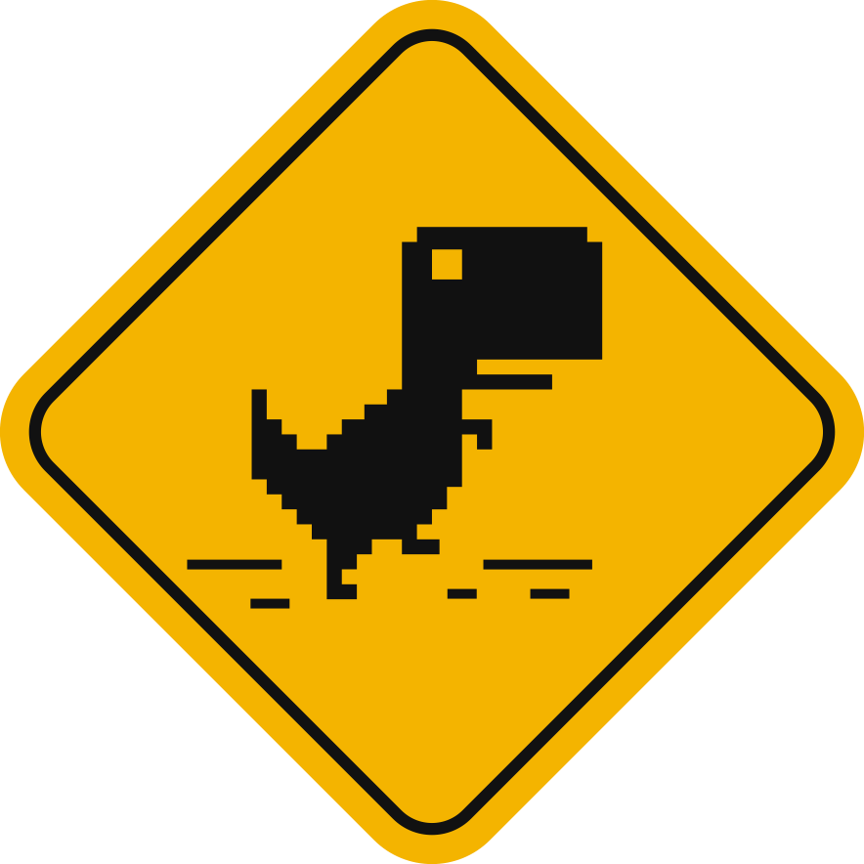
The Challenges
Africa is well-known for its unstable power supply which has pushed data center's to be innovative and invest in alternative power supply.
Political restrictions.
High Layer 2 Connectivity Costs.
Poor infrastructure and the control that telecommunication operators have over consumer rates are among the leading causes of Africa's high data costs

Slide 8
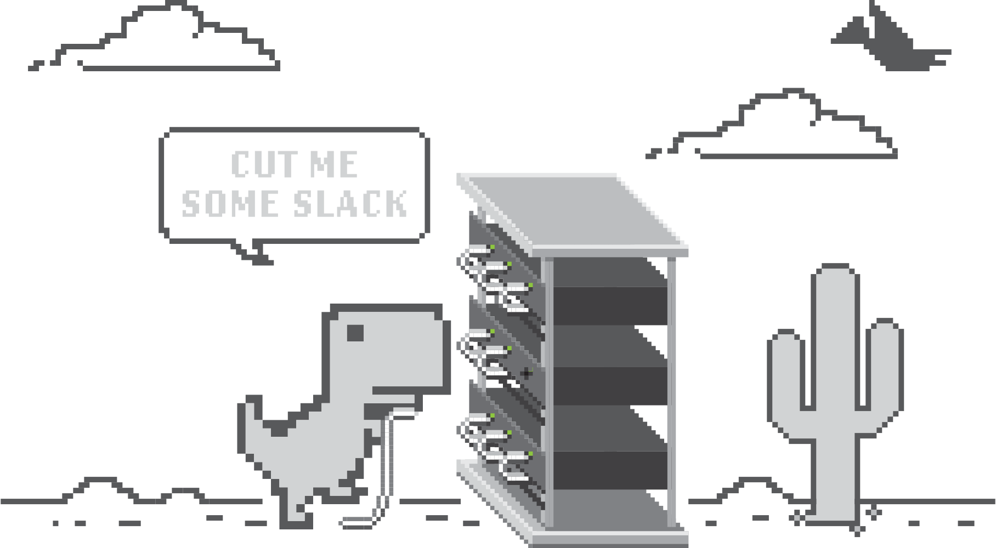

Please cut the internet
Dino some slack…
He’s doing his best to keep us connected.
Notes:
Ending-Off with our ZANOG Dino
Please cut the internet Dino some slack, he is doing is best to keep us connected.

