Slide 1

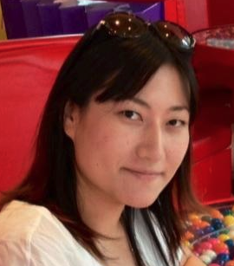
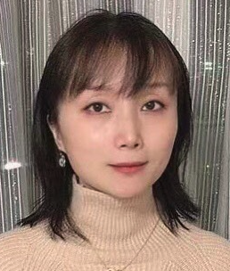
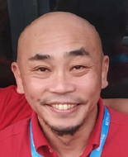
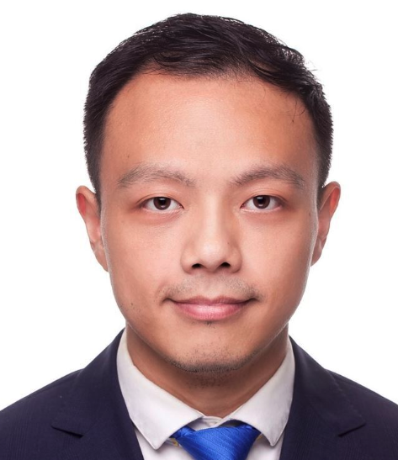
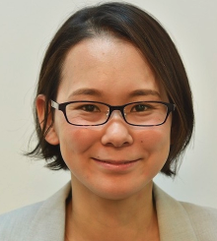
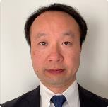
IXP Name/s | BBIX Tokyo | BBIX Osaka | BBIX Fukuoka | BBIX Singapore | BBIX Hong Kong | BBIX Thailand | BBIX USA | BBIX Europe
Location | Tokyo, Sendai, Okinawa | Osaka | Fukuoka | Singapore | Hong Kong | Bangkok | LA, Chicago, Dallas, Miami, San Jose | Amsterdam, London, Marseille
POP | NTT Data Otemachi Digital Edge TYO2 (ComSpace 1) Equinix TY2/TY4 AT TOKYO CC1 Softbank Maruyama CLS NTT Communications Nexcenter Colt DCS Tokyo Shiohama DC/Inzai 1 DC SCSK nexTDC Chiba Center Softbank Tokyo No.4 Data Center TOHKnet Sendai Central Data Center FRT Data Center (iDC) | NTT Data Dojima Equinix OS1 Equinix OS3 NTT SmartConnect Dojima AT TOKYO DC12 Sonezaki Data Center Digital Edge OSA1 (New!) | QTnet Fukuoka No.3 Data Center AT TOKYO QC1 | Equinix SG1 Equinix SG5 Global Switch | Mega-i Equinix HK1 | True IDC North Muang Thong CAT Tower BangRak | Coresite LA1 Equinix SV5 Equinix CH1 Equinix DA6 Equinix MI1 | Interxion AMS9 Telehouse Dockland North 2 Interxion MRS2
# of ASNs | Total 300+
Peak Traffic | Total 5.47T+
Peeringdb | https://www.peeringdb.com/search?q=bbix
Contact | bbix-sales@bbix.net
Iku
Lisa
Araki
Liyu
Tomomi
Kikuchi

