Slide 1
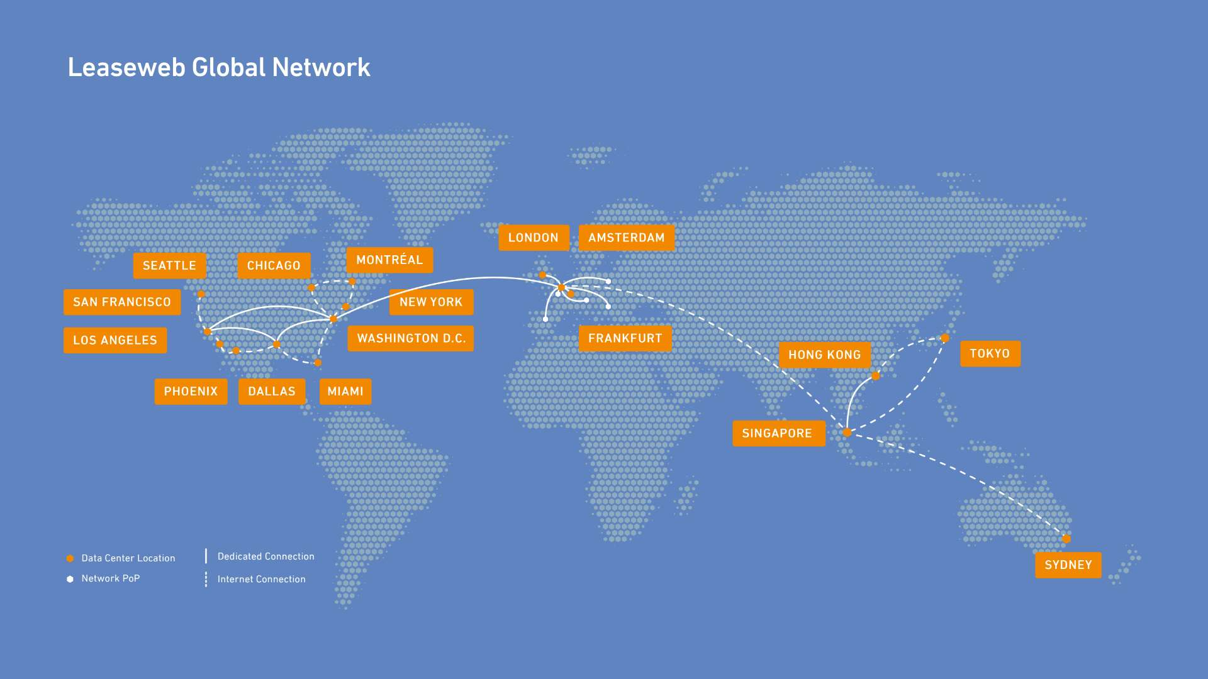

Leaseweb – Global Cloud IaaS provider
Dedicated (bare metal) and virtual servers, data storage, colocation, cybersecurity and Multi-CDN services
Born in the Netherlands – hosting platforms and services in
  Europe (AMS, FRA, LON)
  North America (MTL, NYC, WDC, MIA, CHI, DAL, SEA, SFO, LAX)
  Asia Pacific (SIN, HKG, THY, SYD)
  (29 data centers in 16 cities/metro’s)
Each metro network has its own AS (e.g. AS60781 = AMS/LSW-NL,
AS28753 = FRA/LSW-DE, AS30633 = WDC/LSW-USA)
Global backbone AS16265 (open peering policy)
~ 4Tbps total peak traffic
Contact us through
peering@network.leaseweb.com
d.cenaj@network.leaseweb.com (Drilon Cenaj)
b.vandersloot@network.leaseweb.com (Bart van der Sloot)
Looking for metro connectivity in Amsterdam? Contact us at sales@fibering.com

