Slide 1
Don’t forget the peers!
GPF23, San Diego
Yolandi Robinson

Slide 2


Slide 3


Slide 4
Membership Association of IXPs
Events
Services
Tools & Community Projects
Internet eXchange Point Database – IXPDB
Peering Toolbox
Fellowship & Mentor-IX
Route Server Large BGP Communities list
A new IXP Film
Two Membership events per year hosted by our Members
Workshops & hackathons
Online/ virtual workshops
Reports
Newsletters
Mailing list
Keeping the community connected – Virtual events

Slide 5

Peering Toolbox
Community Focused Learning Tool
5

Slide 6
Traditional Transit
20+ years ago
What has happened?
ISPs provide Internet transit to organisations (content providers and end-users)
Enterprise networks bought their Internet access from access and transit providers
Internet has become an essential part of every organisation's services, so they are taking more control over it
Businesses needed to optimise their services

Slide 7
What’s the Problem?
Growth in the importance of Internet to business operations is driving more enterprise networks to manage their own connection to the internet
Managing this comes with risk
Now there’s more than one vendor relationship:
  IXPs
  Direct Peers

Slide 8
What’s the Problem?
Enterprises now take on roles previously the responsibility of their ISP:
  Having the right resources: IP Addresses, ASNs
  Managing their peers and related costs
  How to peer and with whom?
  Understanding the peering community
There’s A LOT to learn:
  Where to start
  Who to speak to
  What are the best practices?
  How to deal with network problems & outages?
Solution?

Slide 9
What is the Peering Toolbox?
By the Community
Aims
Aims
Community focused Euro-IX project
Organisations involved include LINX, NAPAfrica, Microsoft, Amazon, INEX, HEANET
Provide a learning structure and best practice information for new entrants into the interconnection community
The toolbox will act as a reference/guide that IXPs and networks can point others to for best practice information and learn how meet the IXP and peers’ requirements

Slide 10
Peering Toolbox
There’s already a lot of good work done by the community explaining how peering works and how to go about peering
  We are working to pull it together and make it available in one place
  The toolbox is intended to be the reference point for best practice information.
Target audience:
  Everyone involved with peering!
  Which means: service providers, enterprises, content providers, research & education networks, IXPs,…

Slide 11
Peering Toolbox
Website focused on learning:
  Short sections with clear explanations of each topic
  Easy for new entrants to discover what they need to make the best decisions for their network
  Easy for organisations already peering to learn about current best practices, keep up to date with technology, and help with troubleshooting connectivity and reachability issues
  Advice from experienced peers sharing tips and tricks
  Use of the IXPDB and the PeeringDB

Slide 12

Current work
Philip Smith hired as Product Manager
  25+ years experience
    BGP, IXP, peering, routing workshops
    Capacity building and technical training all over the world
Inventory of resources created
  https://www.peeringtoolbox.net
    beginners section done!
  Under development - an interactive toolbox

Slide 13
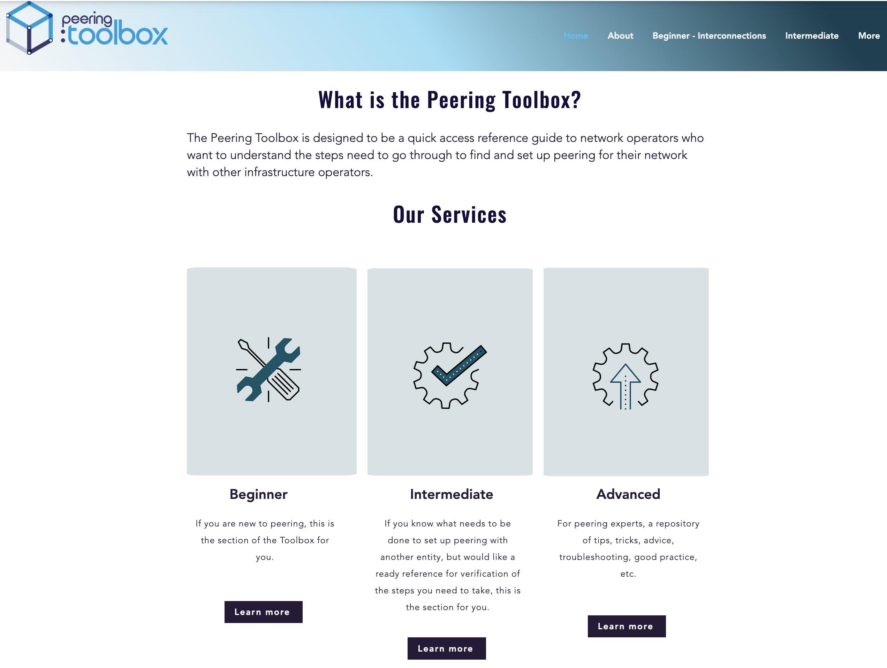

Slide 14
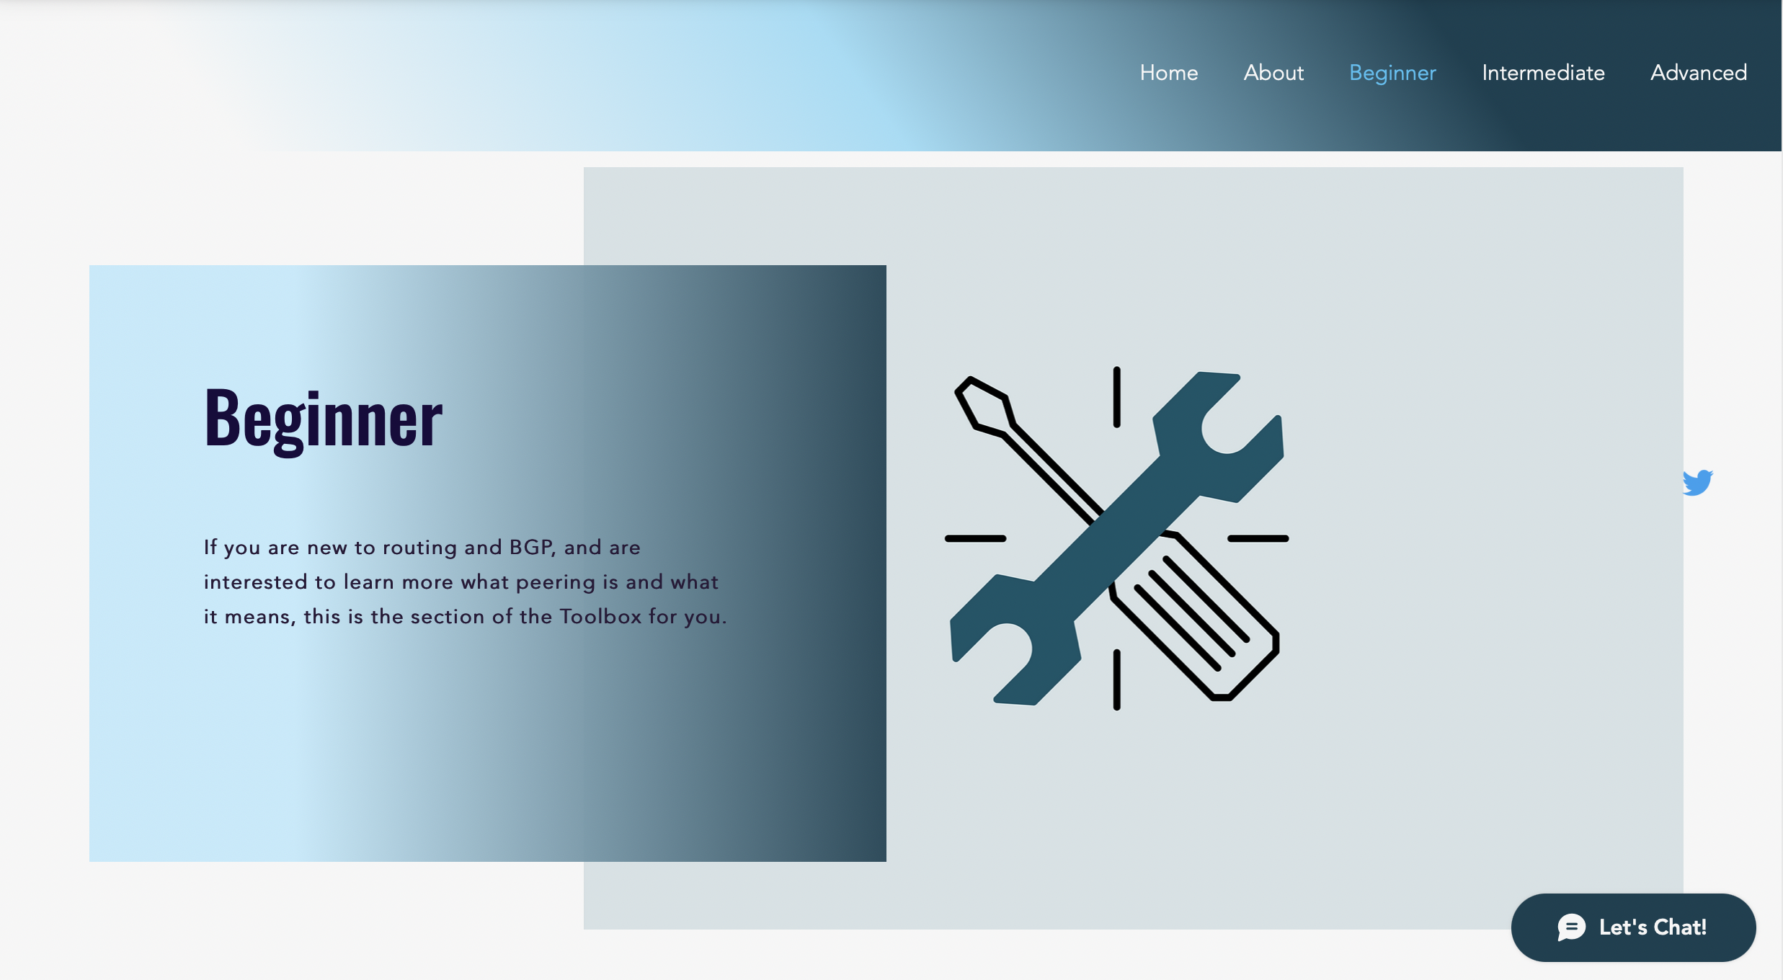

Slide 15
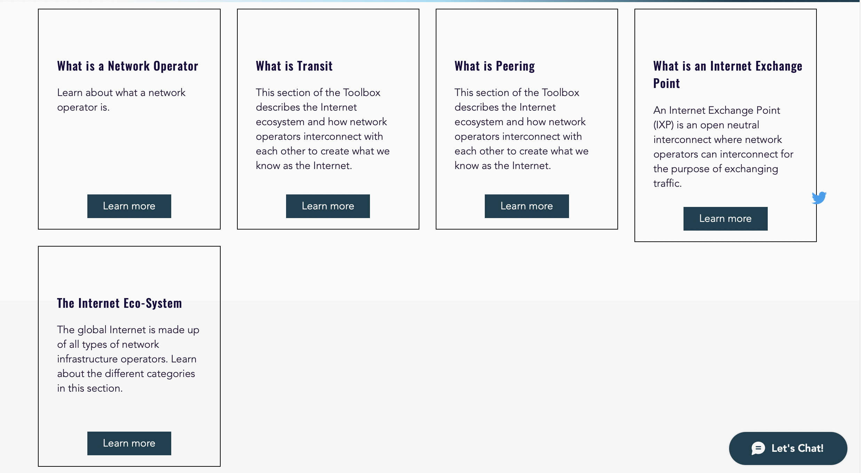

Slide 16
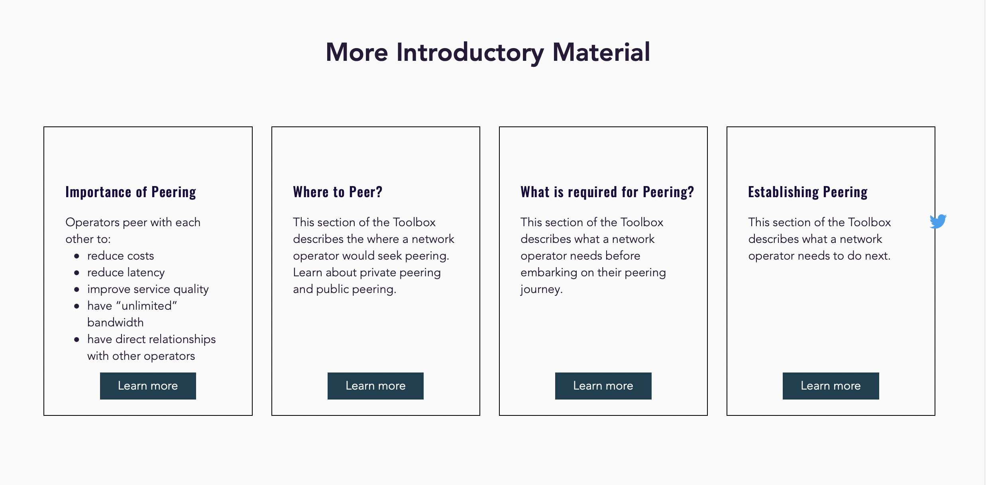

Slide 17
Thank You!
Yolandi Robinson

