Slide 1


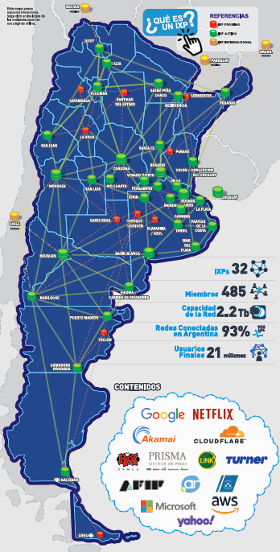
ARGENTINA IX
CABASE: Non profit Organization
32 IXPs – throughout the country
All Interconnected - One big LAN
2.750 ASNs Published
500 Members
21 million end users
Peak Traffic 2.2 Tb
Contact: Hernan Seoane
hernan.seoane@cabase.org.ar
//ixp.cabase.org.ar
AR-IX
ASN 52376

