Slide 1
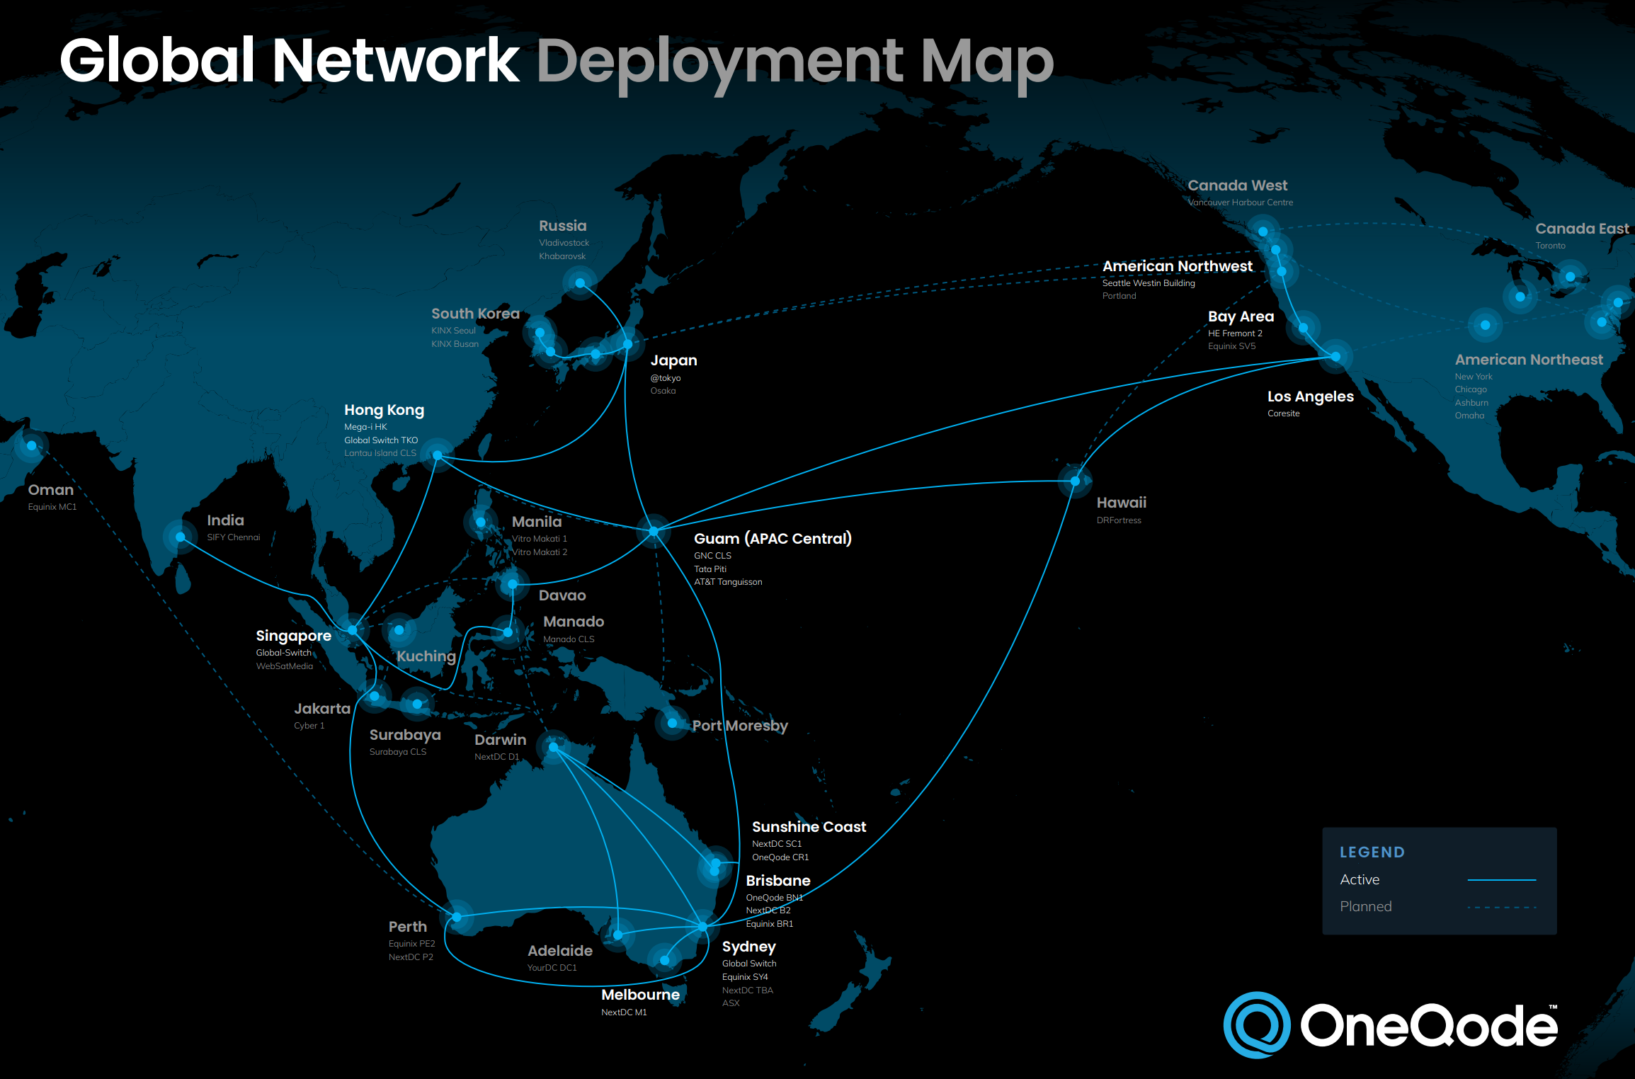
OneQode Gaming Carrier
AS 140627
Low Latency APAC Network
Gaming and Cloud
Nick Plunkett
nick@oneqode.com

