Slide 1
Power Panel
GPF San Diego
April 2023

Slide 2
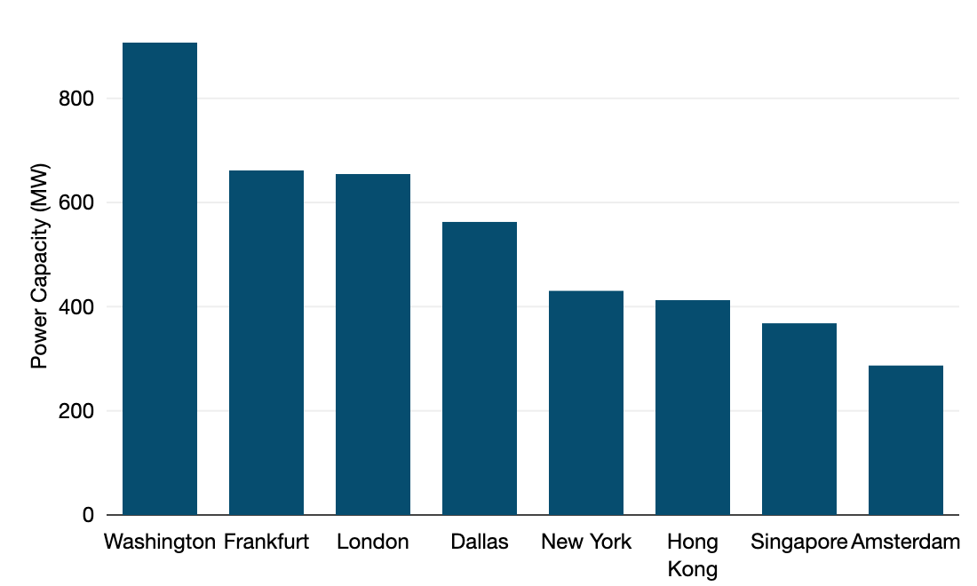
How much power do data centers use anyway?
220-320 TWh of power consumed by data centers globally in 2021 (roughly 1% of all electricity consumption)
Source: IEA “Data Centres and Data Transmission Networks
Singapore: about 7% of all city-state power consumption
EU: approximately 2.7% of power demand
8 markets depicted here consume 4.3 GW of power for retail colocation alone (not including wholesale/hyperscale demand)
Select Metro Areas for Retail Colocation by Gross Power (MW), 2022

Slide 3
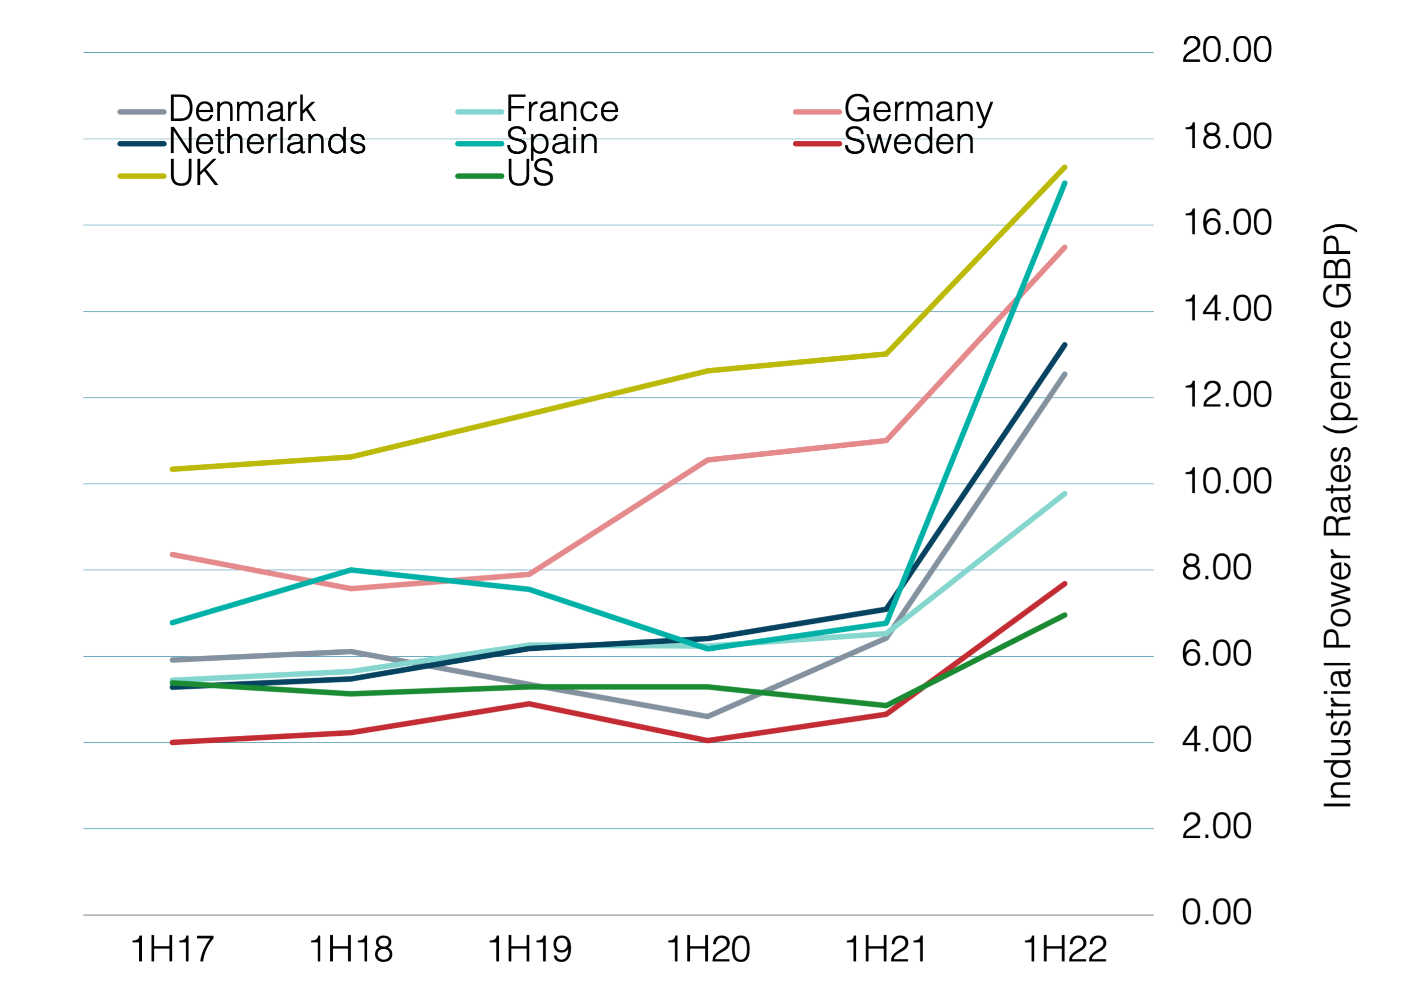
Energy price movements
Industrial Power Rates for Large Users, 1H17-1H22, in pence (GBP)
Price inflation soared across European markets and U.S. in 2022
IEA aggregate futures: at least 250% YoY wholesale energy price growth in France and at least 130% growth in Germany in 1Q 23
US rate growth modest
Sources: Energy Prices International Comparisons, UK Dept for Business, Energy & Industrial Strategy; US EIA, Short-Term Energy Outlook

Slide 4
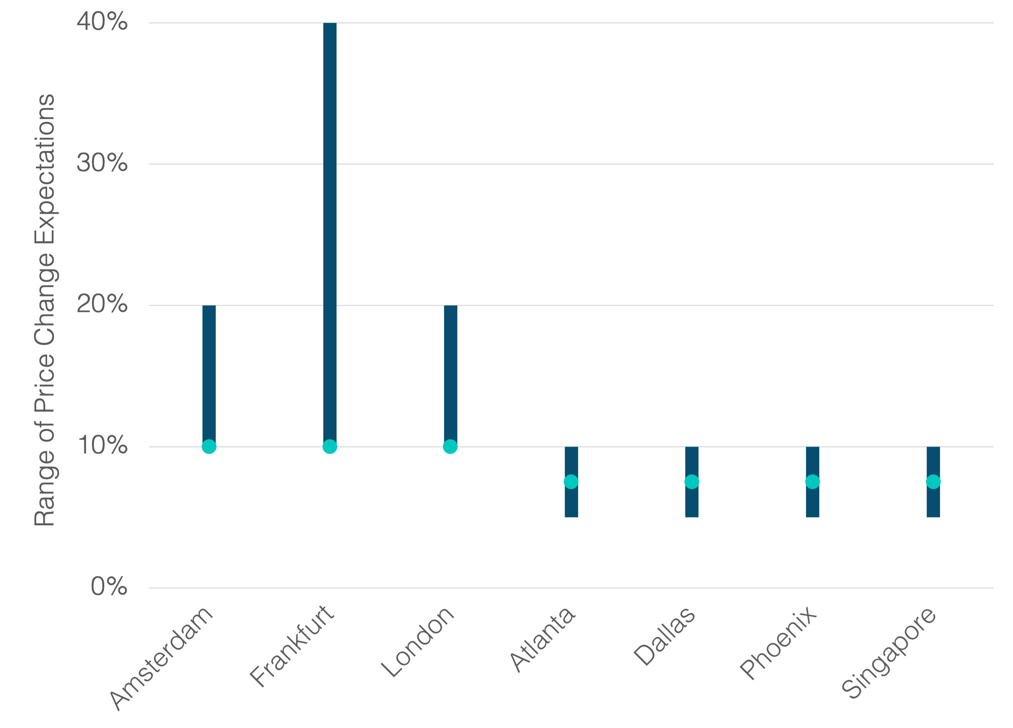
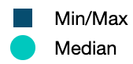
Brace for it: inflation expected across ALL markets
Expected Colocation Price Changes for 2023
All reported expectations in European markets were at least 10% increase. Most much higher

